Slide 1

SOMATIC NEMATODES
COLLEGE OF MEDICINE AND HEALTH SCIENCES
SCHOOL OF NURSING AND MIDWIFERY
COURSE: MEDICAL PARASITOLOGY

Slide 2
General Characteristics of Nematodes- RECAP
Nematodes are elongated, cylindrical, bilaterally symmetrical, unsegmented worms with tapering ends.
The name ‘ nematodes’ means thread like.
The body is covered with tough cuticle.
Their size varies from less than 5 mm (Trichinella spiralis) to 1 metre (Dracunculus medinensis).
The male is generally smaller than female and its posterior end is curved or coiled ventrally. The sexes are separate.

Slide 3
Classification of Nematodes based on the habitat of adult worms
Intestinal Nematodes
Small intestine: A. lumbricoides, A. duedenale, N.americanus, S.stercoraris, T. spiralis.
Large intestine: E. vermicularis, T. trichuria.
Somatic Nematodes
Lymphatic system: Wuchereria bancrofti, Brugia malayi. Brugia tumori
Skin &Subcutaneous tissue: Loa loa (eye also), Onchocerca volvulus (eye also), Dracunculus medinensis.
Muscle: Trichinella spiralis
Body cavity: Mansonella perstans, Mansonella ozzard

Slide 4
LYMPHATIC FILARIASIS
Caused by thread like parasitic worms called filarial worms (filariae)
  Wuchereria bancrofti
  Brugia malayi
  Brugia timori

Slide 5
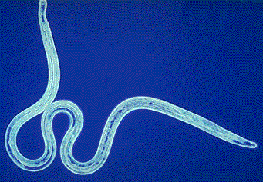
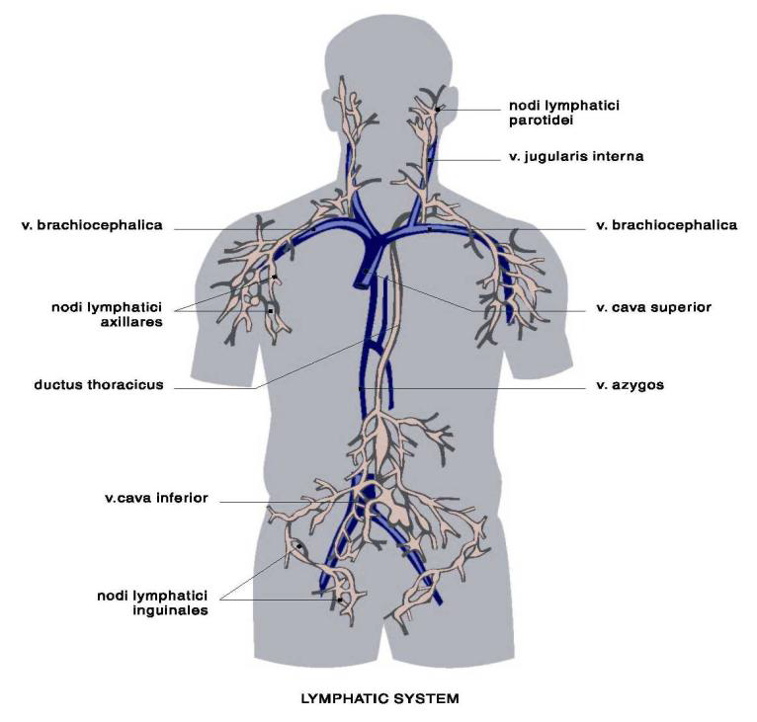
Parasites
White, slender roundworms
W. bancrofti, B. malayi and Brugia timori in their adult stage live in the vessels of the lymphatic system
Live for 5-7 years,
Produce millions of microfilaria

Slide 6
MICROFILARIA
The first stage immature microfilariae of filarial worms that cause lymphatic filariasis can be found circulating in the peripheral blood.
They often show periodicity (present in the peripheral blood in greater numbers during certain hours which correspond to the peak biting times of their insect vectors).
W. bancrofti, B. malayi and B. timori exhibit Noctunal periodicity (microfilaria are present in greatest numbers in the peripheral blood during night hours)

Slide 7
Filarial Vector Mosquitoes
Filarial Species | Periodicity | Vector Mosquitoes
W. bancrofti | Periodic | Culex, Anopheles, Aedes
W. bancrofti | Sub-periodic | Aedes
B. malayi | Periodic | Anopheles
B. malayi | Sub-periodic | Mansonia, Coquillettidia
B. timori | Periodic | Anopheles

Slide 8
Epidemiology
W. bancrofti | B. malayi | B. timori
sub-Saharan Africa | China | Lesser Sunda Islands of Indonesia
Southeast Asia | India
Indian subcontinent | Malaysia
Pacific islands | the Philippines
Latin America | Indonesia
 | Various Pacific islands

Slide 9
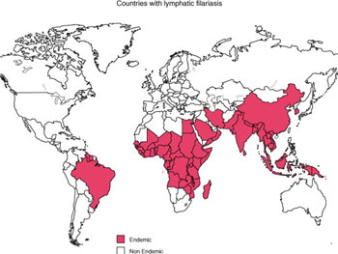
LF ENDEMIC COUNTRIES

Slide 10
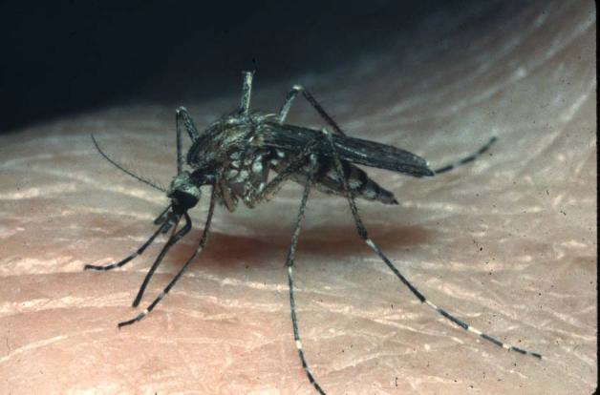
Lymphatic Filariasis transmission
Is caused by the filarial worms Wucheria bancrofti, Brugia malayi and Brugia timori which live in the lymphatic vessels and lymph nodes.
FEMALE MOSQUITO
(Genera: Culex, Aedes, Anopheles, Mansonia)
Taking a blood meal, leaves microfilarial larvae on the bite wound causing infection

Slide 11
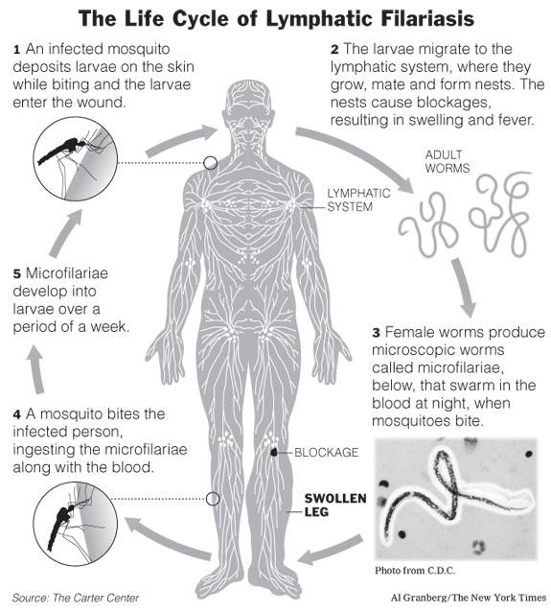

Slide 12
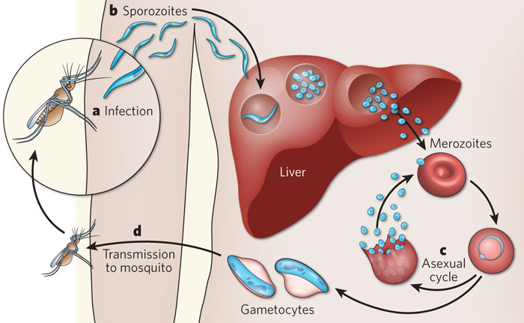
MALARIA LIFE CYCLE
A
C
B

Slide 13
Difference between the life cycle of LF and malaria
Malaria parasite in mosquito
FL parasite in mosquito
Male and female gametocytes are ingested by a mosquito as it takes blood meal
Male and female gametes fuse.
Zygote- Oocyst on outside of stomach wall
Sporozoites form in oocyst
Oocyst raptures sporozoites reach salivary glands of mosquito
Sporozoites are innooculated in the new person when the mosquito takes a blood meal
Man is the intermediate host
Mcrofilariae is taken by mosquito during blood meal
In the mosquito the microfilariae loose shealth.
Develop into a infective larvae in thoracic muscles a period of one week.
Infective larvae develop shealth and migrate to the mouth parts
The microfilariae is inoculated on the wound when mosquito takes a blood meal
Man is the definitive host

Slide 14
Lymphatic filariasis: Clinical Presentation
Clinical features and pathology depend on:
sites occupied by the developing and mature worms,
number of worms (through re-infection),
length of infection
the immune responses of host to damaged and dead worms

Slide 15
PHASES OF FILARIAL INFECTION
Asymptomatic filariasis
  Clinical symptoms are not developed although microfilariae can be found in the blood
Acute filariasis:
  There are recurrent attacks of fever (filarial fever)
  Painful inflammation of the lymph nodes (lymphadenitis) and lymph ducts (lymphangitis)
  Lymphatics involved are those of the limbs, genital organs and breast.

Slide 16
ACUTE PHASE conti…
Acute attacks which are accompanied by rash and eosinophilia last several days.
The inflammation tends to resolve spontaneously after four to seven days, but recurrences are frequent.
Damage to the lymphatics leads to thickening and eventual blockage of lymphatic vessels with lymphoedema (lymph fluid surrounding tissues).

Slide 17
CHRONIC LYMPHATIC FILARIASIS
This is characterized by hydrocele, lympoedema and elephantiasis
Hydrocele is common in bancroftian filariasis
Microfilariae are rarely found in the blood of patients with hydrocele or elephantiasis

Slide 18
ELEPHANTIASIS
This is a complication of advanced lymphatic filariasis
Seen as a coarse thickening, hardening and cracking of the skin enlarged fibrosed tissues.
Legs are more commonly affected than the arms
In W. bancrofti endemic areas, the thigh also is often involved

Slide 19
ELEPHANTIASIS CONTI…
Grossly enlarge limbs making walking difficult.
Secondary bacterial infection of the skin can occur.
Elephantiasis is more commonly seen in filariasis endemic areas of Africa, China, India and the Pacific region

Slide 20
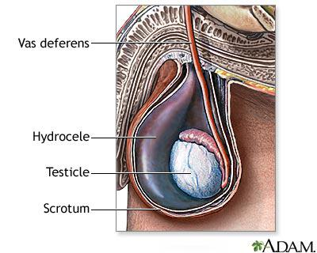

Slide 21
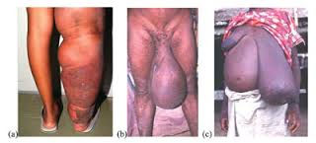
HYDROCELE DUE TO LF
Common in scenario in females

Slide 22
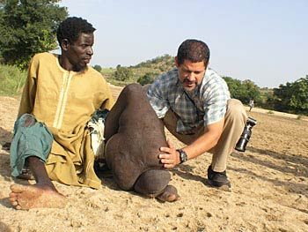
This case requires support to move from one place to another. But LF is a preventable disease

Slide 23
DIAGNOSIS OF LYMPHATIC FILARIASIS
Immunochromatographic filarial antigen testing (ICT)- test of choice
Nonspecific test abnormalities –Eosinophilia up to 3000/µL
Blood examination for detection of microfilariae should be performed in all individuals in whom the diagnosis of filariasis is suspected.
Bancroftian and Brugian filariasis tend to show nocturnal periodicity.
Care must be taken to collect blood at the peak time when the greatest number of microfilariae can be found in blood.

Slide 24
Species (area) | Periodicity | Blood collection time | Peak time
W. Bancrofti (Asia, Africa, Caribbean, S. America, Middle East) | Periodic | 2200-0400 hrs | 2400 hrs
W. Bancrofti (Thailand, Vietnam) | Subperiodic | 2000-2200 hrs | 2100 hrs
W. Bancrofti (Eastern Pacific) | Subperiodic | 1400-1800 hrs | 1600 hrs
B. Malayi (S. & E Asia) | Periodic | 2200-0400 hrs | 2400 hrs
B. Malayi South East Asia | Subperiodic | 2000-2200 hrs | 2100 hrs
B. Timori (Indonesia) | Periodic | 2200-0400 hrs | 2400 hrs

Slide 25
TREATMENT
Diethylcarbamazine—DEC
Ivermectin—Studies have established that ivermectin given as a single dose in Bancroftian filariasis reduces microfilaremia by approximately 90 percent even one year after treatment
Albendazole—has also been used in filarial infections. Prolonged courses of high dose albendazole have a significant macrofilaricidal effect and result in a gradual decrease in microfilarial levels.
Doxycycline—Initial studies suggested that doxycycline, which has good activity against filarial spp, leads to sterility of adult worms

Slide 26
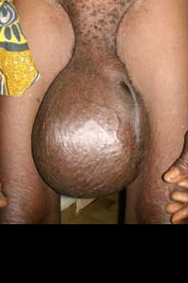
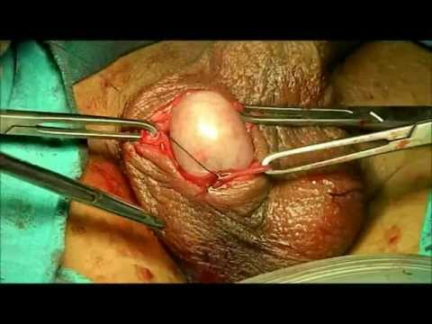
THE FLUID CAN BE DRAINED SURGICALLY

Slide 27


Slide 28
LYMPHATIC FILARIASIS PREVENTION and CONTROL
Controlling vector mosquitoes
Avoiding mosquito bites by wearing suitable clothing
Sleeping under insecticide treated bed nets.
Making houses mosquito proof as far as possible
Treating infected individuals as part of mass control programs
Health education about the causes, early symptoms, detection and control of lymphatic filariasis

Slide 29
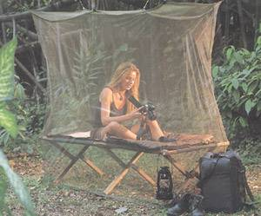
Appropriate use of Insecticide treated Nets

Slide 30
LOIASIS
Loiasis, also known as Calabar swelling , is caused by the filarial worm loa loa which lives in subcutaneous tissues.
L. loa is often referred to as the eye worm because the adult worms sometimes migrate across the conjunctiva or eyelid.

Slide 31
EPIDEMIOLOGICAL DISTRIBUTION OF LOIASIS
Loiasis is restricted to the equatorial rain forest areas of West and Central Africa.
Specific endemic countries include:
  Congo
  Gabon
  Cameroon
  South Nigeria
  Equatorial Sudan
It is endemic in many areas where W. bancrofti also occurs (co-endemic)

Slide 32
LOIASIS LIFE CYCLE
Loa loa is transmitted by blood –sucking biting tabanid flies of the genus Chrysops.
The flies are often referred to as horseflies.
Infective lavae (often in large numbers) enter human skin through the deep wound made by an infected Chrysops fly when it sucks blood.
The lavae penetrate the subcutaneous connective tissues.
Within 6-12 months they develop into mature male and female worms.

Slide 33
LIFE CYCLE OF LOIASIS CONTINUED
The female produce sheathed microfilariae which can be found in the blood during day hours.
Mature worms may live for 4-12 years in their host.
They wonder in subcutaneous tissue and occasionally under the conjunctiva of the eye.
Microfilariae are taken up by a female chrysops when sucking blood

Slide 34
LIFE CYCLE OF LOIASIS CONTINUED
In the stomach of the Chrysops the microfilariae lose their shealth.
They pass through the stomach wall, penetrate thoracic muscles, and develop into infective larvae.
Development in the insect vector takes about 10 days.
Mature infective larvae migrate to the mouth –parts of the insect ready to be transmitted when the Chrysops takes a blood meal.

Slide 35
LOIASIS CLINICAL SYMPTOMS
Many infected individuals do not show symptoms
Loiasis is characterized by the formation of swelling known as Calabar swelling lasting from a few days to 3 weeks.
The swelling measures from 3-10cm in diameter.
Arms are most frequently affected
The inflamed areas are an allergic response to adult L. loa worms migrating in the in the subcutaneous tissue.

Slide 36
LOIASIS CLINICAL SYMPTOMS
Worms can occasionally be seen migrating below the skin surface.
Adult worms also migrate in sub-conjunctival tissues
They can be seen under the eyelids and occasionally slowly crossing the white of the eye.
They can cause inflammation and irritation but not blindness

Slide 37
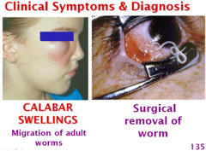

Slide 38
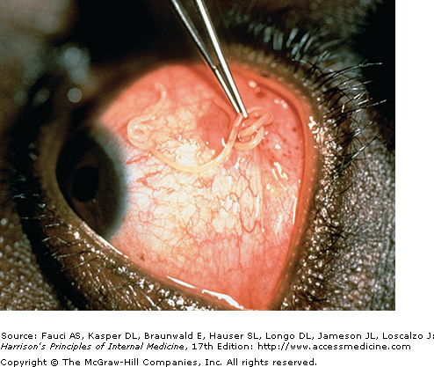
Loa loa worm in the eye

Slide 39
DIAGNOSIS
Finding and identifying L. loa microfilariae in blood collected at the correct time during the day.
In 60-70% of patients with occult loiasis it is not possible to find microfilariae in the blood.
Occasionally by finding L. loa microfilaria in joint fluid
Calabar swelling is accompanied by eosinophilia.

Slide 40
TREATMENT OF LOIASIS
The most straightforward treatment is surgical removal of adult worms migrating under the skin or across the eye.
This can be done with local anesthesia and offers immediate relief, though this only relieves local symptoms and does not cure the patient of the underlying infection.
There are two antiparasitic agents that can be used to treat the infection and manage the symptoms.
These medications are diethylcarbamazine (DEC), which kills both the larvae and the adult worms and is the treatment of choice, and albendazole, which is thought to kill the adult worms.
The treatment of choice in patients with low levels of larvae in the blood is DEC.

Slide 41
Onchocerciasis
Onchocerciasis is an eye and skin disease caused by a parasitic worm (filaria) known as Onchocerca volvulus.
Ochocerca voluvulus is transmitted by the bite of an infected blackfly (genus Simulium).
These flies breed and live in fast-flowing streams and rivers.
They increase the risk of blindness to individuals living nearby rivers, hence onchocerciasis is also known as river blindness

Slide 42
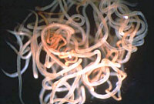
Photomicrograph of onchocerca volvulus (adult worms). Photo: WHO/TDR/OCP

Slide 43
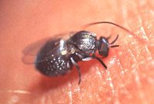
An adult blackfly (Simulium damnosum) taking a blood meal on human skin. Photo: WHO/TDR/Stammers

Slide 44
Epidemiology
The distribution of onchocerciasis is linked to the location of blackflies which are naturally found close to the fast-running streams and rivers in the inter-tropical zones.
Therefore, about 90% of the disease occurs in Africa.
Onchocerciasis is also found in six countries in Latin America and in Yemen in the Arabian Peninsula.

Slide 45
Epidemiology
People who live in rural areas near fast-flowing rivers and streams where there are Simulium blackflies are most at risk of acquiring onchocerciasis.
In 2008 about 26 million people were infected with onchocerciasis, of whom 265,000 were blind and 746,000 were visually impaired (WHO 2010).

Slide 46
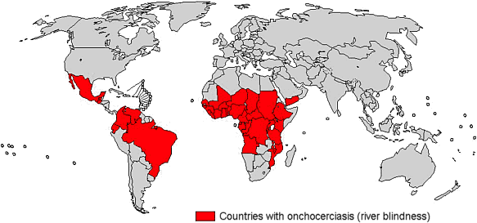
Distribution of Onchocerciasis

Slide 47
Oncho life cycle
During a blood meal, an infected blackfly introduces third-stage filarial larvae onto the skin of the human host, where they penetrate into the wound and subcutaneous tissues
They develop into adult worms called filariae
Filariae commonly reside in nodules in subcutaneous connective tissues, where they can live for approximately 15 years.
In nodules that contain male and female worms, the female worms are capable of producing larvae, called microfilariae, for approximately nine years, producing an average of 1,600 microfilariae per day

Slide 48
Oncho life cycle
The microfilariae have a life span that may reach two years
They are occasionally found in blood, urine, and sputum but are typically found in the skin and in connective tissues.
To repeat the transmission cycle, a blackfly ingests the microfilariae during a blood meal.

Slide 49
Oncho life cycle
After ingestion, the microfilariae migrate from the blackfly’s midgut to the thoracic muscles , where the microfilariae develop into third-stage infective larvae.
The third-stage infective larvae migrate to the blackfly’s proboscis and can infect another human when the fly takes a blood meal .

Slide 50
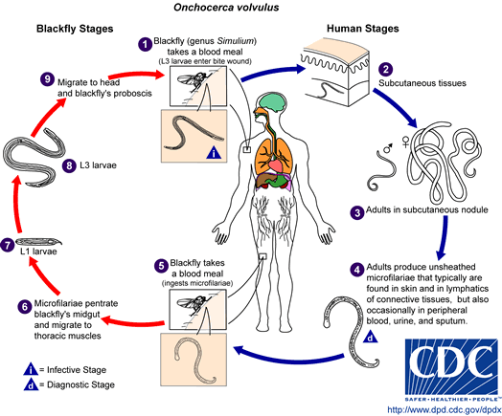

Slide 51
Clinical Presentation
Severely infected people usually develop severe itching and skin and/or eye lesions
The death of microfilariae is very toxic to the skin and the eye, producing terrible itching and various eye manifestations (lesions).
After repeated years of exposure, these lesions may lead to irreversible blindness and disfigurative skin diseases sometimes named "leopard" skin and "lizard" skin.

Slide 52
Clinical Presentation
The inflammation caused by larvae that die in the eye results initially in reversible lesions on the cornea that without treatment progress to permanent clouding of the cornea, resulting in blindness.
There can also be inflammation of the optic nerve resulting in vision loss, particularly peripheral vision, and eventually blindness.
Onchocerciasis is the second leading infectious cause of blindness, after trachoma.

Slide 53
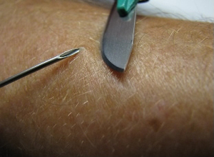
Diagnosis: The Skin Snips
The gold standard test for the diagnosis of onchocerciasis remains the skin snip biopsy.
Six snips provide the most diagnostic sensitivity.

Slide 54
Diagnosis: The Skin Snips
Although the skin snip is highly specific, its sensitivity can be limited in the pre-patent stage of infection, which can last 1 to 1.5 years, and in low intensity infections.
Performing polymerase chain reaction (PCR) of the skin snip can increase the sensitivity
In patients with nodules in the skin, the nodule can be surgically removed and examined for adult worms.

Slide 55
Diagnosis of infection of the eye
Infections in the eye can be diagnosed with a slit-lamp examination of the anterior part of the eye where the larvae or the lesions they cause are visible.
Antibody tests have been developed to test for infection, though they are not widely available.
These tests cannot distinguish between past and current infections, so they are not as useful in people who live in areas where the parasite exists, but they are useful in visitors to these areas.

Slide 56
Treatment
People who are found to be infected with O. volvulus should be treated in order to prevent the long-term skin damage and blindness.
The recommended treatment is ivermectin, which will need to be given every 6 months for the life span of the adult worms or for as long as the infected person has evidence of skin or eye infection. Ivermectin kills the larvae and prevents them from causing damage but it does not kill the adults.
To kill macrofilariae: doxycycline to be given for 6 weeks has been recommended
Before any treatment is begun, infection with Loa loa should be ruled out.
Loa loa is another filarial parasite found in central Africa that is sometimes found in the same areas where O. volvulus is found.
It can be responsible for severe side effects to the medications used to treat onchocerciasis.

Slide 57
Prevention and Control
On a global level, sustainable mass drug administration of ivermectin is currently the primary control strategy for onchocerciasis
Destruction of Simulium
Avoiding Simulium bites

Slide 58
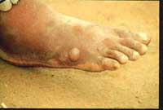
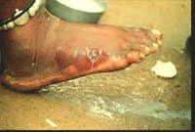
Dracunculus medinensis – The Guinea Worm
Overview:
An important parasite in the Middle East, central India and Pakistan. Also found in Africa in the Sudan and scattered through central equatorial regions, and on its west coast.
It is believed to no longer occur in the Western Hemisphere.
Sometimes classified with the filarial worms, but Dracunculus is not a true filaria.
Blister containing Dracunculus medinensis
Adult Dracunculus emerging from broken blister

Slide 59
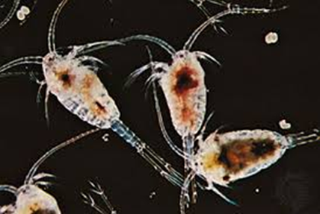
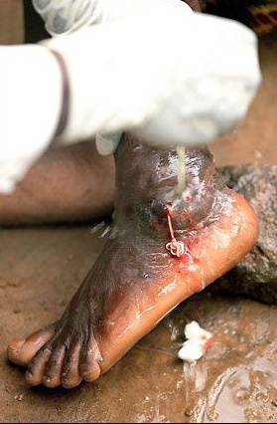
Dracunculus medinensis – The Guinea Worm
Life cycle:
Infective stage exists in a water flea (copepod – the intermediate host).
Humans become infected by drinking water containing the infected copepod.
Larvae penetrate the digestive tract to enter the deep connective tissues where they mature in about 1 year.
Females migrate to the subcutaneous tissue (usually the skin of the extremities).
Females release larvae which leave the human through ruptured blisters on the skin.
The larvae enter the water and are ingested by copepods.

Slide 60
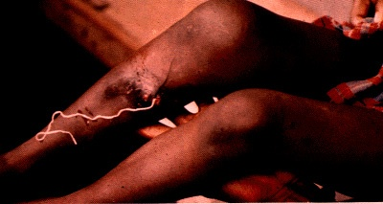
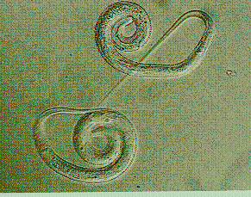
Morphology
Males measure 40mm in length.
Females measure 800mm in length.
Diagnosis
Visual observation of skin blister. The worm’s serpentine presence beneath skin can be seen.
Induce release of larvae from the skin ulcer by applying cold water.
Major pathology and symptoms
Mild allergic symptoms such as urticaria during the migration phase.
A papule develops into a blister with localized erythrema and tenderness.
Generalized symptoms include nausea, vomiting, diarrhea, and possibly asthma attacks.
Additional complications include secondary bacterial infections, permanent damage to joints.

Slide 61
Control of Dracunculiasis
Dracunculiasis can be eliminated by the provision of safe drinking-water.
In the meantime, reliance is vested in active surveillance, education and vector control with larvicides, such as temephos
Treatment of Dracunculiasis
Metronidazole (25 mg/kg daily for 10 days, with a daily maximum of 750 mg for children) provides rapid symptomatic relief.
It also weakens the anchorage of the worms in the subcutaneous tissues, and they can then be removed by traction.
Mebendazole is also effective.
The possibility that albendazole, ivermectin or metrifonate may cure the infection in the early stages is currently being explored.

Slide 62
Thank you

