Slide 1

Nematodes of lower animals that rarely infect man
COLLEGE OF MEDICINE AND HEALTH SCIENCES
SCHOOL OF NURSING AND MIDWIFERY
COURSE: MEDICAL PARASITOLOGY

Slide 2
Introduction
In some cases humans acquire zoonotic infections of enteric nematodes of lower animals.
Humans are not natural hosts for these parasites.
Human infections are accidental, and the human disease may or may not resemble that of the animal host.
Some of these nematodes are not able to complete their life cycle in a human as they do in the animal host; the disease process will differ accordingly.
Other enteric nematodes such as Trichinella spiralis can complete their life cycle in humans, and produce disease similar to that in other mammalian hosts.

Slide 3
Visceral and Ocular Larva Migrans
Two distinct patterns of larva migrans infection are recognized: visceral larva migrans and ocular larva migrans.
These clinical syndromes result from the systemic migration of the larval forms of animal helminthic parasites.
Toxocara species, the common roundworms of dogs and cats, are the usual cause. The disease affects mainly children.

Slide 4
Visceral Larva Migrans
The classic visceral larva migrans syndrome usually occurs in preschool children with a history of pica (dirt-eating).
Patients who have severe infections often present with eosinophilia, fever, and marked hepatomegaly which may persist for months; there may be associated respiratory symptoms with wheezing and coughing.
Pruritic rashes and chronic urticaria may occur.
Neurologic involvement may cause seizures. Death has been associated with myocarditis, encephalitis, and respiratory syndromes.

Slide 5
Ocular Larva Migrans
The ocular form of the disease usually occurs in children who are between school age and young adulthood.
Ocular invasion by the larva may produce retinal granulomas or endophthalmalitis, leukokoria (white pupillary reflex), decreased visual acuity, strabismus and eye pain.
The syndrome may resemble retinoblastoma; misdiagnosis has resulted in unnecessary enucleation of the involved eye.
It has been suggested that ocular larva migrans is associated with fewer larvae than visceral larva migrans.

Slide 6
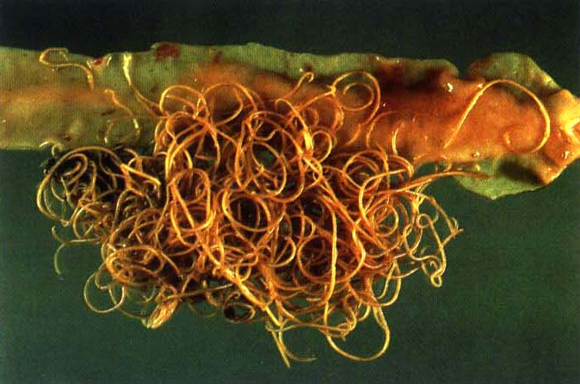
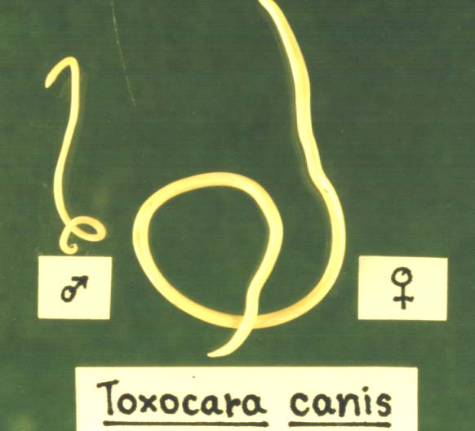
Toxocara sp.
Toxocara canis is the most common cause of visceral and ocular larva migrans.
The larvae are 400 μm × 20 μm; adult females are 5 to 18 cm long and adult males 4 to 10 cm long.
Eggs are about 85 μm × 75 μm, with a thick brown shel
Mature Toxocara canis worms live in the small intestine of the dog, their natural host.
They have an average life span of about 4 months.

Slide 7
Epidemiology
The egg of the parasite is ubiquitous in soil wherever infected dogs defecate.
Infection occurs when contaminated soil or fomites are ingested.
Visceral larva migrans is most common in preschool children with a history of pica (dirt-eating); ocular disease is more common in school-age children.

Slide 8
T. canis modes of transmission
    transplacenta
    transcolostrum
    direct ingestion
    paratenic host

Slide 9
Life Cycle
The life of Toxocara canis in the dog, its natural host, is similar to that of Ascaris in humans.
Ingested eggs hatch in the intestine.
The larvae migrate extraintestinally for a period, then return to the intestine to mature and lay eggs, which are shed in the feces.
In humans, ingested eggs hatch and larvae migrate into the deep tissues, but development proceeds no further.
Pathogenesis
Larvae persisting in either the viscera or the eyes cause granulomatous reactions.
Leukocytosis and eosinophilia are common. Hypergammaglobulinemia and antibodies against the larvae appear.

Slide 10
Clinical Manifestations
Visceral larva migrans: Symptoms include hepatosplenomegaly, fever and eosinophilia. The symptoms and duration of illness depend on the site and extent of larval migration.
Ocular larva migrans: Symptoms include leukocoria (white pupillary reflex), loss of vision in affected eye, eye pain or strabismus. There are usually no systemic symptoms.

Slide 11
Diagnosis
The clinical picture, serologic tests (ELISA), and occasionally biopsy are the chief means of diagnosis.
Control
Larva migrans can be controlled by keeping pets wormed and by sanitary disposal of pet feces.

Slide 12
Cutaneous Larva Migrans
Cutaneous larva migrans (creeping eruption) is a dermatitis caused by the larvae of Ancylostoma braziliense, the dog and cat hookworm, which penetrate human skin and migrate in the subepidermal tissue.
Ancylostoma caninum and other species of hookworms also can cause this infection.
A similar cutaneous eruption may occur in patients with intestinal Strongyloides stercoralis when the perianal skin is autoinoculated by infective larvae passed in the stool.
This syndrome is called larva currens (“racing larva”) because of the rapid migration of this larva in the skin

Slide 13
Epidemiology of Cutaneous Larva migrans
Cutaneous larva migrans is primarily a disease of the southern United States, Central and South America, and other subtropical climates.
The major agent, Ancylostoma braziliense , is a common enteric parasite of dogs and cats.
Humans acquire the infection when infected pets deposit feces containing eggs on the soil.
Within a few days under favorable conditions of moisture and temperature, these eggs hatch and develop into rapidly growing rhabditiform larvae, which feed on organic matter in the soil, molt, and develop into nonfeeding infective filariform larvae.
These larvae remain in the upper half inch of soil, from which they penetrate the skin of humans and other hosts.

Slide 14
Epidemiology of Cutaneous Larva migrans
This disease is an occupational hazard for construction workers, plumbers and electricians who are exposed to contaminated soil under buildings and crawl spaces.
Sunbathers on the beach and children who go barefoot or who play in backyards or sandboxes accessible to infected dogs and cats are other prime candidates.
However, anyone who has skin contact with damp soil contaminated with the excreta of infected animals is subject to infection.

Slide 15
Structure of Ancylostoma braziliense
Ancylostoma braziliense is the smallest of the common canine and feline hookworms.
It has the typical hookworm shape with the anterior end bend dorsally.
The adult female is 6 to 10.5 mm long and the smaller male is 5 to 7.5 mm long.
The infectious third-stage filariform larvae are approximately 600 μm × 20 μm.

Slide 16
Life Cycle Ancylostoma braziliense
The basic life cycle of Ancylostoma braziliense in an animal host is similar to that of A duodenale in humans.
In humans, the larvae cannot complete their life cycle, and generally remain trapped in the cutaneous tissues.

Slide 17
Pathogenesis
The larvae migrate in the epidermis just above the basal layer, and rarely penetrate into the dermis.
Proteolytic enzymes in larval secretions may cause an inflammatory reaction associated with intense pruritus as the lesion progresses.
Although the larvae cannot reach the intestine to complete their life cycle in the unnatural human host, they do occasionally migrate to the lungs where they produce pulmonary infiltrates.
Both larvae and eosinophils have been demonstrated in the sputum of patients with pulmonary involvement.

Slide 18
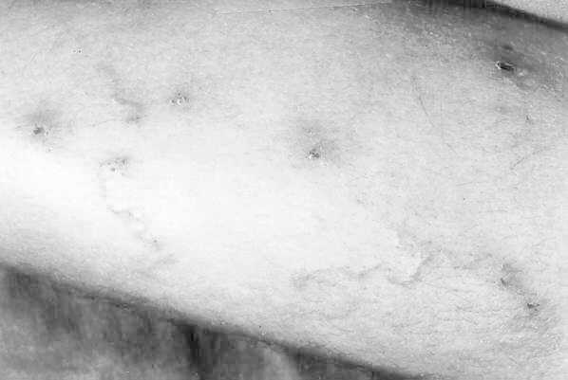
Clinical Manifestations of Cutaneous Larva Migrans
As the larvae invade the skin, a tingling sensation may be felt at the site of invasion.
An erythematous, pruritic papule usually develops within a few hours. This lesion intensifies over the next few days and develops into a slightly raised, erythematous, serpiginous track that usually progresses at the rate of 1 to 2 cm/day
The track may be especially pruritic at its advancing edge, over the offending larva.

Slide 19
Clinical Manifestations of Cutaneous Larva Migrans
Skin lesions may be single or numerous depending on exposure.
The most frequent areas of skin involvement are the feet, hands, buttocks, and genital areas.
The disease is self-limited with death of the invading larvae in a month or two.
Secondary bacterial infections may result from frequent scratching of the lesions.

Slide 20
Diagnosis of cutaneous larva migrans
The classic serpiginous eruption is usually diagnostic.
A biopsy specimen taken at the leading edge of the track may contain the larva.

Slide 21
Control and treatment
Control of human infections depends on responsible pet ownership.
Dogs and cats should be examined periodically for intestinal parasites and wormed as necessary; pet feces should be disposed of in a sanitary way.
Topical treatment of cutaneous larva migrans with a 10 percent thiabendazole suspension is usually effective and avoids the side effects of oral therapy.
For multiple or persistent infections, a combination of oral and topical thiabendazole may be given.

Slide 22
Other Larval Migratory Diseases
Several other animal parasites have been associated with visceral larva migrans-like syndromes.
These include Ascaris suum, Capillaria hepatica, Angiostrongylus cantonsensis, Angiostrongylus costaricensis, and Baylisascaris procyonis.
The tissue phase of such human helminths as Strongyloides stercoralis and Ascaris lumbricoides can also produce similar clinical syndromes. Larvae of species of Anisakis and closely related nematodes of marine mammals have been reported to invade the stomach and other areas of the gastrointestinal tract of humans.

Slide 23
Other Larval Migratory Diseases
Ascaris suum, the common intestinal roundworm of domestic swine, is morphologically very similar to the human roundworm, Ascaris lumbricoides.
Human infections with Ascaris suum are uncommon, but have been associated with a visceral larva migrans syndrome in children.
The larvae invade the liver and lungs, but usually do not develop to maturity in the intestine.

Slide 24
Other Larval Migratory Diseases
Capillaria hepatica is a rat liver parasite. If an infected rat is eaten by a predator, the eggs in the liver are released by the digestive process and passed in the feces to the soil.
Humans acquire the infection by ingesting the infective eggs in contaminated food or water.
The larvae hatch in the intestine and migrate to the liver, where maturation is completed.
Clinical manifestations are usually that of an acute or subacute hepatitis.
Eosinophilia and massive hepatomegaly may develop. Diagnosis is made by liver biopsy. There is no proven drug therapy.

Slide 25
Other Larval Migratory Diseases
Gnathostoma spinigerum is a nematode that resides in the stomach wall of dogs and cats.
Most human infection occurs in Thailand and other Asian countries.
Infective larvae develop in copepods and are transferred through the food chain.
Human infection results from consumption of improperly cooked fish or other food containing infective larvae.
The larvae migrate in the tissues and may invade the eyes, brain, or any organ.
They may cause eosinophilic meningitis.
The immature worm may be demonstrated in subcutaneous nodules. Surgical removal of the larva and treatment with albendazole is recommended.

Slide 26
Other Larval Migratory Diseases
Angiostrongylus cantonensis, the rat lungworm, causes eosinophilic meningitis and ocular disease in Southeast Asia, the Pacific Islands, and Cuba.
Hawaii is the only endemic site in the United States.
Human infections are caused by eating infected snails, slugs, or other mollusk intermediate hosts, or other members of the food chain that have acquired infective larvae by eating these hosts.
The larvae migrate to the brain, producing an eosinophilic meningitis. Paresthesias and ocular palsies are common.
There is no specific treatment, but mebendazole has been used. The prognosis is usually favorable.

Slide 27
Other Larval Migratory Diseases
Angiostrongylus costaricensis is a parasite of the mesenteric arteries of wild rats.
Widespread from Mexico to Brazil; it is even found in cotton rats in Texas.
Humans become infected by eating raw vegetables that have been contaminated by a slug intermediate host with infective third-stage larvae.
The larvae mature in the mesenteric arteries, producing a granulomatous inflammatory reaction. Abdominal pain and a mass in the right iliac fossa, the usual clinical manifestations, simulate appendicitis.
Definitive diagnosis is usually made by surgical exploration; however, this is obviously a fortuitous finding and is not a routine procedure.
A visceral larva migrans syndrome has been reported, with migration of the parasite to the liver. Thiabendazole has been used for treatment.

Slide 28
Other Larval Migratory Diseases
Baylisascaris procyonis, the common raccoon ascarid, may cause an especially virulent form of visceral larva migrans.
The infection may be acquired by ingestion of the eggs passed in animal feces or by ingestion of paratenic hosts (host in which parasite survives without further development) bearing the encysted larvae.
Baylisascaris procyonis has a tendency to invade the central nervous system of humans and other animal hosts.
In two reported cases, young children died of visceral larva migrans syndrome and eosinophilic meningoencephalitis. Larvae were demonstrated in brain and other organs at autopsy.

Slide 29
Other Larval Migratory Diseases
Species of Anisakis and certain related genera have been reported in the stomach and other areas of the alimentary tract of humans.
Found in the United States.
. Humans acquire this infection by eating raw seafood containing the larvae of these nematodes.
The larvae penetrate the gastric mucosa and elicit an intense inflammatory response, gastric pain, vomiting, and diarrhea. Many infections are eliminated by regurgitation of the worm.
Diagnosis is by examination of vomitus or by gastroscopic examination and surgery when indicated.
In nature, these species develop to adults in the stomach of marine mammals. Eggs passed in the feces hatch and are ingested by crustaceans in which larvae develop into a stage infective for fish. Ingestion of infected fish by marine mammals completes the life cycle.
The risk of infection may be avoided in humans by cooking fish at 65° C for 10 minutes or by freezing fish for at least five days at -20° C.

Slide 30
Trichinella spiralis
A tissue nematode caused by Trichinella spiralis
Zoonotic disease
Disease in humans: Trichinosis, Trichiniasis, Trichinelliasis, Trichinellosis
Distribution: Temperate regions where pork is eaten
    T. Spiralis spiralis – found in temperate regions
    T. Spiralis nativa – found in the Arctic
    T. Spiralis nelsoni – found in Africa and S. Europe
Habitat:
  Adults in the small intestine of man and animals specially pigs and rats (reservoir hosts)
  Larvae : encysted in muscles
  Transmission is by Eating flesh of infected pork (raw/undercooked)

Slide 31
Life cycle
The same host (animal/man) act as DH & IH
After fertilization, males die and are expelled.
Females penetrate deeply in the mucosa and lay
Female lays ~ 1500 larvae in its life span (~ 2 months)
Larvae to the circulation
Passes through pulmonary filter
Distributed all over the body (esp. diaphragm, tongue, eye, deltoid, pectoralis, intercostals, etc)
Larvae coil and encyst in the long axis of muscles
Pigs become infected by eating infected flesh from other pigs or ingestion of infected dead pigs and rats
Rats are infected by eating flesh of dead pigs or rats and by canibalism
Larvae liberated from the cysts in small intestine and mature to adults
Larvae start to be deposited by the female

Slide 32
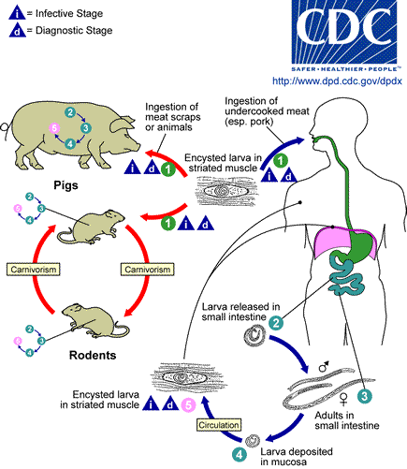
Life cycle

Slide 33
Pathogenicity
Intestinal invasion by adult worms
  Abdominal pain, nausea, vomiting, diarrhoea and colic.
Migration of larvae

Slide 34
Encystment of larvae
  Manifestations depend up on organs affected.
  > 50 – 100 larvae/gm of muscle are symptomatic
  < 10 larvae are often asymptomatic

Slide 35
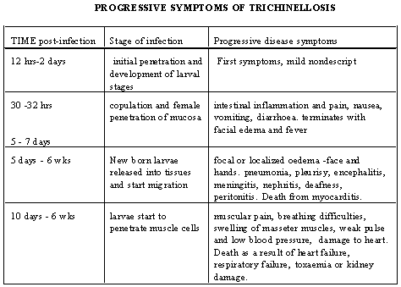

Slide 36
Laboratory diagnosis
Immunodiagnosis:
  Intradermal test (Bachman test)
  Serological tests:
    Bentonite flocculation (BF)
    Latex agglutination (LA)
    Counter – current electrophoresis (CEP)
    Complement fixation test (CFT)
    IFA and IHA
Muscle biopsy:
    Direct examination
    After digestion in a pepsin hydrochloric acid medium
Eosinophilic leucocytosis in the acute stage
Notes:
Intradermal test (Bachman test): antigen prepared from larvae, diluted 1:10000 give an immediate reaction within 30 minutes. It becomes positive about two weeks after infection and remains for several years.
Little value in the diagnosis of acute trichinosis (positive reaction after years) & cross – reaction with other nematodes
Serological tests: become positive 3 – 4 weeks after infection:
Bentonite flocculation (BF), Latex agglutination (LA), Counter – current electrophoresis (CEP), Complement fixation test (CFT), IFA and IHA

Slide 37
Prevention & control
Treatment
Thorough cooking of pork
  77⁰c or freezing at – 15⁰c for 20 days
  – 18⁰c for 24 hours
Proper breeding of pigs
  Sterilizing garbage
  Antirat campaign
Inspection of pork in slaughter houses
  Trichinoscope.
Non specific symptomatic treatment:
  Sedatives
  Cortisone and adrenocorticotropic hormone
Supportive treatment:
  Rest, fluids, smooth diet and vitamins
Thiabendazole
Mebendazole

Slide 38
Dioctophymiasis
Dioctophyme renale, the giant kidney worm, is the largest known parasitic nematode infecting humans — adult females can reach over one meter in length.
Human infections are very rare.
Mustelids serve as the usual definitive hosts for D. renale, although infections with adult worms also occur in wild and domestic canids, otters, martens, and raccoons
Aquatic oligochaete worms, are known to be intermediate hosts. A number of freshwater fish and amphibian species can act as paratenic hosts.

Slide 39
Dioctophymiasis
Zoonotic infections have been reported from the United States, Iran, India, China, and Indonesia.
Diagnosis in humans involves the finding of eggs or adult worms expelled in urine, usually accompanied by hematuria, and sometimes abdominal pain, fever, and eosinophilia.
Adult worms have been found in the right kidney, left kidney, both kidneys, retroperitoneal space, and liver.

Slide 40
Hepatic Capillariasis
The nematode (roundworm) Capillaria hepatica causes hepatic capillariasis in humans.
C. hepatica has a broad global distribution in wildlife.
Human cases have originated from all inhabited continents except for Australia, although there it exists in wildlife.
C. hepatica is a zoonotic parasite with a low host specificity; it primarily exists in rodent and carnivore hosts.
Both true and spurious infections occur in humans.

Slide 41
Hepatic Capillariasis
Hepatic capillariasis is rare in humans.
It typically manifests as an acute or subacute hepatitis with peripheral leukocytosis and eosinophilia, hepatomegaly, and persistent fever (which may be as high as 40℃).
The deposition of eggs in the liver parenchyma causes granuloma formation and liver necrosis, which in heavy infections can lead to potentially fatal liver dysfunction.
The true incidence in humans may be underestimated due to the nonspecific clinical presentation and difficulty of diagnosis.

Slide 42
The END

