Slide 1

Introduction to Helminths
COLLEGE OF MEDICINE AND HEALTH SCIENCES
SCHOOL OF NURSING AND MIDWIFERY
COURSE: MEDICAL PARASITOLOGY

Slide 2
Kingdom Animalia
Kindom Animalia
Phyla
Nemathelminthes
Platyhelminthes
Arthropoda
Nematodes
Trematodes
Cestodes
Insecta
Chelicerata
Organisms
Hook worms
S. mansoni
T. solium
Mosquitoes
Ticks

Slide 3
Helminthes
These are complex multicellular organisms that are elongated and bilaterally symmetric.
They are larger than protozoa and are generally macroscopic ranging in size from less than 1mm to 1m or larger.
The external surface is of some worms is covered with a protective cuticle which is acellular and may be smooth or possess ridges, spines, or tubercles.
Protective covering of flatworms is known as tegument.

Slide 4
Helminthes
Often helminthes possess elaborate attachment structures such as :
    Hooks
    Suckers
    Teeth
    Plates
These structures are usually located anteriorly.
They may be useful in classifying and identifying the organisms.
Helminthes have primitive nervous and excretory systems
Some have alimentary tracts but none have a circulatory system
Helminthes are separated into two phyla:
    Nemathelminthes
    Platyhelminthes

Slide 5
Phylum: Nemathelminthes
Consists of round worms which have cylindrical bodies
The sexes of roundworms are separate
Organisms have a complete digestive system
Nematodes are classified into 3 groups:
Intestinal nematodes/Soil transmitted helminths: transmitted by contamination of environment with eggs in fecal matter.: Hookworms, Ascaris lumbricoides, Trichuris trichiura
Blood nematodes/Systemic nematodes (filarial worms): (Wuchereria bancrofti, Brugia malayi, Brugia timori)
Tissue nematodes/Subcutaneous nematodes: Onchocerca voluvulus, Loa loa, Dracunculiasis medinensis

Slide 6
General characteristics of Nematodes
Cylindrical worms
Have a body cavity and a cuticle (skin) which may be smooth or ridged.
The adults of some nematodes are very long. E.g. Dracunculus medinensis (1m).
The mouth is surrounded by lips, or papillae.
In some species e.g hookworms, the lips open into a buccal cavity which has cutting or tooth like plates.
The digestive system is a simple tube which ends in an anus.

Slide 7
General characteristics of Nematodes
There is an excretory system and nervous system.
Sexes are separate with the male worm being shorter than the female.
Females are either viviporous (produce lavae.e.g Wb) or oviporus (lay eggs e.g hookworm, Ascaris lumbricoides).
The discharged eggs may hatch directly into infective larvae or they may require special conditions in which to hatch.
Undergo up to three developmental stages before becoming infective lavae.
Each stage involves shading of the old cuticle (moulting).

Slide 8
Phylum Platyheminthes
Consists of flatworms with flattened bodies that are leaflike or resemble ribbon segments.
Platyhelminthes can be further divided into:
    Trematodes
    Cestodes

Slide 9
Trematodes
Trematodes (flukes) have leaf –shaped bodies
Most are hermaphroditic (male and female sex organs in a single body). Schistosomes are an exception.
They have oral and ventral suckers that serve as (attachment organs)
Their digestive systems are incomplete and only have sac like tubes. They have no anus but excretory system composed of excretory cells, collecting tubules and an excretory pore.

Slide 10
Cestodes (tapeworms)
All are hermaphroditic and all lack digestive systems with nutrition being absorbed through the body walls.
There is a simple excretory system like that in flukes
Proglottids are formed from behind the head.
Newly formed proglottids are small and immature
Mature proglottids contain fully developed reproductive organs (several testes, bilobed ovary, and a uterus which may be coiled or consists of a central stem and side branches.

Slide 11
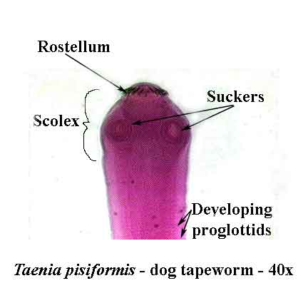
Cestodes (tapeworms)
The body of tapeworm is segmented and tapelike.
It consists of a head (scolex) and many proglottids (segments).
The scolex has suckers and in some species also hooks that attach the tapeworm to it’s host.
There is no mouth or digestive system

Slide 12
Thank you

