Slide 1

AMOEBA
COLLEGE OF MEDICINE AND HEALTH SCIENCES
SCHOOL OF NURSING AND MIDWIFERY
COURSE: MEDICAL PARASITOLOGY

Slide 2
Introduction
Amoebas are primitive unicellular microorganisms with a relatively simple life cycle which can be divided into two stages: Trophozoite – actively motile feeding stage, & Cyst – quiescent, resistant, infective stage.
Their reproduction is through binary fission, e.g. splitting of the trophozoite or through the development of numerous trophozoites within the mature multinucleated cyst.
Motility is accomplished by extension of pseudopodia (“false foot”)
Most Amoeba are free-living widely distributed mostly in aquatic environment
  fresh water ,salt water, wet soil, water plants leaves
Few of the parasitic and free-living amebas produce human disease

Slide 3
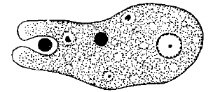
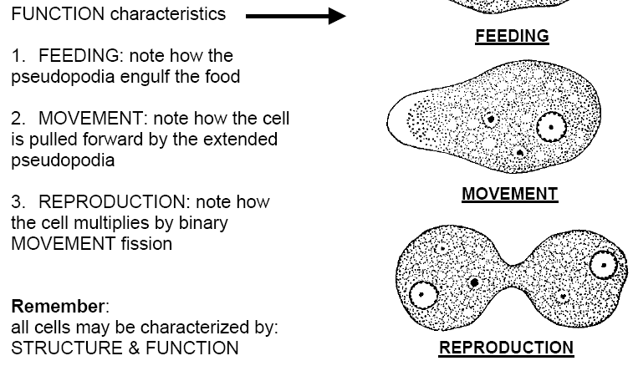
Basic properties

Slide 4
  Respiration is performed by simple absorption of dissolved oxygen from the liquid environment
  Excretion of gases and waste is performed by diffusion out of the organism through the cell membrane
  Egestion of unused residue is performed by the expulsion of the vacuole out of the cell
  Reproduction : asexual reproduction ; by binary fission

Slide 5
AMOEBIC STATE
Trophozoite
  Motile ,actively feeding ,multiplying form
  susceptible to destruction outside the host
Cyst
  Is the non-motile form, non feeding or dormant state which is protected by a distinct membrane or a cyst wall
  is the infective stage of most Amoeba
    except Entamoeba gingivalis

Slide 6
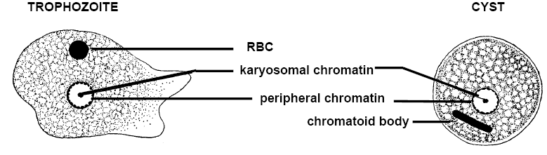
Trophozoite and cyst stage of amoeba

Slide 7
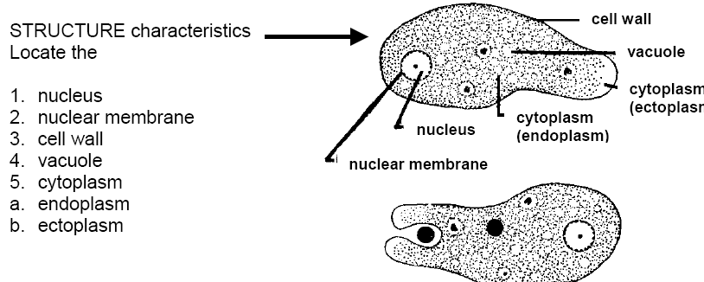
BASIC STRUCTURAL AND FUNCTIONAL CHARACTERISTICS

Slide 8
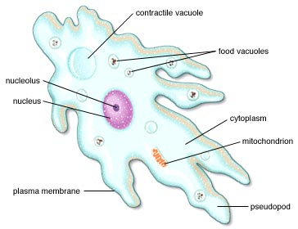
The AMOEBA

Slide 9
Chromatoid body
  Is the RNA-protein complex
  May be rodlike with rounded or splint like end
  It is found in the genus Entamoeba
Glycogen vacuole
  Is a glycogen reserve which stains deeply with iodine and is found mainly in the cysts
Food Vacuole
  A membrane bound vesicle in the cytoplasm formed around an ingested food particle

Slide 10
Contractile vacuole
  A membrane bound vesicle in the cytoplasm which collects and expels water from the cell
Chromatin
  Is genetic material found in the nucleus
  Peripheral nuclear chromatin: found in the inner nuclear membrane
Karyosomes : clumps of chromatin found in the nucleus
  size ,configuration & location of Karyosomes are helpful in identification amoeba

Slide 11
IMPORTANT TERMS USED IN RELATION TO AMOEBAE
Pre-Cyst
  Is the rounded form of trophozoite which precedes the cystic stage
  differs from the cyst in not having a cyst wall
Encystation
  Is the process of formation of the cyst from the trophozoite
Excystation
  Is the process of emergence of the trophozoite from the cyst
Metacyst
  Is the trophozoite which emerges from the cyst

Slide 12
Classification of amoeba
1- pathogenic:
  intestinal amoeba: Entamoeba histolytica (E. histolytica)
2- non pathogenic:
  Mouth amoeba: E. gingivalis
  intestinal amoeba: E. coli, Endolimax nana, E. hartmanni, iodamoeba bütschlii, E. dispar
  Entamoeba dispar is a harmless commensal, which is morphologically indistinguishable from E. histolytica.
3-Free living pathogenic Amoeba
  Naegleria species, Acanthamoeba spp

Slide 13
Entamoeba hystolytica

Slide 14
Habitat
Trophozoites
  dwell in the lumen or wall of the colon, liver and other extra intestinal organs
  feed on bacteria and tissue cells,
  When diarrhea occurs, the trophozoites are passed unchanged in the liquid stool
Cyst
  Found in the stool of chronic dysenteric patients & carriers

Slide 15
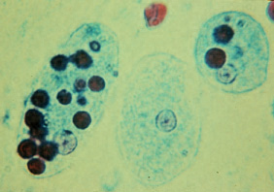
Morphology
Trophozoite
  Size: 12 to 35μm, usually as long as 3 or 4 red blood cells (RBC)
  Shape: elongated form when actively motile & rounded form when at rest
Motility: Active, Progressive , unidirectional amoeboid motility in fresh warm stool specimen
Pseudopodia: Finger like, broadly rounded end
In the case of dysentery, RBCs may be visible in the cytoplasm, and this feature is diagnostic for E.histolytica.
Nucleus: Single nucleus, not visible in the motile form but in iodine stained smear clearly seen
invasive form

Slide 16
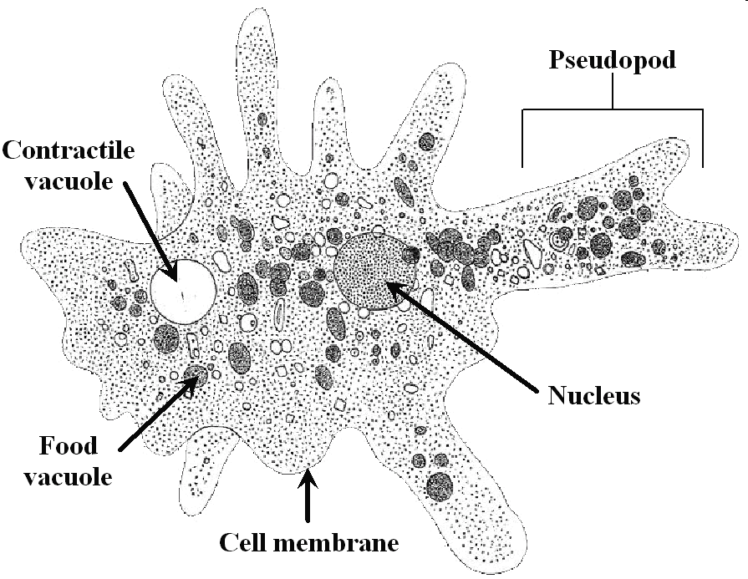
Trophozoite Structure

Slide 17
Cyst
Size: 12-15μm (1½-2 RBC)
Shape: Spherical
Cytoplasm: Yellowish-gray and granular in iodine stained
smear
Chromatoid bodies : if present ciger-shaped ,rounded ends, diagnostic feature
the chromatoidals may also be absent in the mature cyst
Nucleus: Number: 1-4 ;the mature cyst has 4 nuclei
Glycogen : diffused in vacuoles for young cysts. As the cyst matures, the glycogen completely disappears.
.

Slide 18
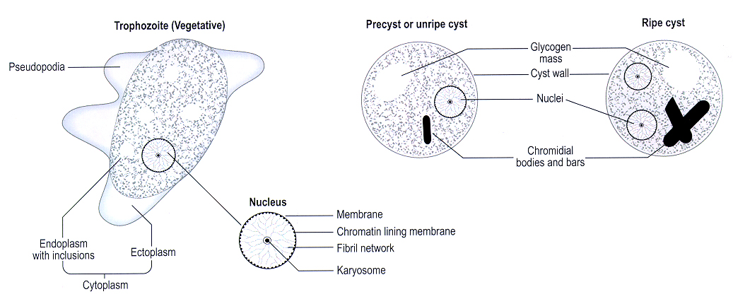

Slide 19
Epidemiology
E.histolytica has a worldwide distribution. Cosmopolitan distribution
Although also found in cold areas, incidence is highest in tropical and subtropical regions that have poor sanitation and contaminated water.
*Worldwide prevalence is about 10% to 50%
*Cyst passers are important source of infection
About 90% of infections are asymptomatic, and the remaining produces a spectrum of clinical syndrome.
Symptomatic amoebiasis is usually sporadic.
The epidemic form is a result of direct person-to-person faecal-oral spread under conditions of poor personal hygiene.

Slide 20
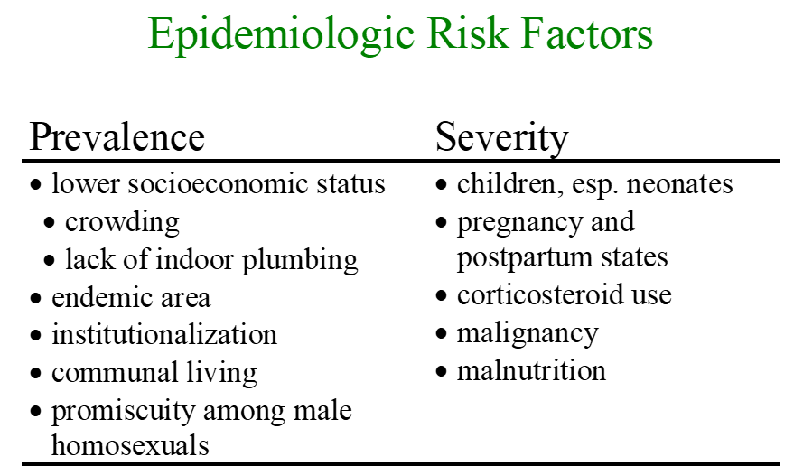

Slide 21
FREQUENCY
Estimation of E. histolytica infection have primarily been based on stool examination which is
    Insensitive & can't differentiate from morphologically identical species E. dispar ( non pathogenic)
~ 10% of world’s population may be infected with E. histolytica / E. dispar
the current epidemiology of amoebiasis doesn’t show the true prevalence of E. histolytica
  true prevalence is close to 1% worldwide
worldwide incidence = 0.2-50%(tropics)
  500 million people worldwide infected
  100 million people suffer acute symptoms
  100,000 people die every year
Molecular Epidemiology: Molecular probes used to survey for E. Dispar and E. histolytica show that E. Dispar ~10-fold > E. histolytica
  Discrete endemic pockets of E. histolytica, Many asymptomatic E. histolytica Infections

Slide 22
TRANSMISSION
1-direct contact of person to person( fecal-oral)
2- Veneral transmission among homosexual males( oral-anal)
3- Food or drink contaminated with feces containing the E. histolytica cyst
4- Use of human feces for soil fertilizer
5- contamination of foodstuffs by flies, and possibly cockroaches
Ingestion of mature cyst (tetranucleated cyst) from contaminated hands ,food or water:
    average infective dose exceeds 1000 cyst, but Ingestion of a single cyst has been known to produce infection.
Humans are the only reservoir excreting up to 45 million cysts daily

Slide 23
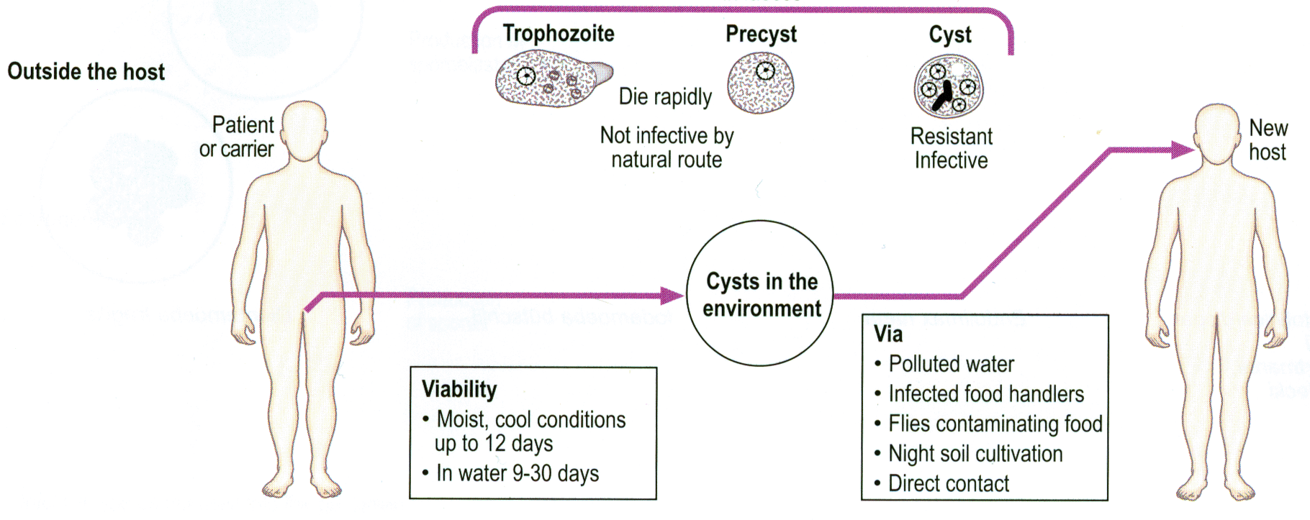
Mature cysts can survive in environment
  temp up to 55°C,
  Norm Chlorine concentration
  gastric acid

Slide 24

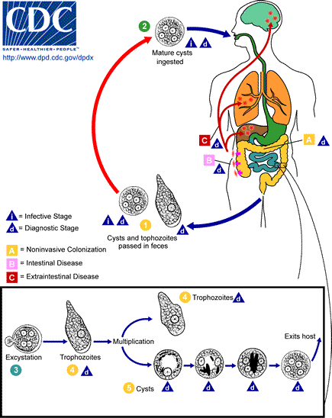
LIFE CYCLE
Intestinal infections occur through the ingestion of a mature quadrinucleate infective cyst in contaminated food or drink and also by hand to mouth contact or via oral anal sex
It is then passed unaltered through the stomach, as the cyst wall is resistant to gastric juice.
In terminal ileum (with alkaline pH), excystation takes place.
Trophozoites invade the tissues and ultimately lodge in the submucous layer of the large bowel where they grow and multiply by binary fission.
Trophozoites are responsible for producing lesions in amoebiasis.

Slide 25

Gradually the effect of the parasite on the host is toned down together with concomitant increase in host tolerance, making it difficult for the parasite to continue its life cycle in the trophozoite phase.
Some trophozoites come from tissues into lumen of bowel and are first transformed into pre-cyst forms.
Pre-cysts secret a cyst wall and become a uninucleate cyst.
Eventually, mature quadrinucleate cysts form (infective forms).
Both mature and immature cysts may be passed in faeces. Immature cysts can mature in external environments and become infective.
Patients infected with E. hisolytica pass non infectious trophozoites and infectious cysts in their stools.

Slide 26
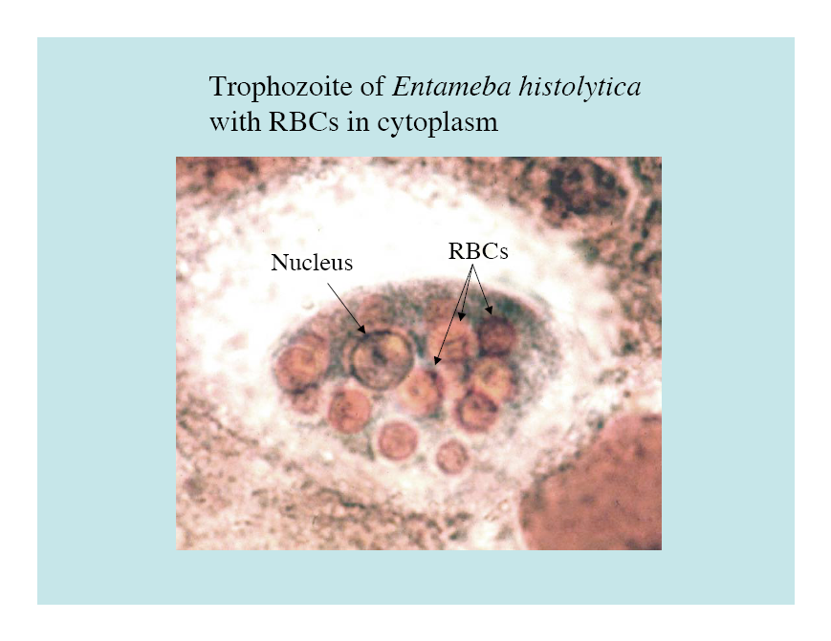
Pathogenesis of Amebiasis
NON-INVASIVE
  Trophozoites colonize , adhere to the mucus layer and ingest bacteria and cellular debris from the lumen
  Usually result in asymptomatic diasease (cyst passer), or
  Exhibits symptoms ranging from mild abdominal discomfort to non-dysenteric diarrhea and cramps
INVASIVE
  The non-invasive infection can persist or progress to an invasive by
    Penetration of mucus layer
    Contact-dependent killing of epithelial cells
    Breakdown of tissues (extracellular matrix)
    Contact-dependent killing of neutrophils, leukocytes, etc.
    necrosis of mucosa → ulcers, dysentery

Slide 27
Pathogenesis
Trophozoites divide and produce extensive local necrosis in the large intestine (secrete proteolytic enzymes( histolysine) and cytotoxic substances (cytotoxin) for cytolysis and tissue destruction leading to tissue necrosis)
Trophozoite invasion into the deeper mucosa with extension into the peritoneal cavity leading to secondary involvement of other organs, such as the liver, lungs, brain, and heart.
Amoebas multiply rapidly in an anaerobic environment, but the trophozites are killed by ambient oxygen concentration.

Slide 28
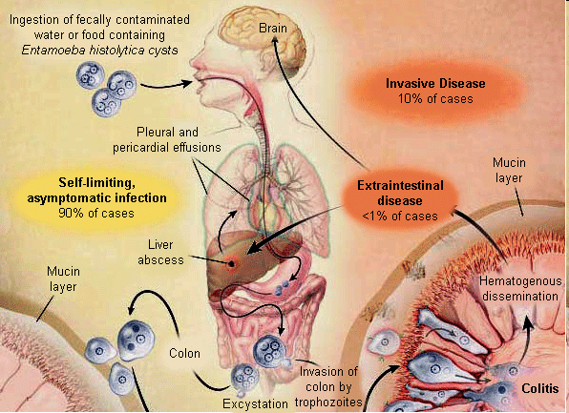
Clinical outcome
Intestinal
Extra-Intestinal
Asymptomatic carriers
Symptomatic nondysentric inefction
Amoebic colitis
Fulminant colitis
Amoeboma
Perianal ulceration
Liver
Lung
Brain
Cutaneous and genital diseases

Slide 29
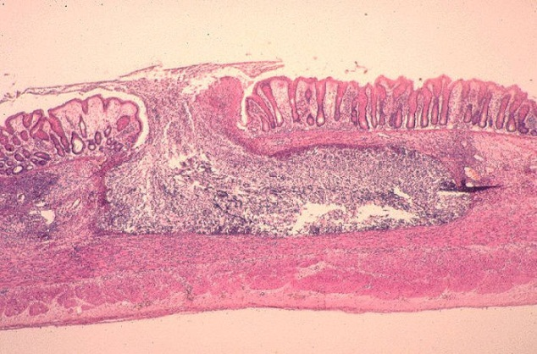
Asymptomatic carriers (non invasive form)
- 90% without symptoms
- does not damage lumen
Symptomatic non-dysenteric
-Diarrhea, cramps, flatulence, nausea
Invasive forms:
Amoebic colitis
- flask shaped ulcers superficial or deep
- abd pain, diarrhoea, blood in stool, fever
- tenesmus, peri-anal ulcers, cramping ,
-anorexia, weight loss, chronic fatigue
Ulcer Enlargement can lead to secondary infection and extraintestinal lesions

Slide 30
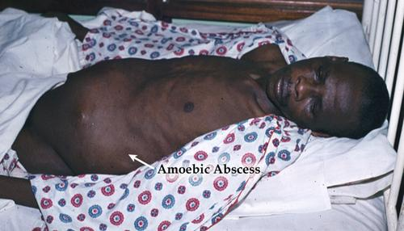
Fulminant colitis - <0.5%
- severely ill with high fever
- intestinal bleeding
- perforation
- paralytic ileus
Amoeboma
- 1% of cases
- inflammatory thickening of intestinal wall leading to obstruction
- palpable mass with trophozoites

Slide 31


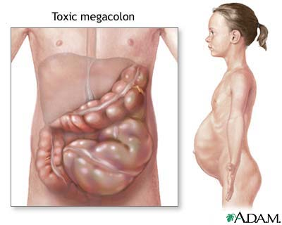
Clinical manifestations
A. Acute amoebic dysentery
Slight attack of diarrhea, altered with periods of constipation and often accompanied by tenesmus.
Diarrhea, watery and foul-smelling stools often containing blood-streaked mucus.
Nausea, flatulence and abdominal distension, and tenderness in the right iliac region over the colon.

Slide 32

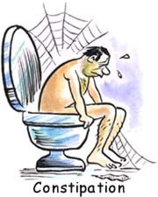

B. Chronic amoebic dysentery
Attack of dysentery lasting for several days, usually succeeded by constipation.
Tenesmus.
Anorexia, weight loss and weakness.
Liver maybe enlarged.
The stools at first are semi-fluid but soon become watery, blood, and mucoid.
Vague abdominal distress, flatulence, constipation or irregularity of the bowel.
Mild anorexia, constant fatigue and lassitude
Abdomen lost its elasticity when picked---up between fingers.
On sigmoidoscopy, scattered ulceration with yellowish and erythematous border.
Gangrenous type of stool

Slide 33
Symptom | Bacillary dysentery | Amoebic dysentery
Onset | Acute | Gradual
General Condition | Poor | Normal
Fever | High grade | Little fever (adult)
Tenesmus | Severe | Moderate
Dehydration | Frequent | Little dehydration (adult)
Faeces | No trophozoites | Trophozoites present
Culture | Positive | Negative

Slide 34
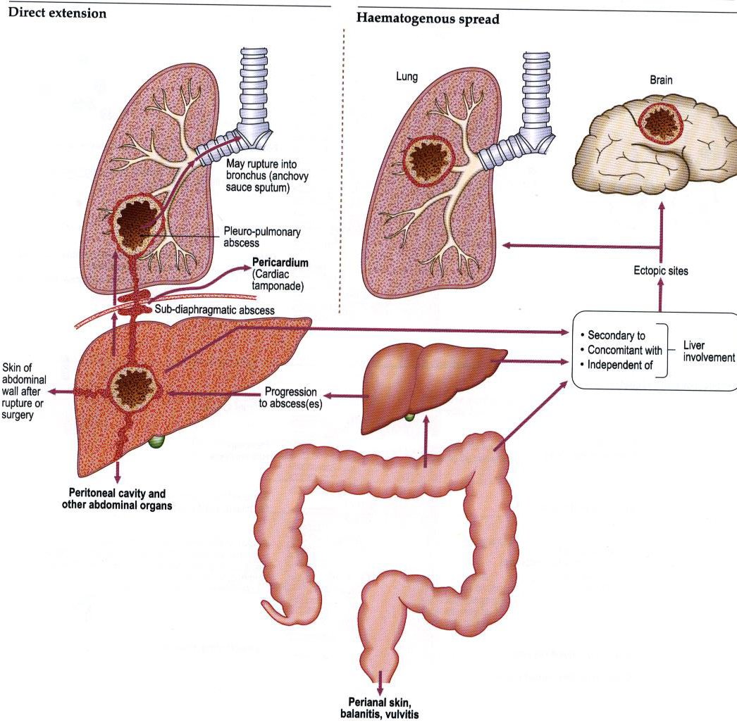
Extraintestinal Amoebiasis
Amoebic liver abscess
    via portal system
    5% of invasive disease
    10 times more common in men
Pleuropulmonary
  - direct spread from liver abscess (10%)
  - haematogenous spread
Brain
  - abrupt onset & rapid progression
  - death in 12-72 hrs

Slide 35
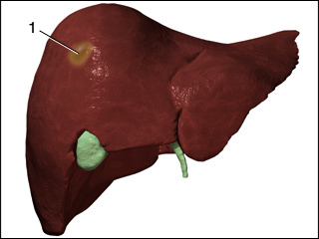
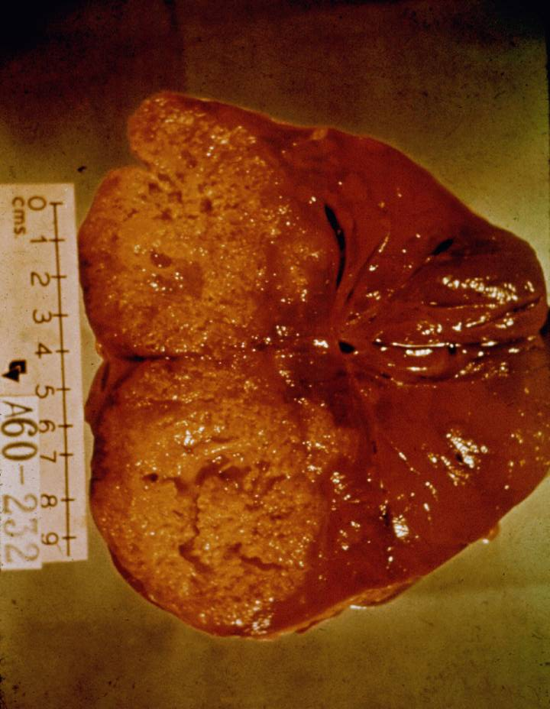
Amoebic liver abscess
Most common form of extraintestinal amebiasis
symptoms are right upper quadrant pain and fever
Fast growing abscess filled with:
  chocolate-colored ‘pus’
    necrotic material
    usually bacteria free
    amoebae are found only at borders

Slide 36
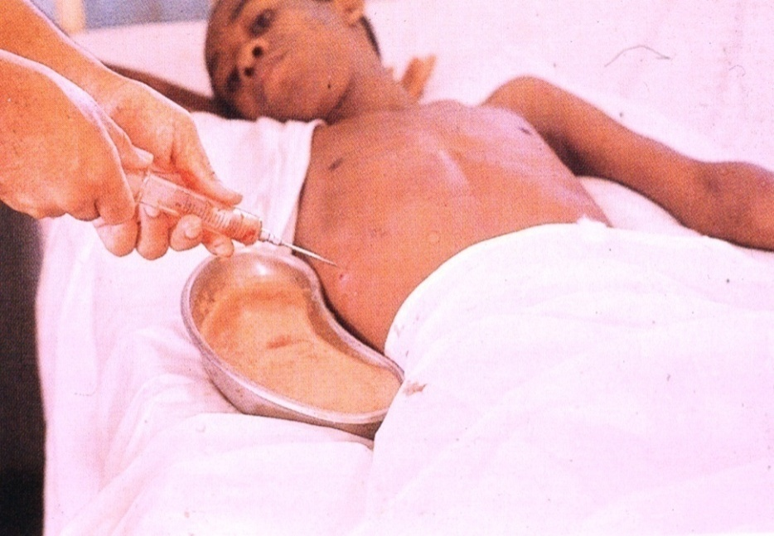
Amoebic liver abscess
30-50% of patients with liver abscess show also pneumonic involvement
Rupture is again a major threat, especially rupture into the pericardium
Draining abscesses is today only performed in extreme cases when rupture is feared

Slide 37
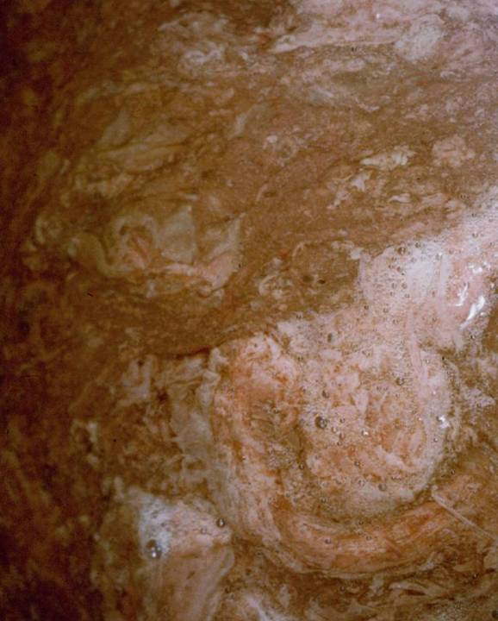
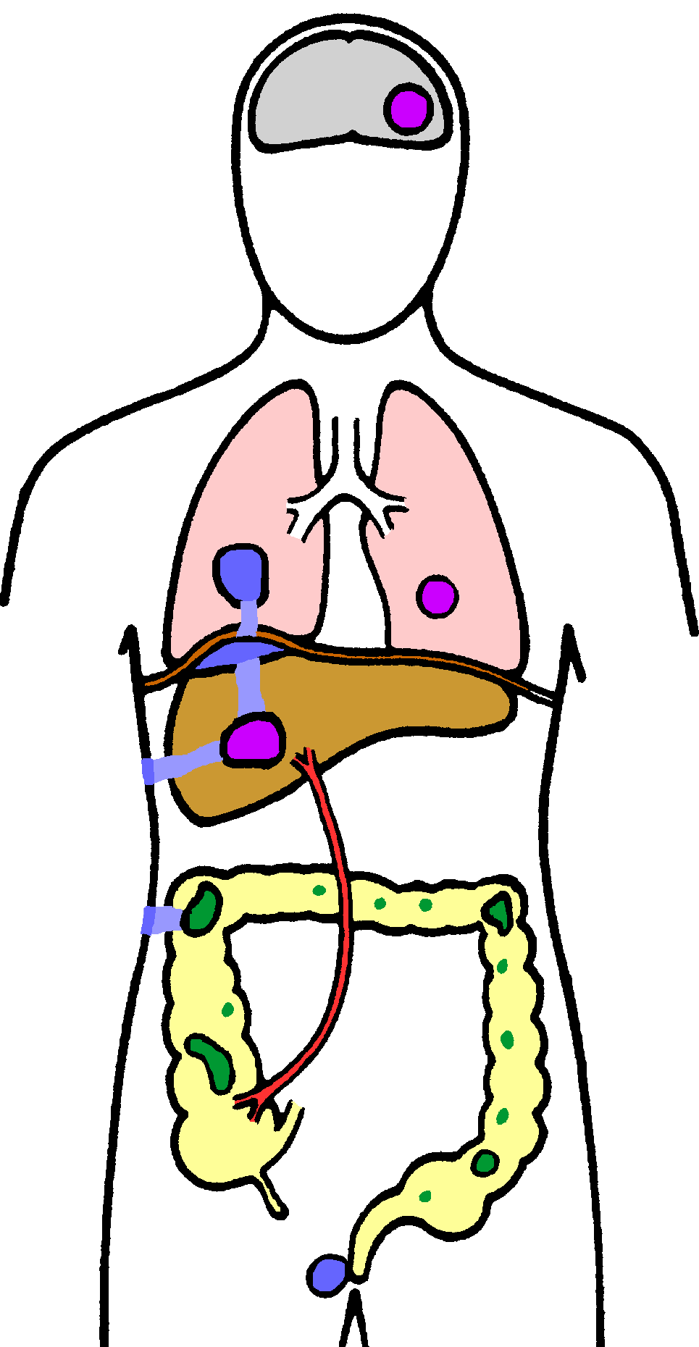
Pulmonary Amoebiasis
rarely primary
rupture of liver abscess through diaphragm
2º bacterial infections common
fever, cough, dyspnea, pain

Slide 38
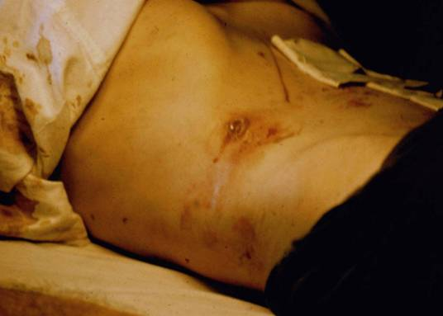
Cutaneous Amoebiasis
intestinal or hepatic fistula
mucosa bathed in fluids containing trophozoites
  perianal ulcers
  urogenital (eg, labia, vagina, penis)

Slide 39
Laboratory diagnosis
1. Microscopic examination of faecal specimens
2. Immunodiagnosis
  Antigen detection
  Antibody detection
3. Molecular techniques
4. Culture method
Choice of diagnostic techniques depends on
    Available equipment and reagents
    Experience
    Time and cost

Slide 40
1. Microscopic examination of faecal specimen
Examination of fresh diarrheic or dysenteric faecal specimen or rectal scraping for motile trophozoites
      Direct saline wet mount
      Permanently stained preparations (e.g. trichrome)
  Specimen for the identification of trophozoites must be examined without delay
      lose their motility, extrude vacoules containing red cells, and finally round up

Slide 41
Examination of formed or semi-formed faecal specimen for cysts
    Wet mount with or without iodine stain
    Smear after concentration
    Preserved stool (10% formalin, PVA ,etc…)
  To maximize recovery of cysts, stool samples should be concentrated prior to microscopic exam
Charcot-Leyden crystals may also be found in a fecal smear having E. histolytica

Slide 42
Specimen Collection and processing
Collect the stool in a dry, clean, leak proof container
Make sure no urine, water, soil with stool
Fresh stool should be examined, processed, or preserved immediately
Specimen collection may need to be repeated if the first examination is negative
  If possible, three specimens passed at intervals of 2-3 days should be examined

Slide 43
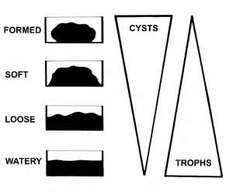
Distribution of protozoa in relation to stool consistency

Slide 44
PREPARATION OF SLIDES FOR MICROSCOPIC EXAMINATION
In many instances amoebae can be identified by examining the 1st two types of preparations;
  Initial Wet Mount Slide
  2. Concentrate Wet Mount Slide
  3. Permanent stained slide
  4. Culture slide

Slide 45
Primary prevention
Sanitation Water Food hygiene Health education
-excreta -protect -protect food -long
-wash hands -sand filter -acetic acid term
-latrines -boiling -detergent
-food handlers
examine
treat
educate
Secondary Prevention
- Early diagnosis
- Treatment

Slide 46
TREATMENT
 | Drug
 | Metronidazole | Tinidazole | Iodoquinol | Diloxanide furoate

Slide 47
NON PATHOGENIC AMOEBAE

Slide 48
Non pathogenic amoebae in Human Intestine
    Several species of amebae are capable of colonizing the human gastrointestinal tract but, in contrast to Entamoeba histolytica, are not considered pathogenic. These include:
    Entamoeba coli
    Entamoeba hartmanni
    Entamoeba polecki
    Endolimax nana
    Iodamoeba bütschlii

Slide 49
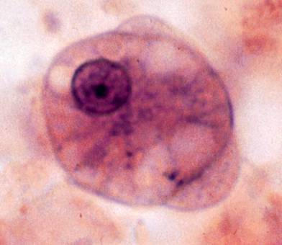
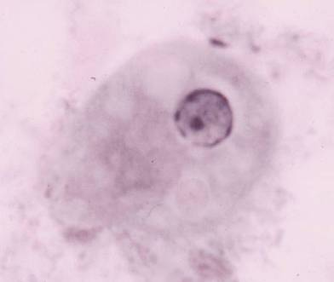
Entamoeba coli
Geographic distribution: Cosmopolitan
  Much more common than E. histolytica
  Definitive Host: Humans
  Intermediate Host: None
Habitat : Both trophozoite and cysts in the large intestine of man
Trophozoite: Size: 15-50μm (average 25μm), usually bigger than E.histolytica
Shape: Oval or elongated
Motility: Sluggish, non -progressive and non- directional - has short blunt pseudopodia
Cytoplasm: Ectoplasm & endoplasm not well differentiated
Nucleus: Single nucleus, visible in the fresh state without
staining
Inclusions: Bacteria, Yeasts, but never RBCs
Notes:
Can survive environmental conditions that kill E. histolytica so more common.

Slide 50
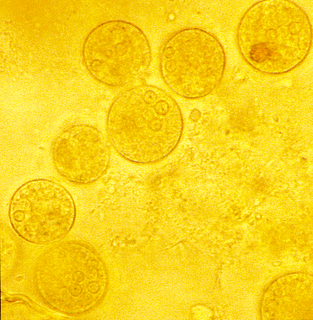
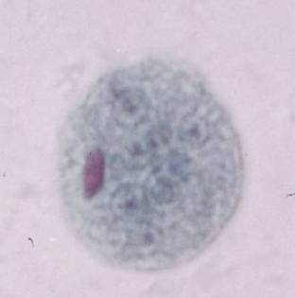
Entamoeba coli
Cyst:
Size: 12-20μm a little larger than the cyst of E.histolytica
Shape: rounded or slightly oval
Nucleus: 1-8 nuclei; thick irregular nuclear membrane
    large, diffuse, often eccentric karyosome
Cytoplasm: bright pale yellow in iodine stained smear,

Slide 51
Entamoeba coli
Mode of transmission
  Ingestion of contaminated food and water by infective cyst
Life cycle: Similar to E.histolytica
Pathology
  Harmless commensal, may cause diarrhea in children
  Feeds on bacteria, yeast, and wastes in intestines
Laboratory Diagnosis
Finding trophozoite & cyst stages in stool specimen
      Can be differentiated from E.histolytica by its larger size
      cyst of E.coli shows a greater variation in shape and size than E.histolytica
        8 nuclei in cyst vs. 4 in E. histolytica
Treatment: Not required

Slide 52
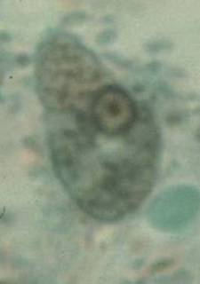
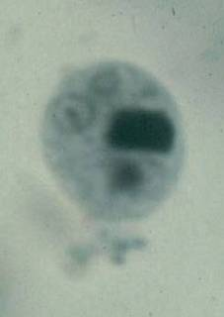
Entamoeba hartmanni
Known as “small race” of E.histolytica because of similarity in their morphology
Geographic distribution: Cosmopolitan
Definitive Host: Humans
Intermediate Host: None
Habitat: both trophozoite and cyst live in the small intestine
Trophozoite: feeds on bacteria ,not red blood cells
Size: 4-12μm, smaller than E.histolytica
Motility : Active but less vigorous directional motility
by finger-like pseudopodia
Nucleus: Single nucleus with fine bead-like coarse chromatine granules on the thick nuclear membrane
  has large central karyosome

Slide 53
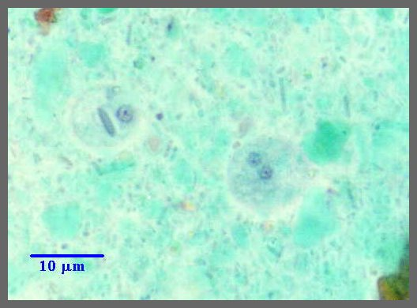
Entamoeba hartmanni
Cyst
    5-10μm in size and spherical in shape
    1-4 nuclei; chromatoidal bars and glycogen mass in the immature cyst stage
Mode of transmission
  through ingestion contaminated food or drink, or from hands contaminated with faeces
Life cycle: similar to E.histolytica
Pathology: Commensal
Laboratory Diagnosis
Finding trophozoite and cyst stages in stool
    Cyst of E.hartmanni is similar to that of E.histolytica / E. dispar but the former is smaller in size
Treatment: Not required

Slide 54
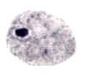
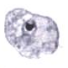
Endolimax nana
Geographical distribution: Cosmopolitan.
  Definitive Host: Humans
  Intermediate Host: None
Habitat: Trophozoite and cyst in the large intestine.
Trophozoite
Size: 6-15μm (average 10μm)
Motility: moving slowly by multiple, small rounded
blunt pseudopodia in all direction
Cytoplasm: very granular with small vacuoles
Inclusion: Bacteria
Nucleus: single large irregularly shaped eccentric
karyosome and thick nuclear membrane with
out lining of chromatin granules

Slide 55
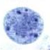
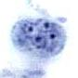
Endolimax nana
Cyst
Size: 8-10μm
Shape: oval
Nucleus: 1-4 nuclei large, irregular karyosome
Cytoplasm: Deep yellowish color in iodine smear
Mode of transmission
Ingestion of contaminated food and water with matured cyst stage
Life Cycle: similar to E.histolytica
Pathology: harmless commensals, feeds on bacteria
Laboratory Diagnosis: finding of the cyst and trophozoite stages in fecal smear
Treatment: Not required

Slide 56
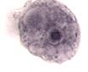
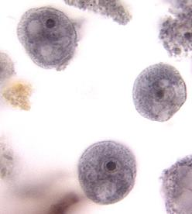
Iodamoeba buetschlii
Geographical distribution: Cosmopolitan
    Definitive Host: Humans, other primates, and pigs
      Most common in pigs
        Probably the original host
    Intermediate Host: None
Habitat: both trophozoite and cyst in the large intestine
Trophozoite
Size: 10-25μm
Shape: compact, leaf -like
Motility: Sluggish by clear, rounded, finger like pseudopodia
Nucleus: single, no chromatin granules on the nuclear
membrane and has large karyosome surrounded by
achromatic granules
Inclusion: bacteria; large food vacuole packed with
glycogen mass that stains deep brown with iodine
solution
Larger than E. nana
Many clear vacoules
Notes:
We will see many parasites that inhabit both pigs and humans.
Two reasons:
similar internal organ size and location and
close contact between pigs and their human owners (some as close as dogs and cats).
Not because we are closely related evolutionarily. Humans share many parasites with other primates because of our close evolutionary histories (parasite invaded and stayed as we evolved).

Slide 57
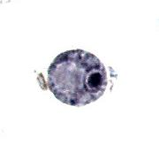
Iodamoeba buetschlii
Cyst:
Size: 8-10 μm
Shape: rounded, oval or irregular
Nucleus: single, very large oval karyosome surrounded
with cluster of granules
Vacuole: very large glycogen vacuole often taking up half
part of the cyst and stains brownish red by iodine
solution
Mode of transmission: Ingestion of contaminated food and water with mature cyst stage
Life Cycle: similar to E.histolytica
Pathology: harmless commensal
  Feeds on bacteria, yeast, and wastes in intestines
Laboratory diagnosis: Finding of trophozoite and cyst stages in faeces
Treatment: Not required
Very similar to E. nana but larger
Large, single, clear vacoule.

Slide 58
E. dispar, E. moshkovskii, and E. bangladeshi
Other morphologically-identical Entamoeba spp., including E. dispar, E. moshkovskii, and E. bangladeshi, are generally not associated with disease although investigations into pathogenic potential are ongoing.
While the discussed species are morphologically-identical, E. histolytica may be observed with ingested red blood cells (erythrophagocytosis);
E. dispar may occasionally be seen with ingested erythrocytes as well, although its capacity for erythrophagocytosis is much less than that of E. histolytica.

Slide 59
Thank you

