Slide 1

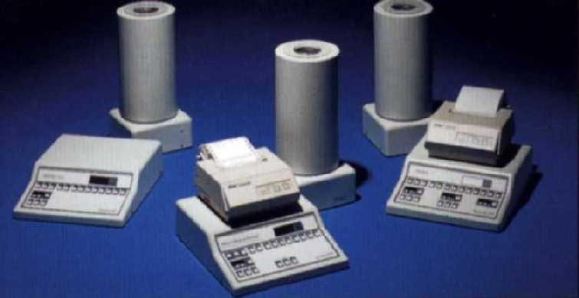
IAEA
NON-IMAGING NUCLEAR MEDICINE INSTRUMENTS
BANA REMY

Slide 2
CONTENTS
–Detectors and electronic
– Dosimeter and contamination monitors, “in vitro” and “in vivo” measuring equipment
–Activity calibrators
–Quality Control of activity calibrators

Slide 3
Nuclear Medicine equipment, according to the radiation detection method
Gas Filled Detectors
Scintillation Detectors
Semiconductor detectors

Slide 4
Ionizing radiation detection
-
α, β, γ
+
+
+
-
E
N = b _{ε}
-
-
+
Electrons and cations are produced.
In the absence of an electric field, the charged particles recombine with each other or produce chemical reactions.

Slide 5
Nuclear Medicine equipment, according to the radiation detection method
Anode (+)
-
Cathode (-)
+
-
+
-
+

Slide 6
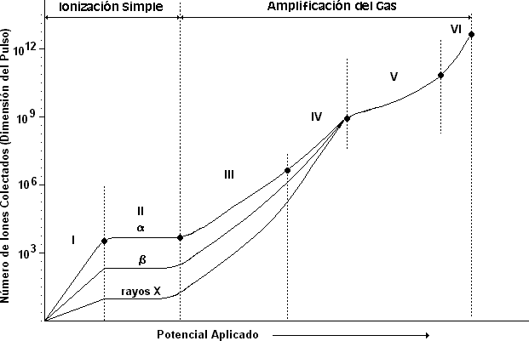
Gas Filled Detectors
Region I - Recombination region. Region II – Saturation region Region III - Proportional region.
Region IV - Region of limited proportionality. Region V - Region Geiger - Mueller.
Region VI – Region of continuous discharge.
Amplitude of output pulse
Applied Voltage

Slide 7
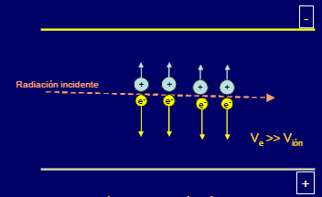
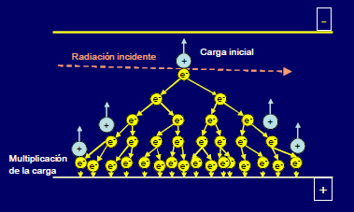
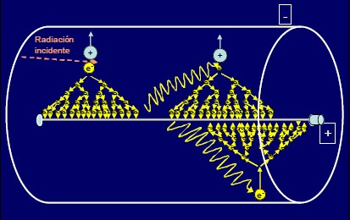
Gas Filled Detectors
Saturation región
(All produced charges are collected)
Proportional región (additional ionization produce a gas amplification factor)
Geiger – Mueller region (avalanche ionization)

Slide 8
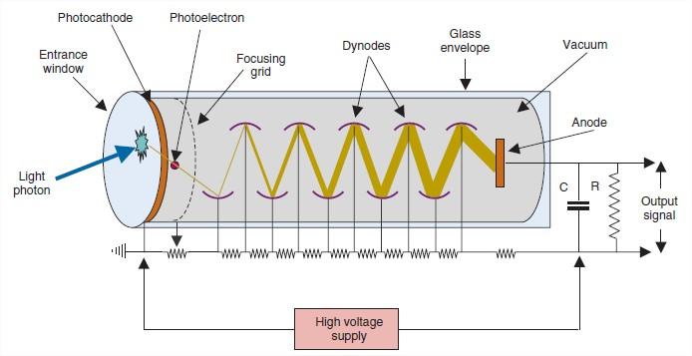
Scintillation detectors
Basic principles of scintillation detectors
(Cherry, Sorenson and Phelps)

Slide 9
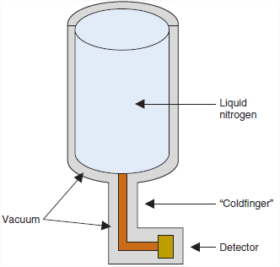
Semiconductor detectors
The detector principles are similar (solid state analogs) to gas-filled
detectors (ionization chambers)
Detector materials are Si-GE, CdT, CZT.
Detectors are 2000 to 5000 times more dense than ionization chambers
Better energy resolution
Better detection efficacy
Noise current at room temperature restricting their efficiency for
detection.
(Cherry, Sorenson and Phelps)

Slide 10
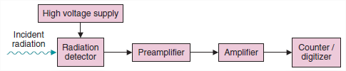
Electronic components for a nuclear radiation counting system
Amplifier functions:
to amplify the still relatively small pulses
To reshape the slow decaying pulse from the To improve SNR.
Pre-amplifier:
To amplify the small signals produced by the radiation
detector,
To match impedance levels between the detector and subsequent components in the system
To shape the signal pulse for optimal signal processing by the subsequent components.
Basic principles of scintillation detectors
(Cherry, Sorenson and Phelps)

Slide 11
Nuclear Medicine measurement equipment, according to their function
Contamination monitors, dosemeters
“In vitro” measurement equipment
“In vivo” measurement equipment
  Non – imaging equipment
  Imaging equipment (main current NM equipment)
Dose calibrators

Slide 12
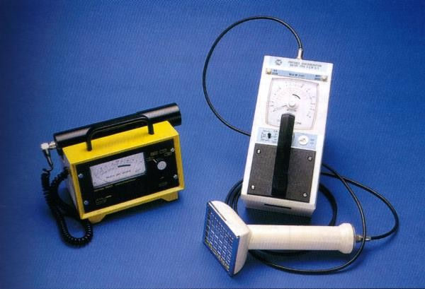
Dosimeters and contamination
monitors

Slide 13
Characteristics and use
Monitoring equipment are usually portable devices.
They use mainly gas ionization or solid state detectors.
Their main use is to monitor radiation dose levels. They are usually calibrated in C.kg.h in air for exposure levels or in count rate (cpm) to measure surface contamination.

Slide 14
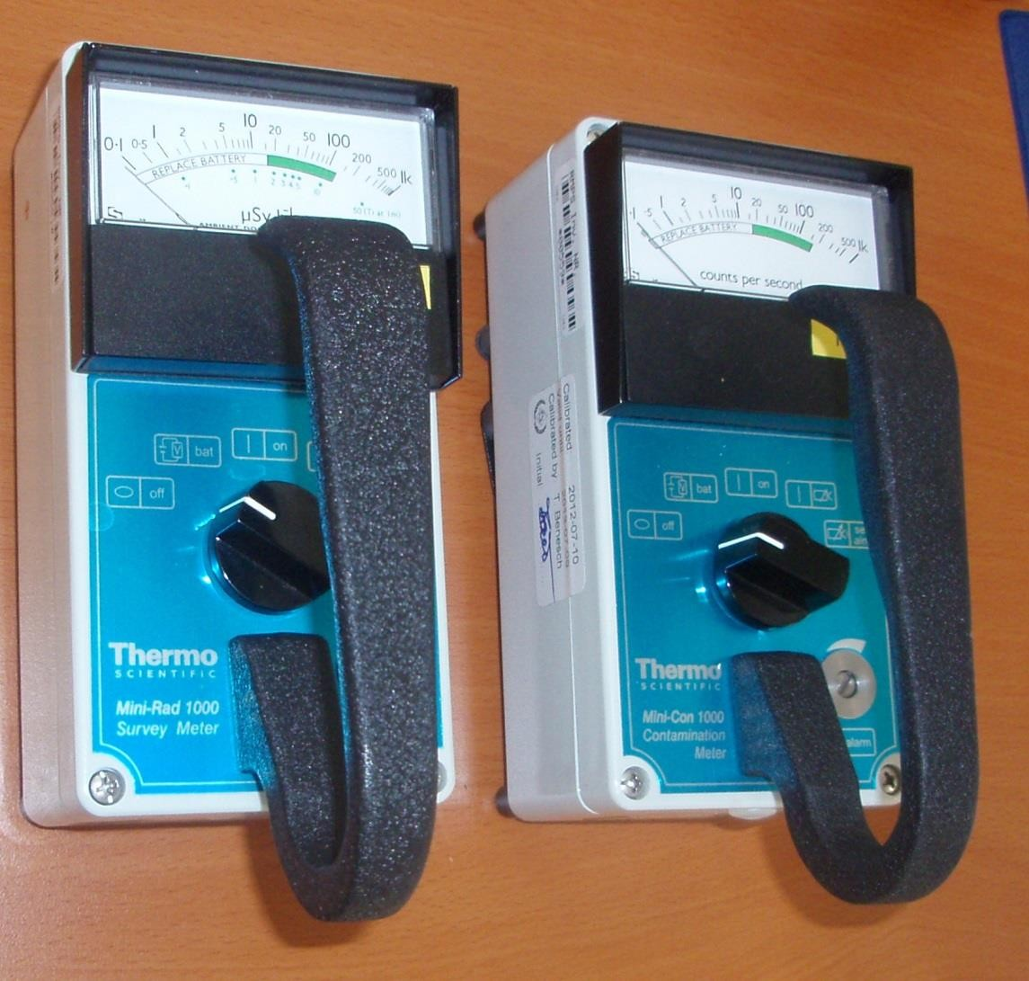
Dosimeter and contamination
monitor

Slide 15
Detectors used
The most popular is the geiger detector, due to its high sensitivity. It is used to measure low dose rates and low contamination levels, usually found in Nuclear Medicine departments.
Solid state detectors are only used for the measurement of count rates and not exposure, as their crystal is not equivalent to air.

Slide 16
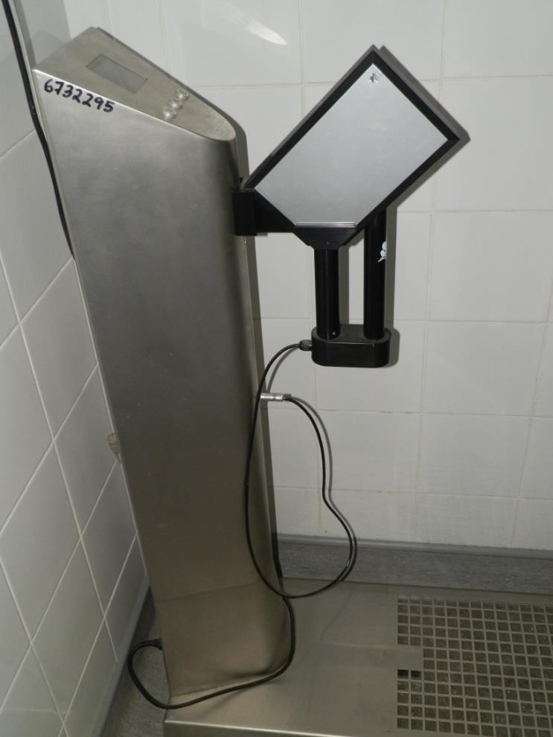
Stationary contamination monitor
It is used to monitor personnel contamination at the entrance/exit of controlled areas (i.e. radiopharmacy).
These monitors can measure hand and feet radioactive contamination, using a set of upper and lower detectors.
Usually, the upper detector can be removed from the stand, to measure contamination of protective clothing.

Slide 17
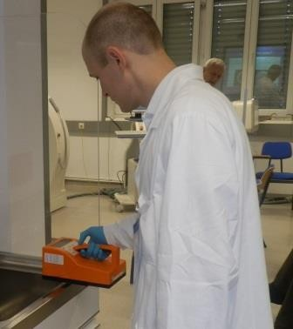
Portable monitors
They are used to monitor working areas which can be potentially contaminated (work benches, laminar flows, isolators, glove boxes, active sinks, etc.).
In areas where dose rate from external sources could be high (i.e. near the radionuclide generator), radioactive contamination cannot be evaluated by direct measurements.
Other methods should be employed, such as wipe tests and measurement of wipe samples in calibrated well counters.

Slide 18
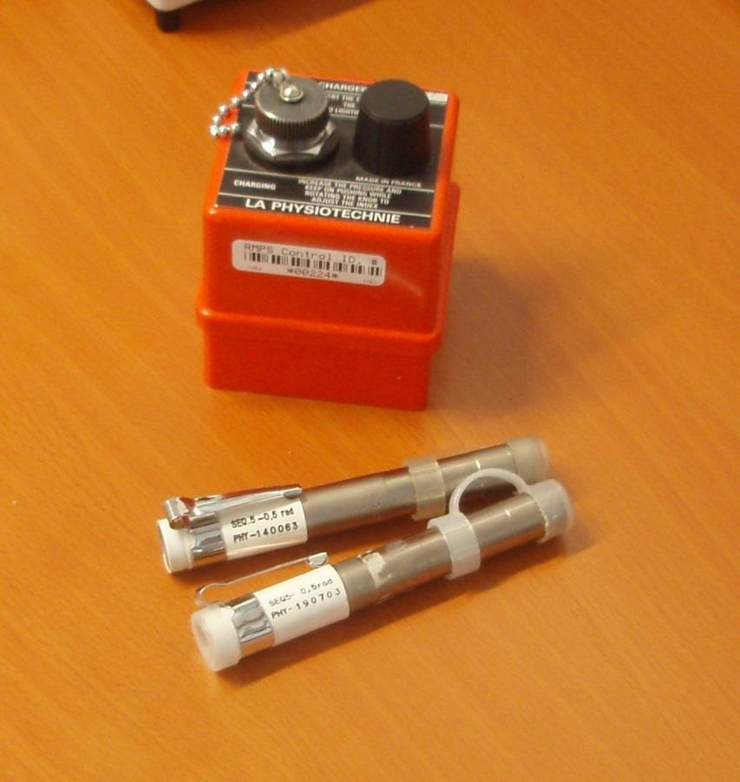
Portable ionization chambers
They are used as an alternative method for personnel monitoring, aside from film or TLD dosemeters.
They are useful in areas where high levels of activities are manipulated (i.e. dispensing therapy doses in the radiopharmacy), where an immediate reading of dose levels could be necessary to implement rotation of personnel to maintain staff dose within acceptable levels.

Slide 19
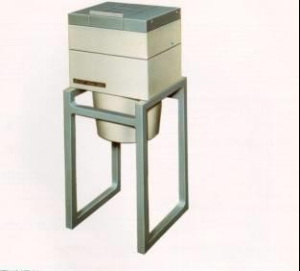
“In vitro” measuring equipment

Slide 20
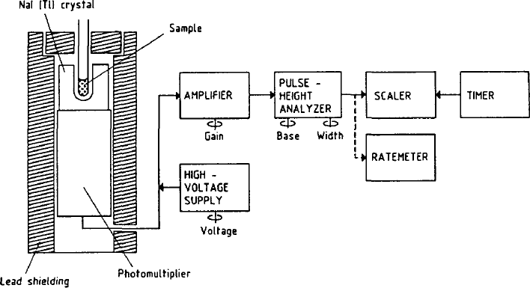
Well counter
Components of a well counter:
INa (Tl) detector
Photomultiplier tube
High voltage supply
Preamplifier
Amplifier
Pulse height analizer
Display
  Counter
  Ratemeter
Block diagram of well counter

Slide 21
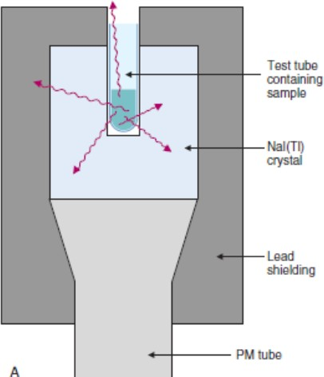
Characteristics of well counters
They use scintillation detectors, typically INa(Tl), with a well to accommodate samples, providing a high counting efficiency.
These detectors are quite sensitive and they measure sample activities from few kBq up to roughly 100kBq.

Slide 22
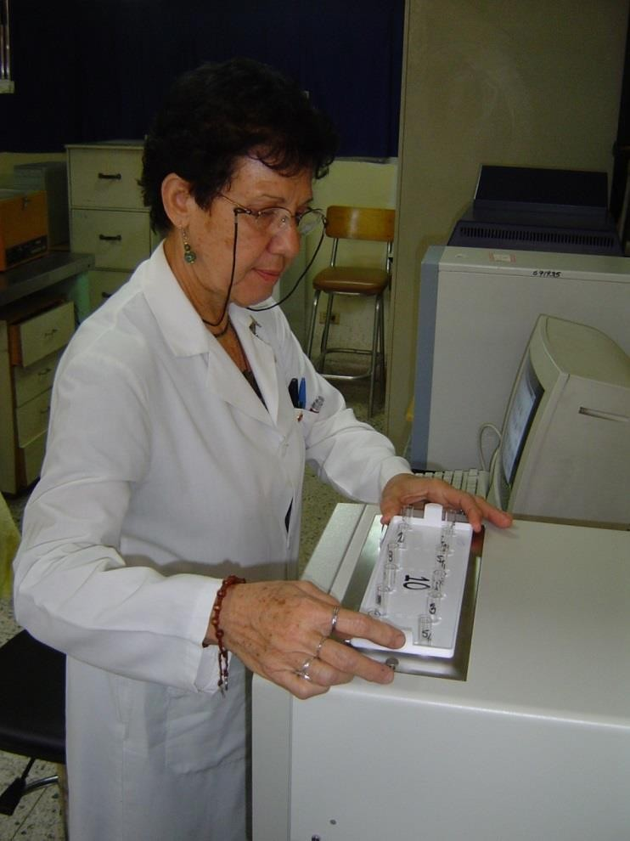
Use of well counters
They are mostly used to measure biological samples (i.e. blood, urine, etc.), radioimmunoassays and other related assays, radiopharmaceutical quality control samples and others.
They are also used to count wipe tests samples, to evaluate radioactive contamination of surfaces within the service.

Slide 23
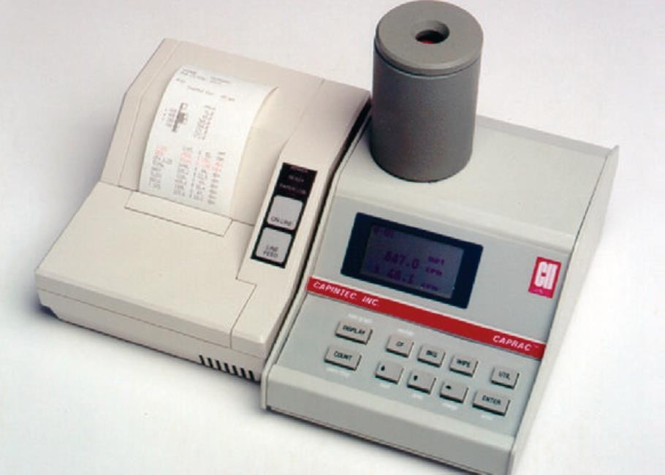
Manual well counter
It is a very simple equipment to operate. It is generally fitted with a single channel analizer, to select the isotope to be measured.
It is used when the number of samples to be measured is small.
They generally use INa(Tl) detectors 4.5x4.5 cm to measure 125I and 99mTc.
For higher energies, (i.e. 59 Fe) bigger detectors should be used.

Slide 24
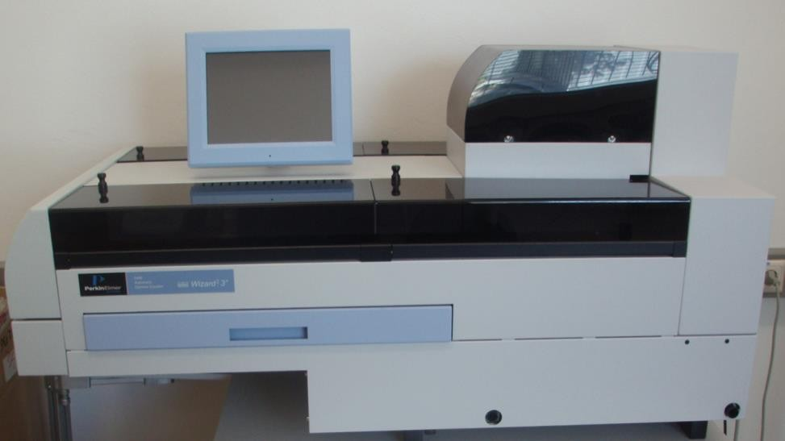
Automatic γ counter
It is capable of continously counting big number of samples, usually hundreds.
Its most frequent use is counting radioimmunoassays and other similar assays.
Their detectors are usually designed for low energies (125I-35keV)

Slide 25
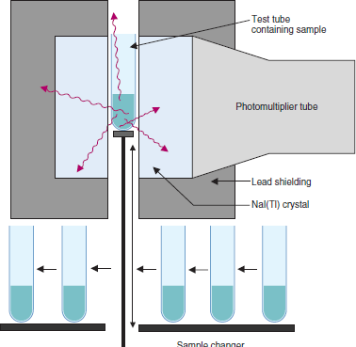
Sample positioning in automatic
counters
They usually have “drilled- through” detectors, which facilitate a central positioning of samples, for
a better counting geometry. This is useful for variable volume samples.
“Crosstalk” effects are more significant for higher energy radionuclides than for 125I (i.e. 131I, 51Cr).

Slide 26
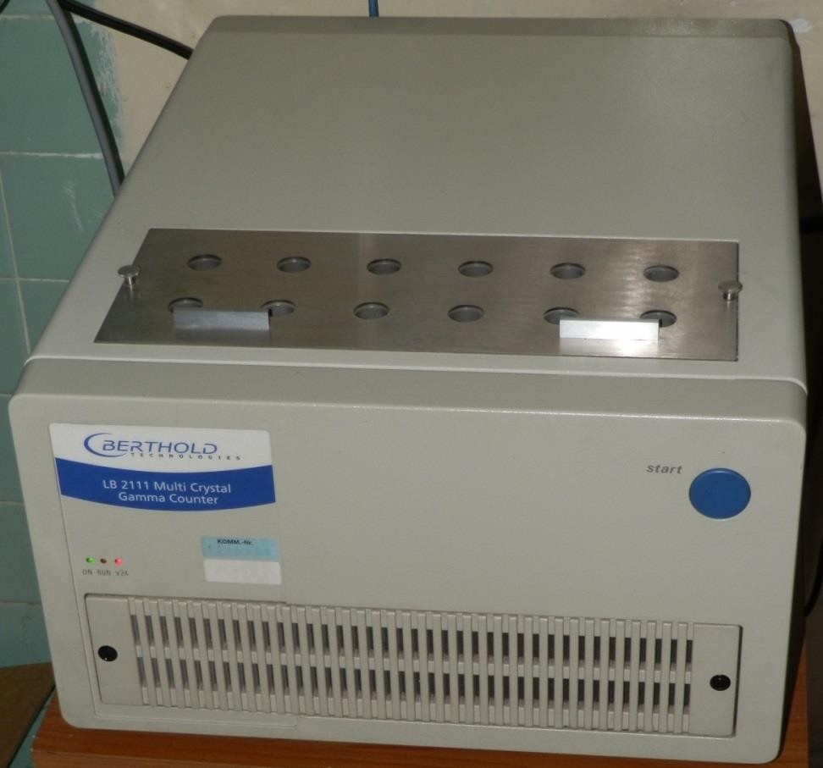
Mutidetector manual counter
It is a cost-efficient alternative to automatic counters.
Not having moving mechanical parts make them quite robust.
A RIA kit of 100 samples can be counted in less than 10 min, which makes them faster than many automatic counters.

Slide 27
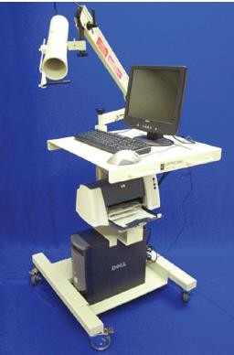
“In vivo” measurement equipment

Slide 28
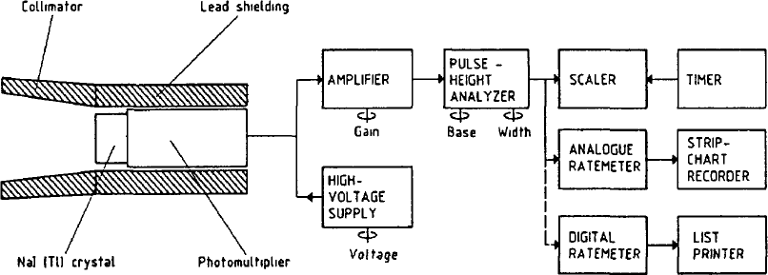
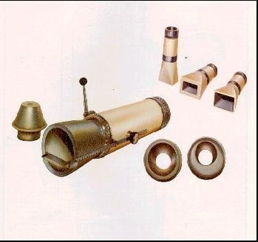
Characteristics and use
“In vivo” counting systems add a new element when compared to “in vitro” counting systems: the collimator. This gives these systems a new characteristic: their “directionality”.
Background counts are higher in these counters, due to the activity distribution in nearby structures.
They are used to determine the uptake of radiopharmaceuticals in organs and tissues, detecting higher levels of activity than well counters, due to their lower geometric efficiency.

Slide 29
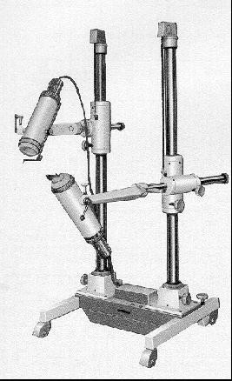
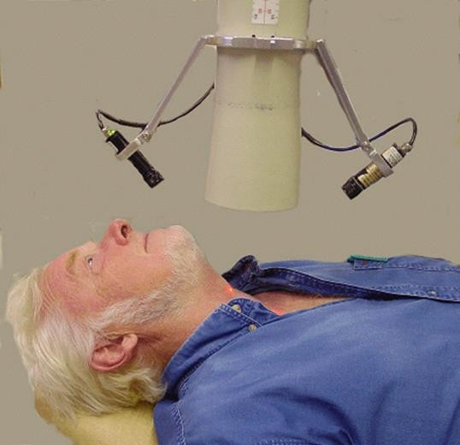
Directional probes
The shielded and collimated detector is positioned by adjustable support structures, facilitating patient- detector relative positioning

Slide 30
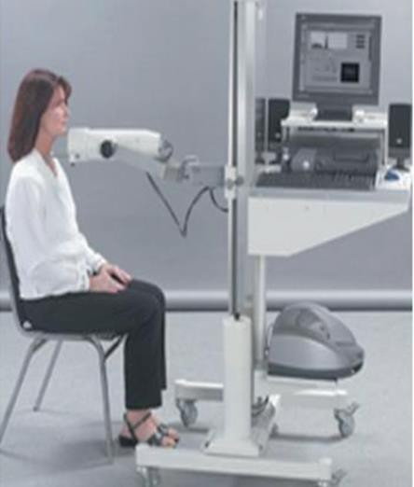
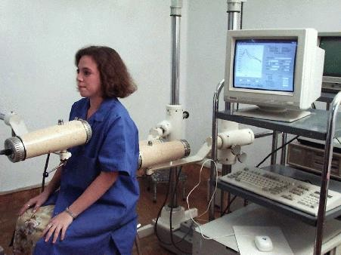
Examples of directional probes
Thyroid uptake probe • Renography
Not currently used, mostly due to imaging procedures that have replaced these measurements
These probes are still produced,
currently coupled to computer systems

Slide 31
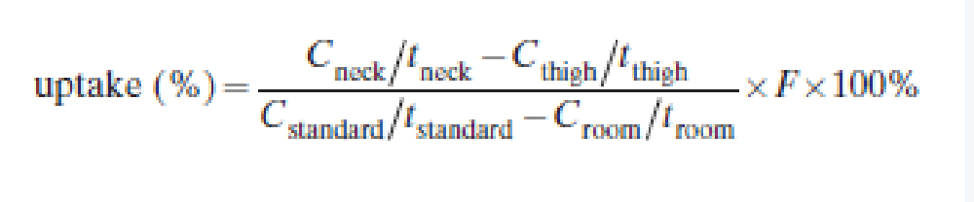


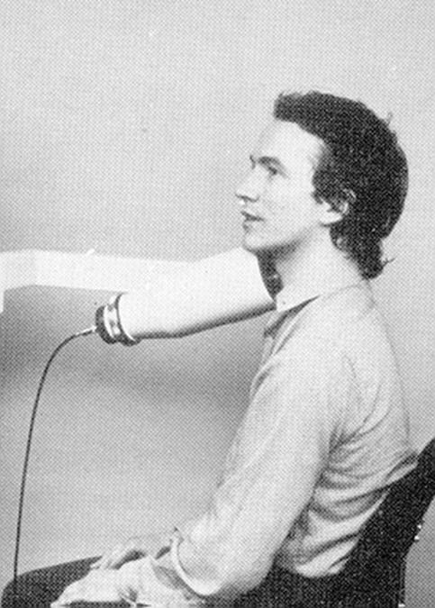
Use: thyroid uptake
.

Slide 32
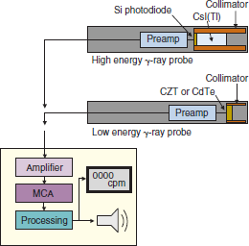
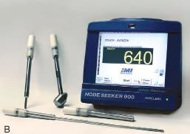
Block diagram of gamma probe
These gamma probes use scintillation or semiconductor detectors, according to the energy of the detected radiation.

Slide 33
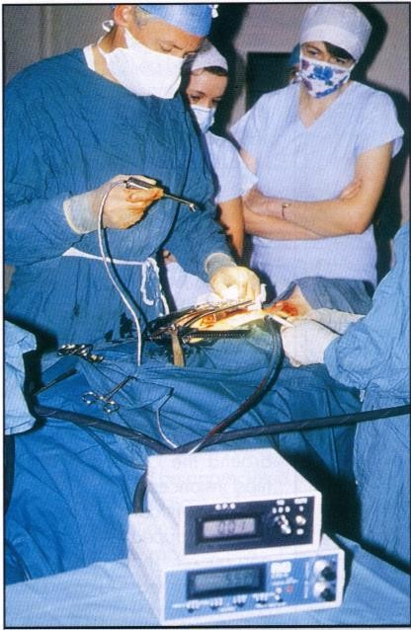
Other uses: intraoperatory probes
They have been successfully employed in sentinel node detection (99mTc nanocolloids), parathyroid adenomas (99mTc-MIBI) and other hard to detect organs in the operating theatre.
Use of beta probes is currently increase in clinical practice (Radioguided surgery)

Slide 34
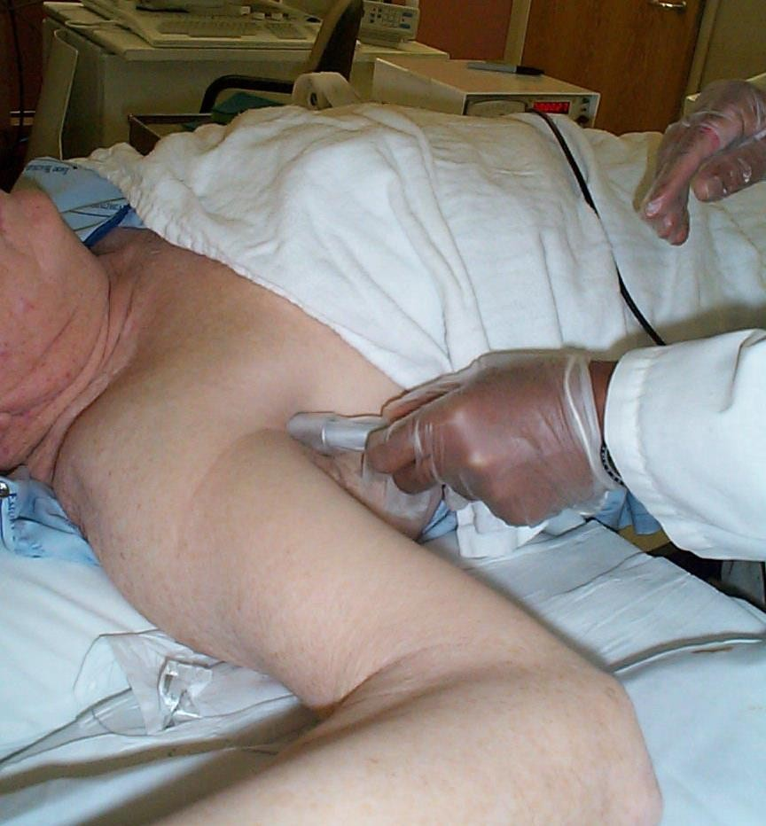
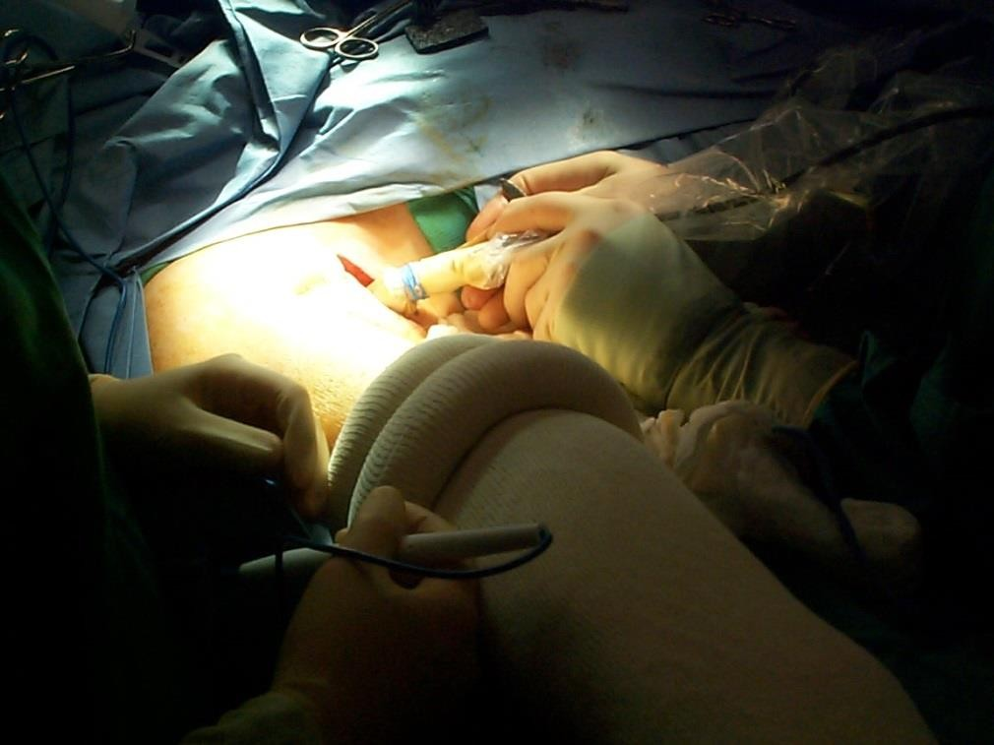
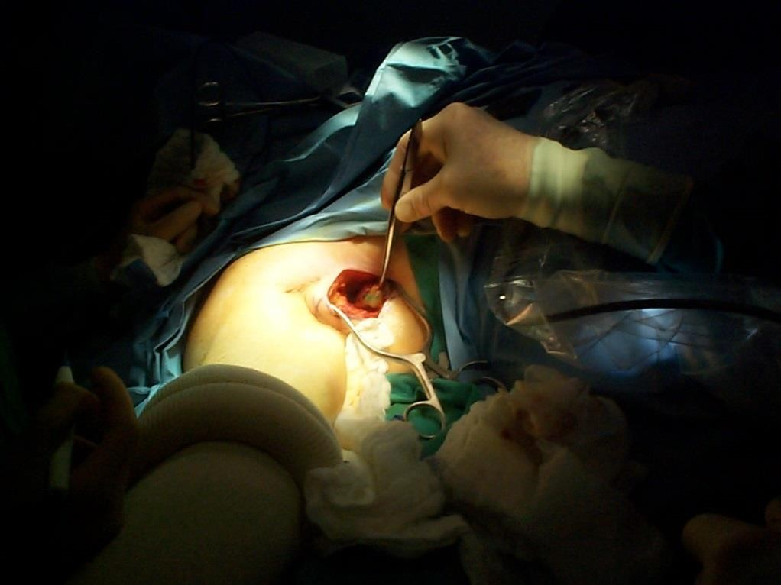
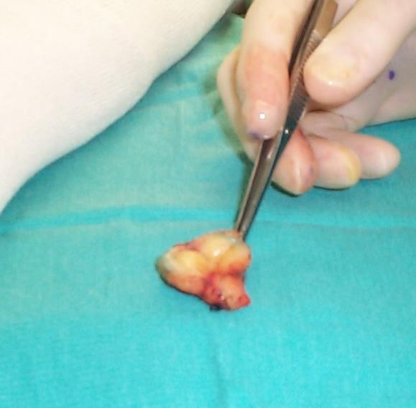
Intraoperative Gamma Probes
Pictures by Patti Langford, CNMT

Slide 35
Gamma Probe Anatomy
Scintillation
Examples:
NaI(Tl) CsI(Tl) CsI(Na) LSO
Crystal
PMT
Crystal
Photodiode
Optical Fiber
Crystal
_{P}P_{M}M_{T}T
Examples:
Solid State
CdZnTe (CZT)
CdTe
Semiconductor Detector

Slide 36
Collimators and Shields
Longer Bore
  Better resolution
  Lower Sensitivity
Higher Energy
  More Shielding
  Bulkier Probe
Variety between Manufacturers
  Built-in
  Removable
Collimator
Shield

Slide 37
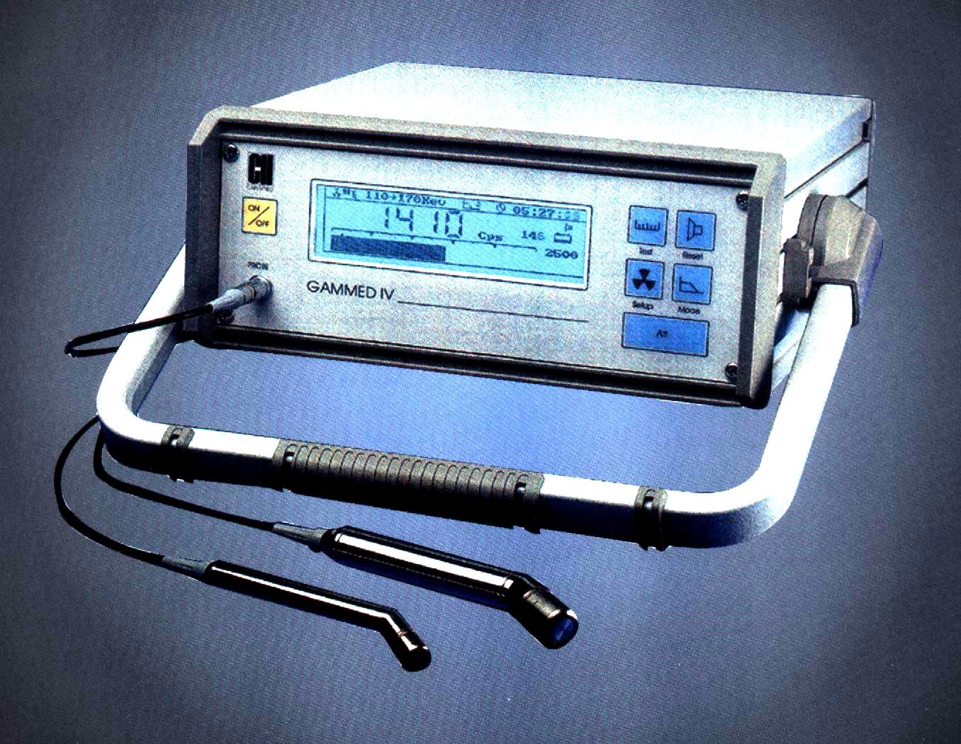
Capintec: Gammed IV
CdTe Semiconductor
– 15-170 keV
  Length = 105 mm
  Diameter = 11 mm
CsI(Tl) Scintillator with Photodiode
  100 keV - 1 MeV
  Length = 110 mm
  Diameter = 16 mm

Slide 38
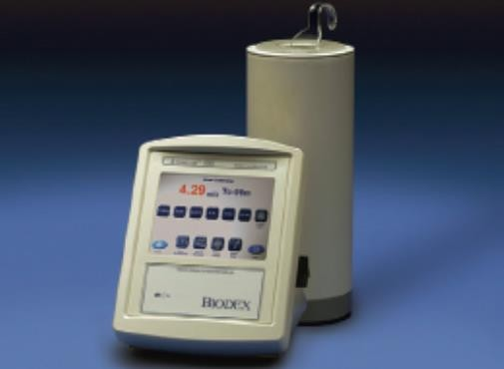
4. Dose calibrators

Slide 39
RADIONUCLIDE ACTIVITY CALIBRATORS
These instruments are capable of providing radioactivity measurements to within the required accuracy levels (for clinical activities in nuclear medicine).
It includes:
  Measurement of the radioactivity to be administered to the patients.
  Preparation of calibration sources for QC of nuclear medicine instruments.
  Quality Control of radiopharmaceuticals.
Radioactivity range: MBq to GBq (μCi to Ci).
Radionuclide activity calibrators are considered an important component for the patient radiation protection.

Slide 40
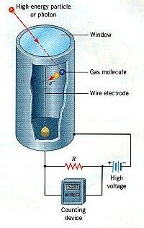
RADIONUCLIDE ACTIVITY CALIBRATORS
The typical instrument for assaying radiopharmaceuticals is the pressurized, well-type ionization chamber.
¿Why ionization chambers?
The ionization chamber is the simplest of all gas-filled radiation detectors.
Low cost.
Good detection efficiency.
Long term stability.
Excellent reproducibility.

Slide 41
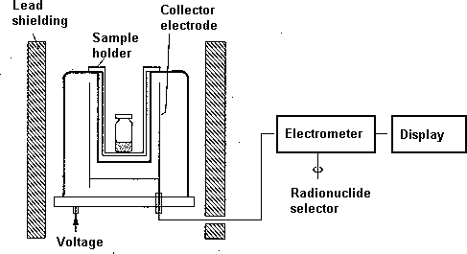
RADIONUCLIDE ACTIVITY CALIBRATORS
COMPONENTS
The well-type ionization chamber is filled with a gas under pressure (e.g. Xenon, argon, nitrogen, gas mixture) .
Typically a pressure of 10-20 atmospheres is used.
Two co-axial cylindrical electrodes
Voltage: 100-500V

Slide 42
RADIONUCLIDE ACTIVITY CALIBRATORS
ELECTROMETER
- The ionization current is converted to a voltage signal, which is amplified, processed and finally displayed (units: Bq or Ci) .

Slide 43
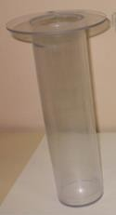
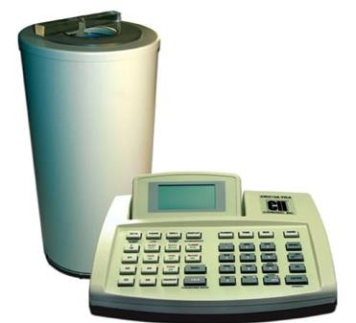
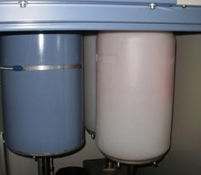
RADIONUCLIDE ACTIVITY CALIBRATORS
WELL LINERS
A removable liner that can be easily cleaned in the event of accidental radioactive contamination of the chamber well is usually provided.
Lead Shieldings

Slide 44



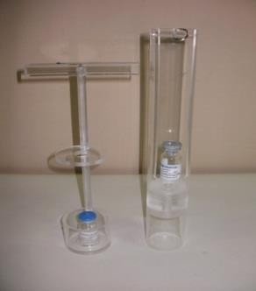
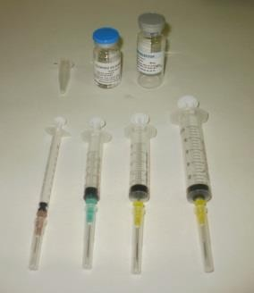
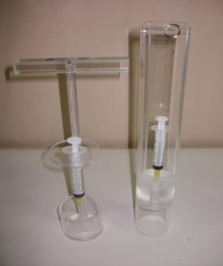
GEOMETRIC EFFICIENCY
Increasing geometric efficiency
The quotient: number of photons reaching the detector over the number of photons emitted from the sample depend on the geometry

Slide 45
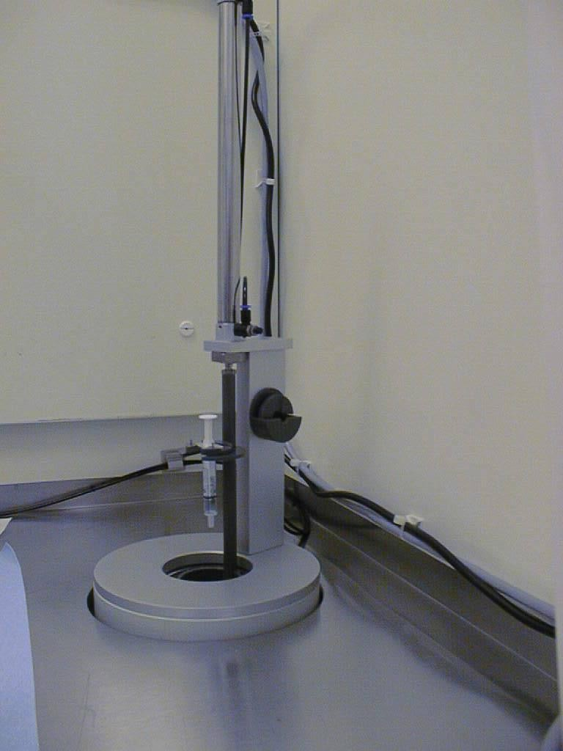
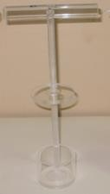
SOURCE HOLDER
Reproducible Geometry
(Material: Low Atomic Number)

Slide 46
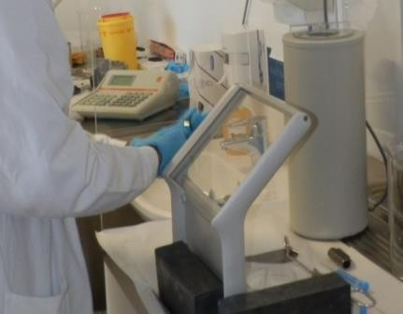
Important facts about dose calibrators
Dose calibrators detectors should be shielded, both to protect the operator and to reduce background counts from other sources aside from the measured sample.
These instruments are rather stable in time. Care should be taken to observe adequate source-detector geometry and source composition, as they could influence the final reading.
Geometric dependence is characteristic of each equipment, but is less as well depth increases.

Slide 47

Location of dose calibrators
Due to the fact that their main use is to measure the activities of the radiopharmaceuticals to be administered, their location should be close to the place where doses are manipulated (i.e. radiochemical hoods, glove boxes, isolators or laminar flows) to minimize irradiation of personnel.
Care should be taken to adequately shield the detector, to avoid high background counts and protect the operator.
Current commercial systems guarantee adequate shielding of the measurement chamber and an easy reading of activities.

Slide 48
RADIONUCLIDE ACTIVITY CALIBRATORS
The response of the detector will depend on:
Radionuclide (type, energy and abundance of radiation).
Geometry of the detector.
Geometry of the source.
The condition of the instrument (QC).

Slide 49


RADIONUCLIDE ACTIVITY CALIBRATORS
Calibration should be made at factory using reference sources that are traceable to a standard laboratory

Slide 50
RADIONUCLIDE ACTIVITY CALIBRATORS
Setting | Measured activity
Tc-99m | 1.00
Co-57 | 1.19
In-111 | 2.35
Tl-201 | 1.76
Ga-67 | 1.12
I-123 | 2.19
I-131 | 1.43
Measured activity/True activity of Tc.99m if the indicated settings are used

Slide 51

QUALITY CONTROL OF RADIONUCLIDE ACTIVITY CALIBRATORS
Acceptance Daily High voltage/display P T Zero adjust P T Background P T Accuracy P |  |  | Monthly Yearly T P T P T P P
Precision | P |  | T | P
Relative responses | P |  | T | P
Subsidiary calibrations | P
Linearity | P |  |  | P
Electrical safety | P |  |  | P
Leakage radiation | P |  |  | P
 |  |  | P: physicist
T: technician
Traceability to a national standard.
Inter-laboratory comparisons.

Slide 52


QUALITY CONTROL OF RADIONUCLIDE ACTIVITY CALIBRATORS
Operational considerations
Radionuclide settings Background Reproducibility

Slide 53

QUALITY CONTROL OF RADIONUCLIDE ACTIVITY CALIBRATORS
Sealed Sources for Calibration of Activity Meters
Long half-life
Range of photon energies
Range of activities
Calibrated sources
Co57, Ba133, Cs137, Co60
53

Slide 54
MEASUREMENT OF PRECISION AND ACCURACY
Purpose of test:
To test the precision and accuracy of a radionuclide calibrator in activity measurements in standard geometry at selected gamma-radiation energies.
Materials: Use certified sources (± 5% overall uncertainty or less). Source
activities must be greater than 10MBq.
Procedure:
Select the operational conditions appropriate to the radionuclide concerned.
Note the background reading to be subtracted from subsequently measured activities.
Insert the source into the source holder by means of the remote handling
device and introduce the source holder into the instrument.
Allow sufficient time for the reading to stabilize.
Measure and record the activity, subtracting the background reading if necessary.
Repeat step 5 to a total of 10 successive measurements.
Remove the source holder from the instrument and extract the source by
means of the remote handling device.

Slide 55


MEASUREMENT OF PRECISION AND ACCURACY
Data analysis
1. To assess precision, calculate for each source the percentage differences between the individual measured activities, Ai, and their mean, Ā, that is:
Record results of calculations.
2. To assess accuracy (E), calculate for each source the percentage difference between the mean measured activity, Ā , and the certified activity of the source corrected for radioactive decay to the day of measurement, C, that is:
Record results of calculations.
Limits of acceptability: ±5% (Take into account the manufacturer specifications)

Slide 56
PRECISION AND ACCURACY ?
Precision (+), Accuracy (-)
Precision (-), Accuracy (-)
Precision (+), Accuracy (+)
Precision (-), Accuracy?

Slide 57
LINEARITY
Purpose of test:
To test the linearity of the activity response of a radionuclide calibrator over the
range of activities for which it is to be used (e.g. 1MBq to 150GBq for 99mTc).
Methods:
Decaying source method.
Graded sources method.
DECAYING SOURCE METHOD
Materials:
Short-lived radionuclide (e.g. 99mTc) in solution. Initial activity equal to or greater than the highest activity for which the instrument is to be used (e.g. 3.7 GBq/100 mCi). Source holder. Remote handling device for sample vial.

Slide 58
LINEARITY
Procedure:
Transfer the radionuclide solution to the sample vial by means of the remote pipetting device. Cap the vial firmly.
Select the operational conditions appropriate to the radionuclide concerned.
Note the background reading to be subtracted from subsequently measured
activities.
Insert the sample vial into the source holder by means of the remote handling device and introduce the source holder into the instrument.
Allow sufficient time for the reading to stabilize.
Measure and record the activity, subtracting the background reading if
necessary. Record the exact time of day corresponding to the measurement.
Remove the source holder from the instrument and extract the sample vial by means of the remote handling device.
Repeat steps 2-7 regularly over a period several times greater than the physical half-life of the radionuclide, sufficient for the source to decay to an activity equal to or less than the lowest activity for which the instrument is to be used.

Slide 59

LINEARITY
Data analysis:
Plot the Activity-time curve (log-linear ) and compute the slope of the line to ensure that it is consistent with the known physical half-life of the radionuclide.
Examine the graph for systematic departures of the data points from the fitted straight line; such discrepancies indicate non-linearity of the activity response of the instrument.

Slide 60
LINEARITY
Limits of acceptablity:
In general, the linearity of the activity response should be such that all individual activities measured in the test are within ± 10% of the values corresponding to the straight line fitted to the data points.

Slide 61
CHECK OF REPRODUCIBILITY
Purpose of test:
To check the day-to-day reproducibility of performance of a radionuclide calibrator in measurements on commonly used radionuclides.
Materials:
Long-lived sealed medium-energy gamma-radiation source, activity > 100uCi (3.7MBq). 133Ba, 137Cs or 226 Ra source is suitable. This test do not require certified sources.

Slide 62
CHECK OF REPRODUCIBILITY
Procedure:
Select the operating conditions appropriate to the radionuclide in most common use (e.g: 99mTc).
Note the background reading to be subtracted from subsequently measured
activities.
Insert the gamma-radiation source into the source holder by means of the remote handling device and introduce the source holder into the instrument.
Allow sufficient time for the reading to stabilize.
Measure and record the apparent activity, subtracting the background reading if necessary.
Remove the source holder from the instrument and extract the source by means of
the remote handling device.
Repeat steps 1-6 under operating conditions appropriate to each other radionuclide in common use.

Slide 63

CHECK OF REPRODUCIBILITY
Plot a line considering as starting point the measured activity and using as slope
the half life of the selected radionuclide.
Construct two additional lines similar to point using as starting points the the measured activity ± 5%, respectively.
The limits of acceptability correspond to ±5% of the expected activity.
5-) If an individual result lies outside these limits, this may be taken to indicate faulty performance. The procedure should then be carried out a second time, but increasing the total number of measurements to 10 , and the individual measured activities examined for evidence of imprecision (random errors), bias (systematic errors), or both.

Slide 64
THANK YOU

