Slide 1
III. BEHAVIOR CHANGE THEORIES USED IN HEALTH PROMOTION

Slide 2
HUMAN BEHAVIOR CHANGE
Understanding human behavior related to health promotion: theories and models
Types of behavior models: In HPR practice…..
Individual-level health behavior models
Address individual characteristics that influence behavior such as knowledge, attitudes, beliefs and personality traits.
1- The Health Belief Model
2- Stages of change Model

Slide 3
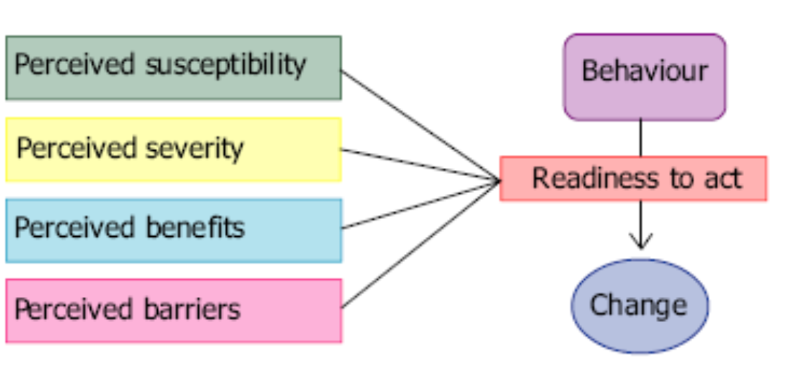
HEALTH BELIEF MODEL

Slide 4
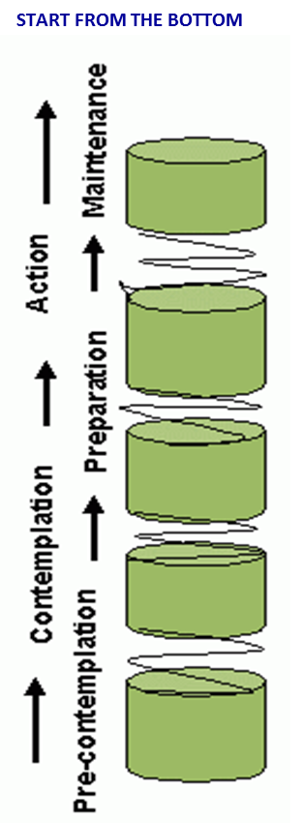
STAGES OF CHANGE THEORY
5. MAINTENANCE: practice required for the new behavior to be consistently maintained, incorporated into the repertoire of behaviors available to a person at any one time
4. ACTION: people make changes, acting on previous decisions, experience, information, new skills, and motivations for making the change
3. PREPARATION: person prepares to undertake the desired change - requires gathering information, finding out how to achieve the change, ascertaining skills necessary, deciding when change should take place - may include talking with others to see how they feel about the likely change, considering impact change will have and who will be affected.
2. CONTEMPLATION: something happens to prompt the person to start thinking about change - perhaps hearing that someone has made changes - or something else has changed - resulting in the need for further change
1. PRECONTEMPLATION: changing a behaviour has not been considered; person might not realize that change is possible or that it might be of interest to them.
RELAPSE: at any point in the change process, the individual could relapse to the old behavior. The factors that contribute to relapse are complex and contextual.

Slide 5
HUMAN BEHAVIOR CHANGE
2. Interpersonal-level health behavior models
examine the individual existing within social environments
Social Learning Theory
The prem­ise of SLT is that people are influenced by, and are influential in, their social environments.

Slide 6
SOCIAL LEARNING THEORY
Concept | Definition | Application
Reciprocal Determinism | Behavior changes result from interaction between person and environment, change is biderectional | Involve the individual & relevant others, work to change the environment, if warranted
Behavior Captability | Knowledge and skills to influence behavior | Provide information and training about action
Expectations | Beliefs about likely results of action | Incorporate information about likely results of action in advice
Self-efficacy | Confidence in ability to take action and persist in action | Point out strengths, use persuasion and encouragement approach behavior change in small steps
Observational learning | Beliefs based on observing others like self and/or visible physical results | Point out others’ experience, physical changes, identify role models to emulate
Reinforcement | Responses to a person’s behavior that increase or decrease the chances of recurrence | Provide incentives, rewards, praise, encourage self-reward, decrease possibility of negative responses that deter + changes

