Slide 1
Unit 6:
Planning for Teaching and Learning

Slide 2
Unit Learning Outcomes
By the end of this unit, you should be able to:
Differentiate levels of educational planning and objectives to be able to make effective plans of T/L activities
Plan key pedagogical documents for effective delivery of lessons;
Teach secondary school subjects related to your area of specialization to growth as a professional teacher.

Slide 3
Unit outline
Planning for Teaching- Learning
    Long-term, middle-term & short-term planning
    Planning key pedagogical documents: Scheme of work, lesson plan and class diary.

Slide 4
Planning for Teaching and Learning
Educational planning is an essential activity requiring an important material, financial and human investment.
In the same way, the teaching-learning process should never allow improvisation and randomness.
Teaching and learning is never done by hazard.
The teacher must plan the teaching and learning activities on a regular basis to ensure the success of the lesson.

Slide 5
Levels of educational planning and objectives
a) Long-term educational planning
Long-term educational planning is also called macro-planning.
It helps to set long-term educational objectives.
They correspond to the overall mission and the general objectives of education in a given country.
To this end, in Rwanda, education aims to fight ignorance and illiteracy and to provide skilled human resources necessary to the socio-economic, cultural and economic development of the country.
This mission and these general objectives of education are normally found in legal texts, the speeches and other declarations of social, economic, political, cultural and religious authorities.

Slide 6
a) Long-term educational planning
The following specific goals of education in Rwanda rise directly from this overall mission:
To educate a citizen free from all sorts of ethnic, regional, religious and gender discrimination,
To promote the culture of peace and insist on the Rwandan and universal values of justice, tolerance, respect of human rights, equality of gender, solidarity and democracy
To promote science and technology with special emphasis on Information and Communication Technology (ICT)
To develop freedom of thought, patriotism and good appreciation of a well done work; etc.

Slide 7
Levels of educational planning and objectives
b. Mid-term educational planning
Mid-term educational planning is also called meso-planning.
It helps to set mid-term educational objectives.
While the long -term educational objectives are applicable to the whole country, the mid-term educational objectives relate to schools, colleges and universities only, which have specific mission to train people.
For instance, the mission of URCE is to develop curricula and offer high level educational programmes and trainings that prepare teachers for all school levels as well as other cadres of educational professionals.

Slide 8
Levels of educational planning and objectives
C. Short-term educational planning
Short-term educational planning is also called micro-planning.
It sets up short- term educational objectives also called teaching and learning objectives, or didactic objectives depending on the context.
The scheme of work and lesson planning are part of the short-term educational planning.
They are part of the key pedagogical documents

Slide 9
Planning key pedagogical documents
Subject curriculum (syllabi) for every subject one teaches
Schemes of work for every subject
Lesson plans for every lesson
Class diary for every lesson to indicate your daily teaching activities
Exercise books for homework, tests and exams for each subject taught.
Lesson notebooks for each subject taught;
Marksheet for recording the marks for student’s scores (tests/quizzes, and exams);
Class register to monitor student lesson attendance
Timetable to indicate teacher’s respecting teaching time/ class

Slide 10
Planning key pedagogical documents
Every teaching activity has to be planned before the real teaching time.
Teaching and learning activities are very important mostly for the student who is supposed to gain knowledge and skills and also for the teacher who facilitates in the achievement and completion of those activities.
So, they have to be well planned before the real lessons.

Slide 11
Planning the scheme of work
The scheme of work is the distribution of the curriculum/syllabus over a given period of time, usually one school year.
In one school year, the scheme of work is subdivided into terms over a period of one year.
These terms are also subdivided into weeks.
The scheme of work is the main plan of the lessons which are supposed to be taught in a given and determined school time like a school term or school year.
The scheme of work is composed of all lessons to be taught to the class depending on the School Calendar, and how they will be taught.

Slide 12
The Template/ format of a scheme of work
The template has been provided in the new curriculum framework to facilitate teachers to prepare their lessons in the same ways as much as possible.
Its modification, adaptation and/or adjustment at different schools should be conditioned that any change does not deviate or alienate the principles underlying the implementation of the competence – based curriculum.

Slide 15
Planning the scheme of work
The scheme of work is elaborated based on the school calendar.
The number of effective teaching periods varies according to both predictable and unpredictable interruptions.
Effective teaching time must therefore be estimated before topics are selected.
The most common interruptions that are likely to disrupt a scheme of work include:
Public Holidays
Examinations (should be schemed for) if they are internal
Revisions (should be schemed for)
Open days
Sports days
Planned school breaks e.g. mid-term break, etc.

Slide 16
Planning the scheme of work
Resources: Teaching aids to be used: Maps, pictures, photos, etc. in the form of apparatus, equipment, materials and of course the real thing if readily available and appropriate.
The teacher should not indicate a teaching aid which will not be available in class.
References: (Textbooks and other resources to be used) include books, handouts, worksheets, journals, reports, etc.
It is necessary for the teacher to provide full and complete reference: indicate authors, year of publication, title of the book, and relevant pages. Refer to some referencing styles like APA, etc.

Slide 17
Planning the scheme of work
Observation: Remarks should be made immediately when the lesson is over during the week or at the end of the week.
The teacher is supposed to indicate whether what was planned for the period has been covered, whether there was over planning or failure of lesson and reasons for either case, etc.
Remarks suggested are meant to help the teacher in his consequent and future planning.
Remarks such as “excellent” “done”, “OK”, “well done”, “satisfactory”, “taught”, etc. might not be very useful to the teacher.
Such remarks as “the lesson was not very well done because of inadequate teaching aids”, or “students were able to apply concept learnt in solving problems as evident from supervised practice”, etc. are appropriate.
After the remarks, it is necessary to write the date when this lesson was taught.

Slide 18
Lesson planning /preparation
Preparing a lesson is to plan in advance:
What will be taught,
How to teach it,
The resources to be used and
Ways of assessment.
A lesson plan is the design of all teaching and learning activities.
This implies planning in advance activities of the teacher (teaching activities) and student activities (learning activities), during the lesson and notes to be given to students.

Slide 19
Advantages of a well- planned lesson:
A teacher who has prepared his/her lesson is comfortable in the classroom, he/she is confident, he/she does not hesitate and is not afraid of committing errors because he has checked, planned, and ordered everything.
He/she has got authority, and the discipline is maintained because he/she attracts students’ attention and keeps them working all the time, they do not have time to get bored (uninterested) and upset (disturb).
His/her presentation is clear and orderly, the questions are well arranged, he/she progresses from simple to complex, from easy to difficult.

Slide 20
Disadvantages of an ill-prepared lesson
The teacher is anxious, he/she hesitates at each stage, which leads him/her flipping through the books all the time, resulting in a great waste of time.
The lesson is not orderly, there is no logical progression, the learner fails to grasp the essential, he/she gets confused, and then drops out completely.
Note: The teacher should not be a slave of his/her lesson plan; he/she can go beyond it without losing the thread (line) of the essentials.
E.g.: - Teachers who do not want to answer questions raised by their students under the pretext that they (questions) are not part of what has been prepared
Teachers who are wasting their time moving away from the topic of the day and tackle those topics proposed here and now by the students.

Slide 21
Steps involved in developing a lesson plan
Pre-lesson preparation/Indirect/distant lesson preparation:
The teacher identifies the title of the lesson, learning objectives to be achieved and searches lesson information by reading books, journals, theses, dissertations,etc.
He/she gathers all necessary documentation.
Immediate lesson preparation:
The teacher prepares the lesson according to REB format/template

Slide 22
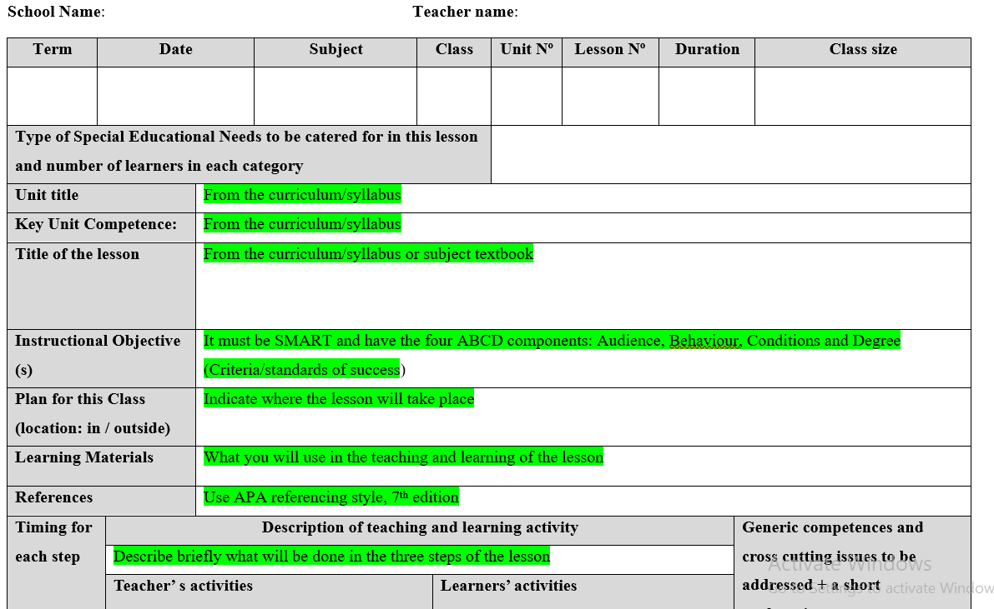
REB lesson plan format/template

Slide 23
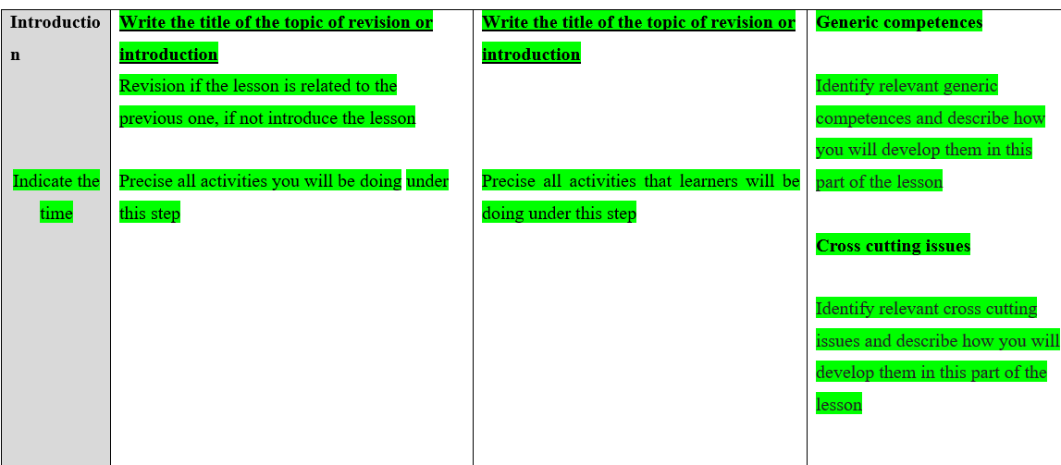

Slide 24
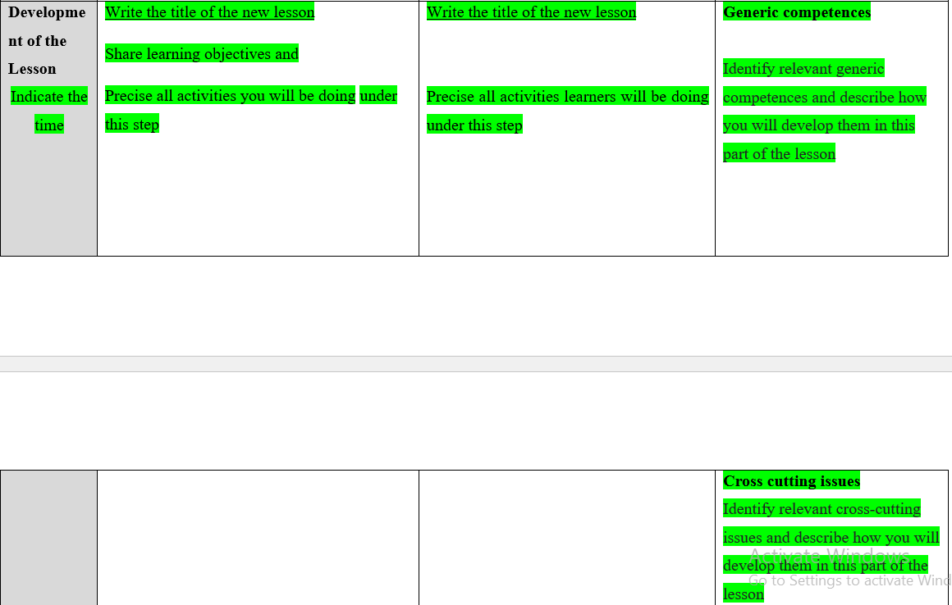

Slide 25
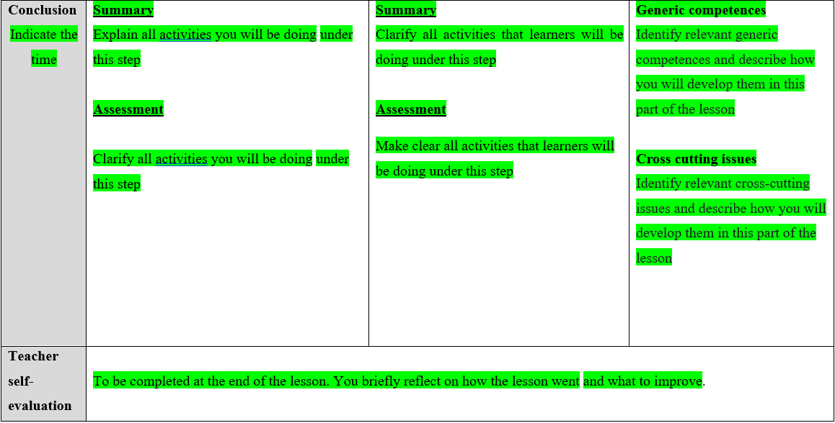

Slide 26
Delivering a lesson
Three main steps/parts of a lesson delivery:
Introduction or revision
Development of the lesson/ body of the lesson
Lesson conclusion: summary of the lesson and lesson assessment

Slide 27
Step 1: Introduction of the lesson or revision of the previous lesson
In this stage, the teacher introduces the new topic of the lesson to motivate or to arouse students’ interest in the new lesson.
It may be a story, a joke or an example attracting students' attention upon important concepts to be learned;
Or the teacher makes a revision of the previous lesson, a reminder of the prior knowledge or concepts taught in previous lessons; a reminder of students’ experience and / or comments made during practical work and which are directly related to the topic of the day; Etc.
It requires the teacher to motivate his/her learners to acquire the new knowledge, skills and values.
This part of the lesson may help the learners to remember what they learned and to launch the motivation process.
This part ends by announcing the lesson of the day and writing its title on the board

Slide 28
Step 2: Development of the lesson/The body of the lesson
This is an essential part of the lesson where the teacher teaches the lesson of the day
The teacher should strictly and logically present the content;
The content is divided in a number parts/sections as many as the number of learning objectives.
At the end of each section, there is a short summary for a better mastery of the new content.
These partial summaries draw the attention of the students on what they must know in each part or section.
Partial summaries are usually followed by a short assessment, which is called formative (continuous) assessment in technical terms.

Slide 29
Step 2: Development of the lesson/The body of the lesson
The content should be organised in a hierarchical order: i.e. follow a sequence that facilitates learning: from concrete to abstract, from simple to complex, from easy to difficult and from near to the distant.
Envisage how to proceed for each section.
Anticipate the types of questions to be asked and when they would be asked,
Envisage the diagrams and sketches/drawings, pictures (teaching aids in general) to be developed and when to use them, when will a particular teaching aid be used?

Slide 30
Step 3: Conclusion: Summary and assessment
A final summary should be made at the end of the lesson.
The teacher must ensure that his/her learners have acquired new knowledge, skills and values.
The summary of the lesson is provided by learners with the help of the teacher.
The final summary is usually followed by an assessment, which is called the summative assessment.
The lesson is assessed and evaluated to ensure:
Its theoretical retention;
Ascertain its understanding; and
Generalize the meaning of the learned concepts.
The importance of evaluation exercises is to show the student that learned concepts are not useless; he/she may need it to solve problems in his/her everyday life.

Slide 31
Step 3: Conclusion: Summary and assessment
Assessment is a significant stage in lesson planning and delivery.
As the teacher prepares his/her lesson, he/she must ask himself/herself what he/she is going to do to achieve the lesson objectives.
He/she will specify clearly the competences his/her learners need to acquire and their indicators.
During this stage, the teacher will specify the criteria or signs, which show that the learners have acquired the necessary required knowledge, skills, attitude and values (competences) planned for in that particular lesson.
The teacher will ask a set of questions to assess whether the competences or lesson objectives have been achieved at the end of the lesson.

Slide 32
Planning a class diary
A class diary is a tool used by teachers, to reflect on teaching and learning experiences, class activities, progress over time.
It serves as a record of what has been taught, what the student has learned, and any reflections or insights related to the content and classroom dynamics.

Slide 35
Assignment
In a small group of five students, prepare a lesson of your choice referring to the subject you will teach in secondary schools and make its class diary.
Note:
Use the REB formats given, times new roman, font size of 12 and spacing of 1.5.
Refer to the REB syllabus and textbooks;
Be ready to teach the planned lesson.

Slide 36
Check your progress!!
Differentiate levels of educational planning and objectives;
What are the key pedagogical documents that an effective teacher must have for effective delivery of lessons?
Prepare the scheme of work of any secondary school grade level (S1- S6) of a school year for one of the subjects you will teach in secondary schools. Refer to the curriculum of the chosen grade level and the textbooks of the subject or any other relevant documents.

Slide 37
END!!

