Slide 1
Unit 2: Key pedagogical concepts

Slide 2
Unit Learning outcomes
By the end of this unit, you should be able to:
Explain key pedagogical concepts as applied in the teaching and learning process
Apply key pedagogical concepts, in diverse teaching and learning situations to enhance student engagement and achievement.

Slide 3
Key pedagogical concepts
Education
Teaching and learning
Pedagogy and andragogy
Didactics (didactic triangle, didactic contract, didactic transportation)
Transfer of learning
Pupil’s representations
Socio-cognitive conflicts
Meta-cognition

Slide 4
1. Education
Etymologically, the word "education" comes from the Latin word "educatio," which is derived from the verb "educare.“
The verb "educare" means "to rear, to bring up, to educate, or to nourish; "to feed" in the sense of feeding a child, taking care of, and raising;
The verb "educare" is derived from the combination of:
  "e-": A prefix meaning "out" or "away."
  "ducere": A verb meaning "to lead."
“Educere” means "to lead someone out of”.
Therefore, "educare" literally means "to lead out" or "to bring forth." This reflects the idea of bringing out or developing one's potential, knowledge, or abilities, as is the goal of education.
The noun form, "educatio," refers to the act or process of rearing, nurturing, or training. It came to signify "the process of educating" or "instruction."

Slide 5
Education
The word "education" entered the English language in the 16th century, where it began to be used in the context of instruction and the development of knowledge, skills, and character.
It retained the idea of "leading out" or "drawing forth" a person's innate abilities.
Thus, "education" in its most fundamental sense is about guiding or leading individuals out of ignorance and helping them develop their potential, knowledge, and capacities.

Slide 6
Education
Education was defined by different authors:
Durkheim (1968: 41), education is: "the action exercised by the adult generations on those who are not yet mature for the social life”
Morin and Brunet (1992:15), education is: " the action that consists in helping a human being to train himself, to develop himself, to raise himself; it is also the result of his action“.
Currently, education is defined as:
A deliberate attempt to transmit and acquire the accumulated worthwhile knowledge , understanding, skills, and attitudes from one human generation to the next.
Process of facilitating learning or the acquisition of knowledge, skills, values, beliefs, and habits
Process of learning and teaching that involves the acquisition of knowledge, skills, values, beliefs, and habits
Through education, we acquire competences (knowledge, ability skills, attitudes and values) in all circumstances of life.

Slide 7




Forms of Education
FormFs of Education Forms of Education
Formal Education
Non-formal Education
Informal Education

Slide 8
Formal Education
Both structured and regular
Provided in schools and other institutions of learning like colleges, universities or professional training centers,
Follows a well-organized curriculum designed to meet specific educational goals,
Usually divided into different stages: early childhood education, primary education, secondary education, and higher education (e.g., undergraduate, graduate),
Mostly mandatory nature;
Certified teachers: teachers are typically required to have formal qualifications, certifications, or degrees in their specific fields of teaching. They follow pedagogical standards and practices to deliver lessons effectively.

Slide 9
Formal education
Includes formalized assessments (e.g., exams, quizzes, projects) to measure students' progress and understanding.
These assessments are usually standardized and contribute to students' academic records or qualifications’
Usually regulated by governmental or accreditation bodies, ensuring that institutions meet certain educational standards.
Often leads to certification or qualifications: Students often receive diplomas or degrees as formal recognition of their achievements.

Slide 10
Non-formal education
Structured and non regular.
Occur outside the traditional, structured school system
Acquired during workshops, training programs, conferences, seminars, adult education, and some online courses.
Aims to meet specific learning needs, including vocational training or personal development.
Does not follow a rigid curriculum or structure like formal education.
Often learner-centered and can be customized to fit the specific needs of participants.
The content can vary widely depending on the goals of the program.

Slide 11
Non-formal education
Normally voluntary: learners choose to participate based on their interests or needs.
Often focus on specific practical skills, personal development, or knowledge that may not be covered in formal education: vocational training, adult literacy programs, life skills courses, or hobby-based workshops;
Can take many forms, such as workshops, seminars, community learning circles, online courses, internships, apprenticeships, or even learning through social activities.
May offer certificates of completion or informal recognition of achievement, generally do not grant academic degrees or qualifications in the same way formal education does.
The focus is often on personal or professional development rather than certification.

Slide 12
Non-formal education
Often seen as a way to facilitate lifelong learning,offering opportunities for individuals to continue learning and developing skills throughout their lives, beyond traditional schooling years.
May be designed to bridge gaps in formal education or address specific needs in society.
Formal and non-formal education refer to hetero-education (education by others) by opposition to auto- education (education by oneself).

Slide 13
Informal education
At the same time non structured and non – regular:
doesn’t follow a fixed curriculum or standardized learning pathway.
Often emerges naturally from daily experiences or activities,
Occurs outside the structured, formal classroom environment and every day life.
Acquired in life circumstances through personal readings, inter- personal relationships, various events, life experiences, family interactions, community involvement, observing others, and self-directed study, etc.
Typically spontaneous, learner-driven by his/her curiosity, motivation, and interests rather than a predetermined educational framework, and adaptable to the needs and interests of individuals.

Slide 14
Informal education
Usually doesn’t lead to formal qualifications, diplomas, or certificates.
Not usually accredited or formally recognized by educational institutions, though it can still be valuable for personal growth, skill development, and career advancement
A continuous, lifelong process that occurs at any age, from childhood through adulthood.

Slide 15
Activities
1. Give examples of things that you can learn informally and where you can learn them.
2. Discuss the advantages and challenges of each of the three forms of education.

Slide 16
2. Teaching and learning
Teaching:
"teaching" has its origins in the idea of showing or pointing out, which aligns with the modern sense of educating or instructing someone.
The word "teaching" has its roots in Old English verb "tǣcan“ meaning "to show, point out, or instruct."
This Old English word is derived from the Proto-Germanic verb "taikjan", meaning "to show" or "to instruct.“
Its evolution:
Middle English: The word "techen" (the Middle English form) retained the meaning of "to show, to instruct, or to teach," and it gradually came to be associated with formal or structured instruction, as we understand it today.
Modern English: The word "teaching" came to denote the act of imparting knowledge, skills, or wisdom, as well as the profession or role of those who do so.

Slide 17
Meaning of “teaching”
Teaching is defined as a set of steps, operations and conditions that are implemented by the environment (the teacher, parents,…) in order to facilitate learning.
It is the process of imparting knowledge, skills, values, or behaviors to others, typically in an educational context.
It involves guiding, instructing, and supporting students to understand concepts, develop critical thinking, and apply learning.
It is often characterized by communication, interaction, and assessment of progress.
Teaching is not just about delivering information, but also about facilitating the learning process, adapting to learners' needs, and fostering a deeper understanding that can be applied in real-life contexts.

Slide 18
Meaning of learning
The word "learning" has its roots in Old English verb "leornian", meaning "to learn“, "to study or get knowledge“.
It comes from the Proto-Germanic root "lizn-" or "leizn-", which also meant "to learn" or "to acquire knowledge.“
The verb "leornian" evolved into the noun "learning", which referred to the process of acquiring knowledge or understanding.
By the 14th century, "learning" referred not only to the act of acquiring knowledge but also to the body of knowledge itself.
The concept of "learning" as the process of acquiring and understanding knowledge has remained central to its meaning through its linguistic history.

Slide 19
Meaning of learning
Learning is a personal activity that consists of integrating new knowledge into the existing one.
It is the process of acquiring knowledge, skills, behaviors, or understanding through study, experience, or teaching.
Both concepts go together and we usually say: Teaching – learning process,
Learning can be defined in many ways, but psychologists often define learning as a relatively permanent change in behavior as a result of experience or practice.
This definition has three important terms:

Slide 20
Meaning of learning d learning theories
Change in behavior: learning involves a change for better or worse i.e. learning can involve both beneficial and negative behaviors.
Sometimes people learn things that help them become more knowledgeable and lead better lives.
In other instances, people can learn things that are detrimental to their overall health and well being.
Change takes place through experience or practice; changes due to growth or maturation are not learning;
Before it can be called learning, the changes must be relatively permanent. What one learns is relatively permanent because it can be changed by future experience.

Slide 21
Meaning of learning
The ability to learn is possessed by humans, animals and machines.
There is evidence for some kind of learning in some plants.
Learning is perhaps the most important human capacity.
It is an ongoing process that takes place throughout all of life.
Human learning begins before birth and continues until death as a consequence of ongoing interactions between person and environment.

Slide 22
3. Pedagogy and andragogy
Pedagogy and andragogy are terms used to describe two different approaches to teaching and learning, each based on the age and developmental stage of the learner.
The word pedagogy comes from the Greek word "paidagōgia“,which is derived from two words :
"pais", meaning "child".
"agōgos" meaning "leader" or "guide" (from the verb "agō", meaning "to lead" or "to bring").
Agogos is derived from the verb " ageirō ", which means "to lead“.
Agogos refers to someone who leads, directs, or guides others, especially in the context of learning, teaching, or social movements
"Paidagōgia" literally means "the act of leading a child" or "the practice of guiding children.“
Notes:
In the context of education, the role of an agogos is typically associated with guiding or leading the learners through the process of knowledge acquisition.
The educator, teacher, or trainer takes on the responsibility of guiding the students and fostering an environment where learning can occur.

Slide 23
Meaning of pedadogy
In ancient Greece, a paidagōgos was a slave or servant responsible for escorting and supervising the education of children.
It is true, the word pedagogy refers historically to a person who leads a child, but this leader was not the “teacher,”
The “pedagogue” was a slave who led a male child to school in the morning and then back home again in the afternoon.
Over time, the term evolved to refer more broadly to the theory and practice of education, not just the supervision of children.
Today, pedagogy refers to the methods and strategies of teaching, particularly in formal educational settings, especially the teaching children or young learners.
Pedagogy is concerned with the education of the child.
It implies the science of the child (psychology), the knowledge of educational techniques and the art to put them into practice (pedagogy itself).

Slide 24
The meaning of Pedagogy
Pedagogy often focuses on foundational knowledge, skills, and behaviors that learners need for future learning.
Example: A teacher explaining a history lesson to a group of children, guiding them step by step through the material.
For Durkheim (1911), pedagogy is "the practical theory of education”.
Lafon (1969, 537) believes that "Pedagogy is a technique of education that is both a science and an art".

Slide 25
The meaning of Andragogy
Deals with the theory and practice of teaching adults.
The term itself comes from the Greek word "aner" (man) and "agoge" (leading), literally meaning "the art and science of adult learning
the concept of andragogy was developed by an American educator Malcolm Knowles (1913–1997) in the 20th century.
Malcolm Knowless developed it into a theory (theory of andragogy) based on the differences between how adults and children learn.
He is often referred to as the "father of adult education" because of his pioneering work in understanding how adults learn and how their learning needs differ from those of children

Slide 26
Application of Andragogy
Andragogy is widely used in:
Adult education programs, such as those found in community, vocational training, continuing education, or training;
Workplace Learning and Training programs to help employees improve job-related skills.
Many online education platforms (e.g., Coursera, edX) by offering self-paced courses that allow adult learners to choose what they want to learn, when they want to learn it, and how they approach the material.
Community-based learning and social movements: Adults participate in community workshops or groups where they can share their experiences and apply their learning in practical, socially relevant ways

Slide 27
Differences between Andragogy and pedagogy
Feature | Andragogy (Adult Learning) | Pedagogy (Child Learning)
Learner’s age | Applies to adults | Applies to children and adolescents
Learner's Role | Self-directed and responsible for their own learning. | Dependent on the teacher for direction.
Experience | Prior experiences are a key resource for learning. | Learners have less experience to build on.
Learning Motivation | Primarily intrinsic motivation (personal goals, career). | Primarily extrinsic motivation (grades, external rewards).
Learning Approach | Problem-centered, focuses on real-world issues. | Content-centered, often focuses on theory or abstract concepts.
Learning Environment | Collaborative, learner-centered. | Teacher-centered, with more direction from the educator.
Readiness to Learn | Readiness is related to life’s immediate needs. | Readiness is based on age and developmental stage.
Application | Immediate application: Adults want to see how what they learn applies to their lives. | Future application: Children typically learn for future knowledge, without immediate practical use.

Slide 28
4. Didactics
The term "didactics" has its roots in Greek and Latin.
The word "didactics" comes from the Greek word "didaktikos" , which means "apt to teach" or “suitable for teaching." The root of this word is "didaskalos" meaning "teacher."
The term was then borrowed into Latin as "didacticus", maintaining its meaning related to teaching or instruction.
From Latin, the word entered modern European languages, including English, in the 17th century, where it came to refer to the art or science of teaching and the methods and principles of instruction, especially those applied in formal educational contexts.
Thus, "didactics" literally means the theory or practice of teaching, specifically focusing on instructional methods and the way knowledge is imparted to others.
Didactics became more formally recognized as a discipline in the 18th and 19th centuries, especially in Europe.
Notable figures, such as Johann Amos Comenius, contributed to the development of didactics as a methodical approach to teaching

Slide 29
Didactics
Johann Amos Comenius (1592–1670) was a Czech philosopher, theologian, and educator, often referred to as the "father of modern education."
His ideas and contributions significantly influenced educational theory and practice, especially in Europe and beyond.
He is best known for his pioneering work in universal education, advocating for the education of all people, regardless of their social class, gender, or background, and for his innovative ideas on teaching methods.

Slide 30
Didactics
Didactics involves the methods, strategies, or techniques, and principles used to effectively deliver content and facilitate learning.
The term is often used to describe a more formal or structured approach to teaching, focusing on how knowledge is conveyed, understood, and applied by learners.
It is about choosing and applying the most effective methods and strategies to help learners achieve educational goals.

Slide 31
Key aspects of didactics
Theories of Teaching and learning: Didactics involves understanding teaching and learning theories that guide the instructional process. These theories provide frameworks for how best to approach teaching, depending on the subject, learner characteristics, and the learning environment.
Methods and Techniques: Didactics includes the methods and strategies teachers use to deliver content. This could range from lectures, discussions, and problem-solving activities to more active learning approaches like project-based learning or experiential learning.
Curriculum Development: It also relates to how educational content is structured, organized, and sequenced. Didactics involves the design of curriculum that is aligned with learning objectives and outcomes, ensuring that students receive a comprehensive education in a particular subject area.

Slide 32
Key aspects of didactics
Learning Objectives: didactics involves setting clear learning objectives/outcomes for what learners should achieve, such as acquiring specific knowledge or developing particular skills.
Student-Centered Focus: While didactics has historically been teacher-centered, modern didactics emphasizes the importance of student-centered learning, focusing on creating engaging and interactive learning experiences that consider learners' needs, interests, and abilities.
Learner Engagement: Didactics also involves how teachers engage and motivate learners to actively participate and understand the material.
Assessment and Evaluation: Didactics involves the methods used to measure and evaluate learning outcomes, such as tests, assignments, or performance assessments. Teachers must use appropriate assessments to gauge how well students have learned and to adjust their teaching methods accordingly.

Slide 33
Types of Didactics
General didactics:
  General didactics refers to the overall principles, methods and techniques of teaching that can be applied across various subjects and educational levels.
  It addresses broad issues like how to engage students, how to organize lessons, and how to adapt teaching to different contexts.
Subject-specific didactics:
  This refers to teaching strategies and methods specific to particular subjects, such as mathematics didactics or language didactics.
  Each subject has its own unique set of instructional methods and content structures, which can be addressed by specialized didactic frameworks.
  Examples: Special didactics of Mathematics, Geography, History, Biology, etc.

Slide 34
4.1 Didactic triangle
Every teaching and learning/pedagogical situation can be analysed through a triangular diagram
The Didactic Triangle is a conceptual model that represents the core elements of the teaching and learning process.
It highlights the relationship between three key components:
Knowledge (K)/ Content (C) represents the content, disciplines, programs, etc. The subject matter, information, or material being taught and learned.
Learners (L) refer to pupils, trainees, students, etc. The student or individual who receives, processes, and engages with the knowledge or skills being taught.
The teacher (T) refers to the lecturer, trainer, educator, initiator, accompanist, etc. The individual responsible for imparting knowledge, guiding learning, and facilitating the overall learning experience

Slide 35
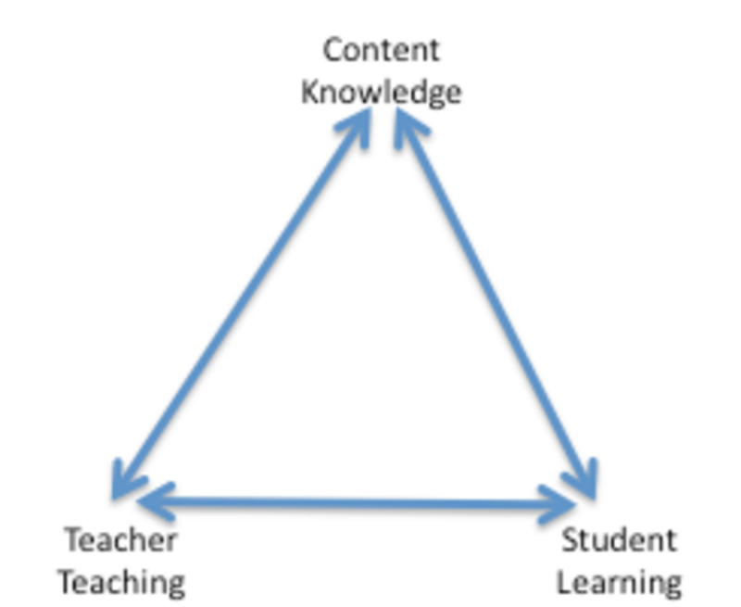
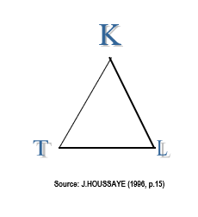
Illustration of the didactic triangle

Slide 36
The Relationships in the Didactic Triangle
Teacher ↔ Learner: This relationship is crucial for effective communication, understanding, and feedback.
The teacher must be able to connect with the learner, recognize their needs, and adapt their teaching approach accordingly.
Teacher ↔ Knowledge/Content: The teacher’s role involves selecting, structuring, and presenting content in an engaging and comprehensible way.
The teacher needs to have a deep understanding of the content and how best to teach it.
Learner ↔ Knowledge/Content: This represents how the learner interacts with the material.
The learner engages with the content, makes sense of it, and internalizes or applies it.
The learner’s prior knowledge, motivation, and learning strategies affect this interaction.

Slide 37
Significance of the didactic triangle
The didactic triangle emphasizes the dynamic and interconnected nature of teaching and learning.
Effective teaching occurs when the teacher, learner, and content work together in a balanced and thoughtful manner.
The model underscores that the success of learning depends not just on the teacher’s ability to deliver content but also on how well the learner engages with the material and how appropriate and meaningful the content is to the learner.
The didactic triangle is a helpful framework for understanding the roles and interactions between the teacher, the learner, and the content in the learning process.
It shows that the effectiveness of teaching is influenced by the quality of these relationships.

Slide 38
4.2 A didactic contract
A didactic contract refers to the implicit or explicit agreement between the teacher and the learner regarding expectations, responsibilities, and behaviors in the teaching and learning process.
It outlines what both the teacher and the learner are expected to contribute to ensure effective learning.
While this "contract" is often informal and unspoken, it shapes the educational environment and can significantly influence the learning experience.
Implicit Contract: Often unspoken, this refers to the natural, expected dynamics between teacher and student.
For example, it is generally assumed that students will attend class, complete assignments, and the teacher will provide instruction and assessments.
Explicit Contract: This is a formal or negotiated agreement, where the roles, responsibilities, and expectations of both the teacher and the learner are clearly outlined.
It could be in the form of a syllabus, classroom rules, or a specific learning agreement.

Slide 39
Key components of a didactic contract:
Teacher's role and expectations:
  Delivery of content: The teacher is expected to present knowledge clearly, guide the learning process, and provide resources and feedback.
  Support and facilitation: The teacher creates an environment conducive to learning, offering guidance, encouragement, and assistance when needed.
  Assessment: The teacher outlines how students will be assessed, what criteria will be used, and when assessments will occur.

Slide 40
Key components of a didactic contract:
2. Learner's role and expectations:
  Active participation: Learners are expected to engage with the content, ask questions, and participate in discussions.
  Study and effort: Learners must invest time in studying, completing assignments, and preparing for assessments.
  Respect and responsibility: Learners should adhere to classroom norms, respect the teacher and peers, and take responsibility for their learning.
3. Content and context:
  The subject matter to be taught and the methods used to teach it (lectures, discussions, projects, etc.) are part of the contract.
  Learners need to understand what they will learn and how the content will be delivered.

Slide 41
5. Didactic transposition
Process of transforming knowledge from its original, specialized form (as found in scholarly research or professional practice) into a form that is suitable for teaching and learning in classrooms.
It involves adapting complex, advanced concepts into a form that is accessible, understandable, and engaging for students.
This process ensures that students understand the key ideas and concepts at an appropriate level of complexity for their age and understanding, fostering deeper learning.

Slide 42
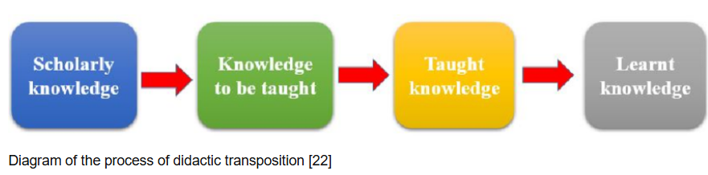
The process of didactic transposition

Slide 43
Example of a didactic transposition
Topic: Water Cycle
Original Knowledge (Scientific Level): At a scientific level, the water cycle involves processes like evaporation, condensation, precipitation, infiltration, and transpiration. These processes are often described in terms of complex interactions between temperature, pressure, and humidity. For instance, evaporation is explained as the transition of water molecules from liquid to gas due to energy provided by heat, often discussed in terms of thermodynamics.
Transposed Knowledge (Classroom Level): For a younger audience, such as elementary school students, the water cycle can be taught through a simple and relatable explanation:
  Evaporation: Water from lakes, rivers, and oceans heats up from the sun and turns into vapor, rising into the air (like steam from a kettle).
  Condensation: The water vapor cools down and turns back into liquid, forming clouds (like how a mirror fogs up after a hot shower).
  Precipitation: When the clouds get heavy, the water falls back to Earth as rain or snow.
  Collection: The rainwater collects in lakes, rivers, or oceans, ready to start the cycle again.

Slide 44
Importance of didactic transposition:
Ensures accessibility: Without transposition, expert-level content might be too difficult or irrelevant for learners, leading to disengagement and frustration. By transforming content, teachers ensure that learners can undertand and apply the knowledge effectively.
Promotes effective learning: This process helps in aligning teaching with learning goals, making sure that the knowledge students acquire is both relevant and applicable.
Fosters engagement: When content is presented in an engaging, appropriate, and contextually meaningful way, students are more likely to be motivated and invested in their learning.

Slide 45
External and internal didactic transposition
External didactic transposition refers to the process of adapting knowledge for different contexts, audiences or settings outside the domain in which it was originally created.
It includes adjusting knowledge for different:
Age groups: Knowledge is simplified for younger audiences, such as secondary vs. university students, primary vs. secondary students
Educational system levels: Adjustments are made depending on the level of schooling, such as primary school vs. high school or higher education.
Cultural contexts: Information might be altered to be more relevant or relatable to the cultural or geographical context of the learners.
Learning environments: How knowledge is structured for in-person classes, online learning, or practical, hands-on environments.

Slide 46
External didactic transposition
The teacher moves the content from one context (often academic) to another (e.g., real life, different subjects, or practical examples), making the learning more relevant and engaging for students.
Example 1:
A university-level course on climate change might involve studying climate models, complex data analysis, and global carbon emissions.
For high school students, the same topic might be taught with simpler concepts: using everyday examples (like how a car emits CO2), and discussing global warming in terms of its observable impacts (such as extreme weather patterns) rather than complicated scientific models.

Slide 47
External Transposition:
We saw that external transposition involves adapting or modifying content from one context or domain to another.
In this case, the core topic of climate change remains the same, but the approach, complexity, and level of detail are adjusted to suit the different audiences (university students vs. high school students).
Why it qualifies as external transposition?
The subject matter is consistent: climate change.
However, the way it is taught is transposed across two different educational contexts (university vs. high school).
The content is not only simplified but also made more relevant and accessible to the different groups.

Slide 48
External Transposition:
Example 2:
Expert knowledge: In advanced geology, the topic of plate tectonics might be discussed using complex models, satellite images, and research data on the movements of Earth's crust.
Classroom transposition (for primary students): The teacher might simplify this by explaining that the Earth is like a giant jigsaw puzzle made of pieces (plates), and these pieces move very slowly. They might use a model or visual aids like a ball with pieces attached to explain earthquakes and volcanoes in a simple way.
Explanation: We learnt that external transposition involves adapting the same subject matter to different educational contexts, which often means simplifying or modifying the content to make it more accessible to learners at different levels.
In this case, the content (plate tectonics) is taught at different levels—advanced geology for experts and primary school students for younger learners—while the core idea remains the same.

Slide 49
In this example 2 of external transposition,
Expert Knowledge (Advanced Geology): The topic of plate tectonics is taught with complex models, satellite images, and research data. This is appropriate for university or advanced geology students who are familiar with scientific concepts and can understand detailed data and research.
Classroom transposition (Primary Students): The concept of plate tectonics is simplified using an analogy: the Earth is like a giant jigsaw puzzle made of pieces (plates) that move slowly. The teacher uses visual aids, such as a ball with pieces attached, to explain earthquakes and volcanoes in a simple and visual way. The core idea of tectonic plates moving remains the same, but the method of delivery is adjusted to the level of understanding of primary students.

Slide 50
Why is example 2 external transposition?
The subject (plate tectonics) is presented in two different ways:
For advanced geology students, the content is technical and involves scientific data and models.
For primary students, the same subject is introduced in a more tangible, simplified, and visual form, using analogies and models that fit their developmental level.
The knowledge remains consistent, but the teaching methods and depth are transposed to match the different educational contexts.
This is a clear example of external transposition—the concept is transferred across different levels of understanding, making it accessible to each group in a way that fits their cognitive and developmental stage.

Slide 51
Example 3 of external transposition: Teaching Geography (Map skills)
Original content: Understanding how to read a map, including identifying directions, scales, and symbols.
External transposition for teaching: The teacher uses the example of planning a road trip to teach map skills.
  "If you want to travel from City A to City B, you can use a map to find the best route. Look for symbols like highways, mountains, and rivers. The scale tells you how many kilometers are represented by each centimeter on the map.“
  Here, the content of geography (map skills) is transposed into the real-world context of planning a road trip, making the skills more relatable and practical for students.

Slide 52
Example 4: Teaching Language (Grammar in the Context of Storytelling)
Original content: The grammatical concept of verb tenses.
  Example: Present tense ("She runs"), past tense ("She ran"), future tense ("She will run").
External transposition for teaching: The teacher uses storytelling to teach verb tenses.
  "Imagine you are telling the story of your weekend. On Friday, you went to the park (past tense). On Saturday, you are going to a concert (present tense). Next Sunday, you will visit your grandmother (future tense).“
  The teacher brings in storytelling as an external context to help students understand how verb tenses change based on time, making the grammatical content more engaging and memorable.

Slide 53
Internal didactic transposition
The process of adapting knowledge within the same subject area to make it teachable at different levels.
It involves simplifying complex concepts or restructuring knowledge without changing its core principles.
It’s the process of breaking down advanced knowledge into smaller, more digestible units for students to learn and understand.
It involves reorganizing or simplifying content within the same subjects for easier understanding.
It involves modifying content within the same subject, often by breaking it down, reorganizing, or simplifying it for students.
The content stays the same but is made more accessible or structured in a way that promotes understanding.
For instance, breaking down a math formula into smaller steps for clarity.

Slide 54
Example 1 of internal transposition: Teaching History (Timeline of events)
Original content: A list of historical events in chronological order:
  1492: Christopher Columbus arrives in the Americas.
  1776: Declaration of Independence.
  1914: Start of World War I.
Internal transposition for teaching: The teacher might break down the events into categories to aid understanding, such as:
  Age of Exploration (e.g., Columbus in 1492).
  American Revolution (e.g., Declaration of Independence in 1776).
  World Wars (e.g., Start of WWI in 1914).
  The teacher transposes the information internally by reorganizing it into thematic categories (such as "Age of Exploration" and "World Wars") to help students understand broader historical trends and connections between events.

Slide 55
Example 2 of internal transposition: Teaching Science (Chemical Reactions)
Original content: The concept of chemical reactions and the balancing of equations.
  Example equation: H₂ + O₂ → H₂O.
Internal transposition for teaching:
  The teacher simplifies the explanation by breaking down the balancing of chemical equations into a series of steps:
    Count the number of atoms on each side of the equation.
    Balance the number of atoms by adjusting coefficients (e.g., 2H₂ + O₂ → 2H₂O).
The teacher rearranges the concept of balancing chemical equations into a step-by-step process for easier comprehension without changing the actual content.

Slide 56
6. Transfer of learning
Society, parents and teachers, all have always wished that learning taking place in schools serve out of it.
It should be somehow “transferable”.
Transfer of learning is therefore the capacity to apply knowledge or skills in situations different from where learning occurs.
It is the process by which knowledge, skills, or behaviors learned in one context are applied to new situations, contexts, or problems.
It occurs when a learner takes what they have learned and uses it beyond the original learning environment or context
Note: The situation of reutilisation of learning does not correspond necessarily to transfer.
On the contrary, situations of reutilisation of learning can be exclusively of the order of the application of knowledge.

Slide 57
Types of transfer of learning:
Positive transfer: When prior learning helps or enhances the acquisition of new knowledge or skills in a different context.
It occurs when previous knowledge or skills help a learner acquire new knowledge or skills more easily and effectively.
It involves applying learned material in one context to enhance performance in a new situation.
Examples:
A student who has learned to play the piano may find it easier to learn the guitar because both instruments involve understanding music theory, rhythm, and coordination between hands and fingers.
A student who learns how to organize their time effectively for school assignments might apply the same organizational skills to manage their work tasks in a job after graduation.

Slide 58
Positive transfer
Examples:
A person who speaks Spanish might find it easier to learn Italian because both languages share a similar Latin origin and have many similar vocabulary words and grammatical structures.
Someone who has used a smartphone for years may find it easier to learn how to use a tablet or smartwatch, as the operating systems, user interfaces, and functions are similar across these devices.
A person who has learned to drive a car can more easily learn to drive a motorcycle or a truck because they already understand basic concepts such as road rules, controlling speed, and spatial awareness.

Slide 59
Types of Transfer of Learning:
Negative transfer: When prior learning or previous knowledge interferes with or hinders the acquisition of / the ability to learn new knowledge or skills.
Examples:
If someone learns to drive a car with a manual transmission, they may struggle to drive a car with an automatic transmission at first because the new skills conflict with their prior knowledge.
A person who is used to using a smartphone may face difficulty navigating a touchscreen laptop because they might expect the same gestures (like swiping or tapping) to work in the same way, but the laptop's interface may require different gestures.
A native English speaker learning French might mix up words that look similar in both languages but have different meanings, such as "actuellement" (French) vs. "actually" (English). While they appear similar, they mean different things.

Slide 60
Types of Transfer of Learning:
Near transfer: When the knowledge or skills learned in one situation are applied to a very similar or closely related situation or context.
The new situation closely resembles the original learning experience, so the transfer is relatively easy and straightforward.
Examples:
A person who is familiar with using a smartphone model (e.g., an iPhone 12) easily learns to use a newer iPhone model (e.g., iPhone 14), since both devices have similar features, apps, and user interfaces.
A student who has written an essay in history applies the same essay-writing skills to write an essay in English literature. Both essays require the same basic structure (introduction, thesis, supporting arguments, and conclusion).
Someone who is proficient in using Microsoft Word applies the same skills to use Google Docs. Both word processors share similar tools for formatting text, inserting tables, and spell-checking.

Slide 61
Types of Transfer of Learning:
Examples of near transfer of learning:
A student learns how to solve simple addition problems (e.g., 15 + 7) and then applies the same process to slightly more complex addition problems (e.g., 234 + 56).
The concept of addition remains the same; only the numbers are different. The student transfers the strategy used for smaller numbers to larger ones.

Slide 62
Types of Transfer of Learning
Far transfer: When knowledge or skills are applied in a context that is quite different from the original learning environment.
This type of transfer requires more effort and adaptation since the new situation is less similar to the original learning experience.
Examples:
A person who has learned strategic planning in a business course might apply similar strategies to organize and plan their personal life or manage a nonprofit organization, even though the contexts are very different.
A student who has been involved in debating applies the skills of argument construction, critical thinking, and public speaking in their role as a lawyer, arguing cases in court.
Both debating and law involve the ability to analyze arguments, present evidence, and speak persuasively.
These skills transfer, even though the specific contexts (a debate competition vs. a legal setting) are far apart

Slide 63
Types of Transfer of Learning
Examples of far transfer:
A person who plays team sports (like football or basketball) applies their teamwork and collaboration skills to a workplace project, working effectively with colleagues from diverse departments to achieve a shared goal.
The skills of communication, collaboration, and coordinating with others in sports can be transferred to professional work situations, despite the very different environments (a sports field vs. an office).

Slide 64
Transfer of learning
Transfer of learning is a fundamental concept in education, as it determines how well learners can apply their acquired knowledge and skills to new and diverse situations.
Effective teaching not only focuses on content acquisition but also on helping students make connections between what they learn and how they can use it beyond the classroom, thus enhancing their ability to adapt to various challenges in life.

Slide 65
7. Pupils’ representations
Pupils' Representations refer to the ways in which students mentally construct, interpret, and make sense of the knowledge and concepts they encounter during the learning process.
These representations are mental images, ideas, or symbols that learners use to understand, organize, and recall information.
Examples:
A pupil studying historical events might create a timeline to represent the chronological order of key events, such as the events leading up to a significant war or revolution.
A pupil learning about family history might create a family tree to represent their lineage and the relationships between ancestors.
A pupil studying different cultures may represent traditions, symbols, and beliefs through images or drawings of cultural practices, clothing, and festivals.
A pupil in an art class might represent an abstract concept like happiness by using bright colors, and smiling faces in a painting or drawing.

Slide 66
Types of Pupils' Representations:
Conceptual representations: These are the mental models or frameworks that students develop to understand abstract concepts.
For example, a student might create a mental image of the water cycle to better understand how precipitation, evaporation, and condensation work.
Conceptual representations are important because they help learners make sense of new information by connecting it to what they already know.
Visual representations: These include diagrams, charts, pictures, maps, or other visual aids that help students represent information.
For instance, a student might use a graph to represent the relationship between variables in a scientific experiment.
Visual representations are often helpful in clarifying abstract or complex ideas, making them easier to understand and remember.

Slide 67
Types of Pupils' Representations:
Verbal Representations: These are the ways students use language—whether spoken or written—to represent their understanding of concepts.
A student might describe a process or explain a solution to a problem using words.
Verbal representations often help students clarify their thoughts and communicate their understanding to others.
Symbolic Representations: These involve using symbols or notations to represent mathematical or scientific concepts.
For example, students use equations, formulas, or algebraic expressions as symbolic representations of relationships or phenomena.
Symbolic representations are essential for working with mathematical concepts and abstract scientific ideas.

Slide 68
Types of Pupils' Representations:
Action-Based Representations: Some students may use physical actions or hands-on activities to represent their understanding, especially in subjects that require practical skills.
For example, building a model or conducting an experiment can serve as an action-based representation of scientific concepts.
This type of representation helps kinesthetic learners or those who learn better through movement and physical interaction.
Notes:
Kinesthetic learners are individuals who learn best through physical movement and hands-on activities.

Slide 69
Pupils' Representations
Pupils are never "totally empty" while facing a new learning.
In fact, they possess always an already known, that is a certain idea about the notions to be approached, an opinion against which the teacher is often brought to fight.
They have a “spontaneous conception” or a “representation” of it.
It is always necessary to start from the “already known” of the learners when you teach them. This allows leaners to analyse any new information.
Also, the manipulation of the "already known” of the pupils is precious since it informs the teacher abundantly about the "stock of knowledge" of his pupils.
Then, the pupil feels an imbalance and becomes aware that he should question himself, amend his perception of the real situation while having new elements.

Slide 70
8. Social cognitive conflict
Social cognitive conflict refers to a situation in which individuals experience cognitive dissonance or disagreement within a social context, often when their beliefs, understandings, or behaviors are challenged by others in a group.
This conflict arises as a result of differing perspectives, expectations, or interpretations within social interactions, leading to a potential shift or adaptation in cognitive processing.
Social cognitive conflict often occurs when individuals are exposed to new ideas, perspectives, or experiences that challenge their existing beliefs or understanding.

Slide 71
Examples of social cognitive conflict:
Students in a class might disagree on the interpretation of a historical event, creating a conflict that challenges their understanding.
If a student’s approach to solving a problem is radically different from the traditional method taught in class, they might face conflict with their peers or teachers.
If a student learns a new approach to solving a problem that contradicts their previous understanding, they might experience cognitive conflict.
In a history class, students are discussing the causes of a historical event, such as the American Civil War. One student argues that economic factors were the most important cause, while another believes it was slavery. This disagreement creates a social cognitive conflict, forcing both students to reconsider their views and integrate new information that may have been overlooked. As a result, they develop a more comprehensive understanding of the event.
During a group project, team members may have different approaches to solving a problem. One team member suggests a traditional method, while another proposes a more innovative but unconventional solution. The disagreement creates cognitive conflict as team members evaluate the pros and cons of each approach, potentially leading to the development of a more effective solution.

Slide 72
Social cognitive conflict
  The cognitive conflict itself is not necessarily negative; rather, it can lead to cognitive growth and change:
  When individuals confront cognitive conflict, they are forced to rethink their understanding or adopt new ways of thinking, which can ultimately lead to deeper learning and improved problem-solving skills.
  Social cognitive conflict is often enhanced or moderated by the influence of peers, as individuals may adjust their beliefs in response to the opinions or behaviors of others.
  In educational contexts, peer interactions (group work, discussions, debates) can either reinforce or challenge personal cognitive structures.

Slide 73
Inter-individual disequilibrium and intra-individual disequilibrium
These concepts derived from Jean Piaget's theory of cognitive development, which focuses on how individuals make sense of the world around them through processes like equilibration and disequilibrium.

Slide 74
Inter-Individual Disequilibrium
This occurs when two individuals have conflicting viewpoints or responses to a particular issue or problem.
These differences in perspectives create a state of disequilibrium between them because their responses oppose each other.
Example: Imagine two students, Alice and Bob, discussing a topic in class. Alice believes that a plant needs sunlight to grow, while Bob argues that plants can grow without sunlight. Their contrasting answers create inter-individual disequilibrium.
For them to reach equilibrium, they would need to reconcile their different perspectives, either by exchanging ideas, collaborating, or through further exploration of the subject.
In this context, inter-individual disequilibrium can lead to cognitive conflict, which may encourage the individuals to rethink their ideas, adjust their understanding, or develop new knowledge through dialogue, leading to cognitive growth.

Slide 75
Inter-Individual Disequilibrium
Another example of Inter-Individual Disequilibrium:
Two students are debating the causes of climate change. One student believes it is primarily caused by human activity (e.g., burning fossil fuels), while the other believes it is mainly caused by natural cycles.
Their conflicting responses lead to inter-individual disequilibrium.
The teacher could encourage them to research together, share findings, and discuss different viewpoints, helping them reach a more informed understanding of the topic.

Slide 76
Intra-Individual Disequilibrium
This refers to the internal conflict or cognitive struggle that occurs within a single individual when their existing mental structures or frameworks (schemas) are challenged by new information or experiences.
The new information does not fit into their current understanding, leading to a state of disequilibrium.
Example: A child who has learned that all birds can fly might experience intra-individual disequilibrium when they see an ostrich, a bird that cannot fly. The child's existing schema (mental framework) for birds is challenged because ostriches do not conform to the child's initial understanding. To resolve this, the child might adjust their schema to include that not all birds can fly, thus achieving equilibrium again by assimilating or accommodating the new information.
In intra-individual disequilibrium, the individual is faced with the need to adapt their understanding to incorporate new or conflicting information. Piaget believed that this process of adjustment (through assimilation and accommodation) was fundamental to cognitive development.

Slide 77
Intra-Individual Disequilibrium
Another example of Intra-Individual Disequilibrium:
A student who has always understood that addition is the process of combining positive numbers faces a problem where they must add a positive number and a negative number.
This creates a mental conflict because their schema for addition doesn't fit this new situation.
To resolve this, they may revise their understanding of addition to include the concept of negative numbers and their behavior, ultimately reconciling the new information.
In both cases of Intra-Individual Disequilibrium and Inter-Individual Disequilibrium, disequilibrium serves as a catalyst for cognitive development, either through interactions with others (inter-individual) or through personal cognitive adjustments (intra-individual).

Slide 78
Key Differences Between Inter-Individual and Intra-Individual Disequilibrium
Scope:
  Inter-individual disequilibrium involves two or more people, each holding differing viewpoints or responses.
  Intra-individual disequilibrium occurs within a single individual, as their existing mental structures are confronted by new or contradictory information.
Resolution:
  Inter-individual disequilibrium is resolved through communication, collaboration, or dialogue between individuals, where they attempt to reconcile their differences.
  Intra-individual disequilibrium is resolved through cognitive processes like assimilation or accommodation, where the individual adjusts their understanding to restore equilibrium.
Impact on Learning:
  Inter-individual disequilibrium can lead to shared learning, where both individuals negotiate and refine their ideas based on their interaction.
  Intra-individual disequilibrium leads to individual cognitive development, as the person works internally to integrate the new information into their existing knowledge structure.

Slide 79
8. Metacognition
Metacognition refers to the awareness and understanding of one's own thinking processes.
It involves the ability to monitor, control, and regulate one's cognitive activities in learning situations.
Essentially, metacognition is "thinking about thinking."
It refers to the ability to think about and regulate one's own thinking processes.
It encompasses a variety of skills and strategies that help individuals reflect on their learning, plan how to approach a task, monitor their progress, and evaluate the effectiveness of their strategies.
It involves being aware of how we learn, how we approach problem-solving, and how we reflect on and control our cognitive processes.
Example: A student knows that they are good at memorizing definitions but struggle with understanding complex concepts, so they use diagrams and practice problems to help with conceptual understanding.

Slide 80
Key components of metacognition:
Metacognitive Knowledge:
  This involves knowing about oneself as a learner, knowing your strengths and weaknesses as a learner.
  For example, if you can explain what your strengths are in academic writing, or exam taking, or other types of academic tasks, then you are metacognitively aware.
  It involves knowing about the strategies that work best for understanding and remembering information, and the nature of the task at hand

Slide 81
Metacognitive Knowledge:
  Metacognitive knowledge can be broken down into three main types:
    Declarative Knowledge: Knowing what you know (e.g. facts, concepts), or understanding the information and concepts you are learning and what strategies are available for learning.
    Procedural Knowledge: Knowing how to perform certain tasks or how to use strategies effectively to process information, such as how to summarize, organize, or self-test.
    Conditional Knowledge: Understanding when and why to use specific strategies, depending on the task or context; why a procedure or strategy succeeds in solving a problem, under what conditions and why a strategy is better than the other.

Slide 82
Key components of metacognition:
Metacognitive Monitoring:
The ongoing process of checking and evaluating one's own understanding, performance, or progress during a learning task.
This involves self-assessment to identify when something is not working and needs to be changed.
It involves:
  Self-questioning: Asking questions like "Do I understand this?" or "Am I making progress?" while learning.
  Tracking progress: Continuously assessing whether current strategies are effective or whether a different approach is needed.
  Recognizing gaps: Realizing when knowledge or skills are missing or unclear and identifying when more effort is needed to understand something fully.
Example: While reading a chapter in a textbook, a student checks whether they can recall the main ideas from the previous section, deciding to review the material if they can't.

Slide 83
Key components of metacognition:
Metacognitive control or Regulation:
The ability to control or adjust one's cognitive processes to optimize learning.
This includes deciding when and how to use particular strategies, when to switch strategies, and how to overcome obstacles.
This is the active process of monitoring, controlling, and adjusting one's cognitive processes during learning.

Slide 84
Metacognitive control or Regulation:
It involves planning, monitoring, evaluating and adjusting:
    Planning: setting goals and deciding on the strategies to use before beginning a task (e.g., choosing a study strategy, choosing learning methods, allocating time).
    Monitoring: Continuously checking one's progress and understanding during the task (e.g., asking oneself, "Do I understand this?" or "Is this strategy working?"). Continuously evaluating whether the current strategy is working during the task.
    Evaluating: Reflecting on the outcome of the task after completion and assessing whether the learning goals were met (e.g., evaluating the effectiveness of study methods or strategies). Reviewing the outcome of the task afterward and assessing whether the chosen strategies led to successful learning.
    Adjusting: Changing strategies if necessary (e.g., switching from rote memorization to more active engagement with the material).
    Examples: If a student realizes that highlighting the text is not helping them understand the material, they might switch to summarizing key points or discussing the material with a peer.
    A student might decide to take a short break after completing a set of practice problems in order to recharge and maintain focus for the next set.

Slide 85
Key components of metacognition
Metacognitive Reflection
Reflecting on one's cognitive processes after completing a task.
It involves evaluating what worked well, what didn’t, and how future performance can be improved.
It involves:
  Self-reflection: Looking back on the strategies used and their effectiveness in solving a problem or completing a task.
  Analyzing successes and failures: Reviewing whether the chosen strategies led to success or failure and considering why.
  Adjusting for future tasks: Using reflection to guide future decisions about strategies, time management, and learning approaches.
Example: After finishing a test, a student reflects on the questions they found most challenging, evaluating which strategies helped them succeed and which ones need improvement for next time.

Slide 86
Examples of metacognitive processes in action:
Problem solving in Math:
  Planning: A student reads through the problem, breaks it down into smaller steps, and decides whether to use a formula or draw a diagram.
  Monitoring: As they work through the problem, they periodically check if their steps make sense or if they are stuck on a specific part.
  Control: If they get stuck, they decide to try another approach or seek help from a classmate.
  Reflection: After solving the problem, the student reflects on which strategies were most effective and how to approach similar problems next time.

Slide 87
Examples of metacognitive processes in action:
Writing an Essay:
  Planning: A student decides on a topic, outlines their argument, and plans when to write different sections of the essay.
  Monitoring: While writing, they periodically check to see if their arguments are clear and relevant to the topic.
  Control: If they find that their argument isn’t strong enough, they might change their thesis or gather more evidence.
  Reflection: After finishing, they reflect on what worked well in the writing process, such as organization or clarity, and what could be improved in the future

Slide 88
Examples of metacognitive processes in action:
Studying for an Exam:
A student who engages in metacognition while studying for an exam might start by assessing what they already know about the subject (planning).
As they read a chapter, they ask themselves questions like, "Do I understand this concept?" or "Can I explain this to someone else?" (monitoring).
After studying, they evaluate whether their study techniques were effective, considering what helped them understand the material best and what might need to be adjusted for next time (evaluating).

Slide 89
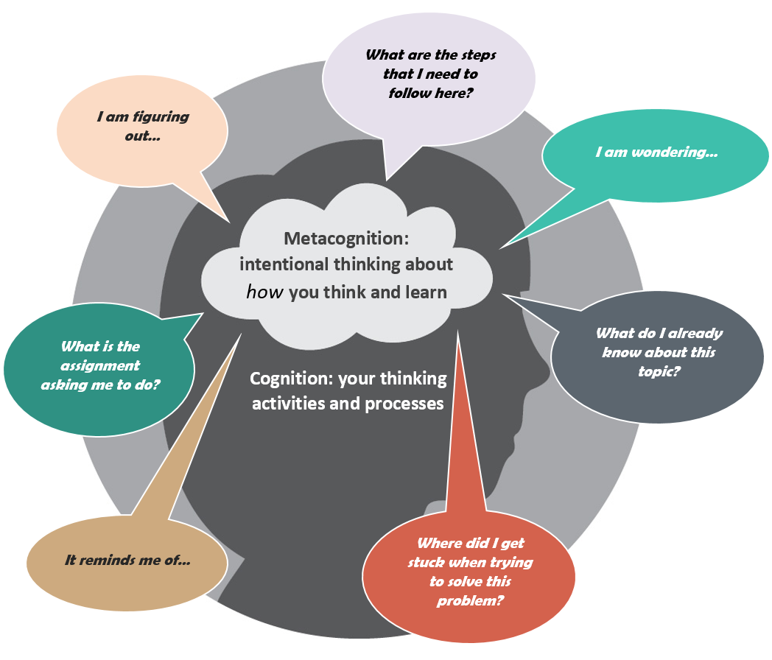
The meta-cognition
It involves:
knowing when you know,
knowing when you don’t know, and
knowing what to do when you don’t know.
In other words, it involves self-monitoring and correcting your own learning processes

Slide 90
Some of the metacognitive strategies:
Self-questioning: Asking questions before, during, and after learning tasks (e.g., "What do I already know about this topic?" "How can I apply this information?" "Did I understand this correctly?").
Think-aloud: Verbalizing thoughts while solving problems or reading to make the thinking process explicit and help students identify errors or areas of confusion.
Summarizing and paraphrasing: Writing or speaking summaries of what has been learned to ensure understanding and reinforce key concepts.
Mind mapping: Using diagrams to organize and represent knowledge, helping learners visualize connections between concepts.
Self-testing: Regularly testing oneself on the material to monitor understanding and retention, which helps reinforce learning and identify gaps in knowledge.

Slide 91
Activity
Discuss the importance of :
Pupils’ representations,
Didactic contract,
Metacognition,
Social cognitive conflict

Slide 92
Check your progress
Explain the following concepts: Teaching, learning, education, didactics, didactic contract, didactic transposition and transfer of learning, metacognition.
Using examples, differentiate:
The forms of education
Pedagogy and andragogy
Types of didactic transposition
Types of didactics
Give two examples for each type of transfer of knowledge (do not provide examples discussed in class)

Slide 93
END!!

