Slide 1
The global burden of malnutrition, causes of malnutrition and nutrition interventions

Slide 2
Malnutrition is a universal issue holding back development with unacceptable human consequences
Three forms of malnutrition – childhood stunting, anaemia in women of reproductive age and overweight among women
88% countries experience a high level of at least two types of malnutrition, with 29% experiencing high levels of all three.
Most of countries experiencing malnutrition are in Africa

Slide 3
Malnutrition affects most of the world’s population at some point in their lifecycle, from infancy to old age.
No country is untouched.
It affects all geographies, all age groups, rich people and poor people, and all sexes. It is a truly universal problem.

Slide 4
While anyone can experience malnutrition people who are particularly vulnerable include : young children, adolescent girls, pregnant and lactating women, older people, people who are ill or immuno-compromised, indigenous people and people in poverty.
Groups migrating or displaced due to conflicts, droughts, floods and other natural disasters, famines or land tenure issues are also at acute risk and vulnerable to malnutrition.

Slide 5
Undernutrition explains around 45% of deaths among children under five, mainly in low and middle-income countries.
The health consequences of overweight and obesity contribute to an estimated 4 million deaths (7.1% of all deaths)
Estimates suggest that malnutrition in all its forms could cost society up to US$3.5 trillion per year, with overweight and obesity alone costing US$500 billion per year.
By comparison 2019 US federal budget is $4.746

Slide 6
Where are we?
Stunting in children under five years of age is declining at a global level but numbers in Africa are increasing, and there are significant disparities in progress at the subnational level.
Stunting declined from 32.6% of all the world’s children under 5 years of age in 2000 to 22.2% in 2017.
Stunting among children in Africa has decreased in percentage terms from 38.3% to 30.3% over the same period, yet due to population growth, the actual number of stunted children has risen.

Slide 7
Where are we?
Underweight among women has declined slightly since 2000 though not significantly – 9.7% of women (aged 20–49) and 5.7% of adolescent girls (aged 15–19) are still underweight.
Anaemia is at 32.8%
Globally, overweight (body mass index (BMI) ≥25) and obesity (BMI ≥30) have been increasing year on year since 2000.
Women have a higher prevalence of obesity than men, at 15.1% compared with 11.1%.

Slide 8
The challenge of coexistence of malnutrition
Undernutrition coexists with overweight and obesity at a country level
This ‘double burden’ is also found in communities and households, notably with stunted children living in households with overweight mothers
Conditions associated with stunting can coexist with overweight in the same person (1.87% of under-fives globally (8.23 million children) experience both stunting and overweight)

Slide 9
The challenge of coexistence of malnutrition
Low birth weight and undernutrition in early life can be associated with increased risk of NCDs later in life
In the US, women who are food insecure, particularly women with children, are more likely to be affected by obesity and consume poor quality diets ( pattern NOT SEEN in other settings)

Slide 11
LMICs continue to have a high DBM; however, countries with a high DBM have lower incomes than the countries that had a high DBM in the early 1990s.
The high DBM is being driven by the rapid increases in the prevalence of overweight and obesity occurring in these lower-income countries that are also experiencing a slower decline in the prevalence of undernutrition.
This new nutrition reality is driven by important and rapid changes that have taken place in the food system (increased availability of ultra-processed foods in LMICs)

Slide 12
Causes/determinants of maternal and child undernutrition

Slide 13
The factors and pathways leading to undernutrition are diverse, complex, and most often interconnected
Immediate causes : inadequate food/nutrient and disease
Underlying causes : household food insecurity, inappropriate care practices and unsafe environments including low access to quality water, sanitation and hygiene, inadequate access or availability to health services
Basic causes : rooted in poverty and involve interactions between social, political, demographic, and societal conditions

Slide 14
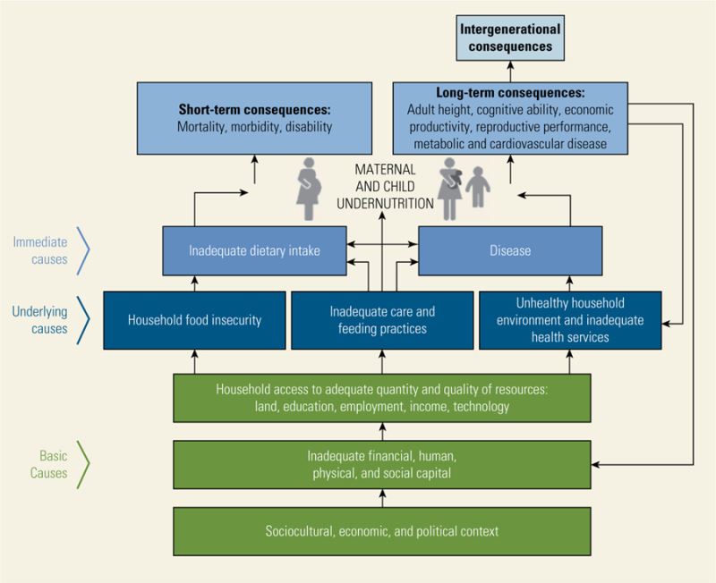
Conceptual Framework of Determinants of Undernutrition
Source: UNICEF, 2013

Slide 15
The immediate causes : inadequate dietary intake and infection.
Infection reduces appetite and increases nutrient requirements
Inadequate intake of food of the right quantity and quality makes the body more susceptible to infection
When lack of food and infection are combined a synergistic interaction can precipitate or worsen undernutrition.

Slide 16
The underlying causes are (i) inadequate access to food and or/poor use of available food (ii) inadequate child care practices and (iii) poor water and sanitation and inadequate health services.
These underlying causes frequently interact with each other and are themselves underpinned by more basic or root causes which reach down deep into the political, economic, cultural and religious systems and institutional structures that govern society.
They control the amount and use of potential human, economic and organizational resources available at the household level and determine the degree of social justice in society and the status and autonomy of women.

Slide 17
The UNICEF framework not only illustrate the complex, multi-level causation of child undernutrition but also highlight the need for multidimensional, cross-sectoral interventions to sustain nutritional improvements in the long term

Slide 18
Malnutrition harms health throughout life, but its early emergence has particularly harmful consequences.
Development is characterised by a succession of sensitive periods or so-called critical windows, when phenotype is particularly responsive to nutritional influences.
Profound imprint of early malnutrition on later phenotype, affecting both the risk and the metabolic effects of subsequent overweight

Slide 19
Early nutrition generates long-term effects on organ size, structure, and function.
Mammalian growth in fetal life and early infancy comprises cell proliferation, crucial for the development of organ structure, whereas from late infancy, growth comprises hypertrophy (increases in cell size).
Infants with a low birthweight have altered cardiac structure and small liver and kidneys whereas macrosomic infants might have organomegaly.

Slide 20
Early nutrition affects hormonal axes regulating growth and appetite.
Both undernutrition and excess nutrition in the perinatal period affect insulin metabolism and hypothalamic circuits regulating food intake.
Infants with low birthweight might be insulin-sensitive at birth, but are susceptible to insulin resistance in association with faster weight gain in childhood.

Slide 21
The gut microbiome rapidly matures in early life, and early undernutrition can disrupt this process.
For example, among twins discordant for kwashiorkor the affected sibling developed narrower gut microbiome diversity, and transplanting this biota to germ-free mice induced weight loss
Gut microbes are key to many aspects of human health including immune, metabolic and neurobehavioural traits

Slide 22
Gene expression in the offspring is shaped by maternal nutrition in pregnancy and by nutritional experience after birth. For example, periconceptional exposure to maternal famine has been associated with epigenetic changes in IGF1 expression that persisted into early old-age,16 while when the offspring was conceived in rural Africa was associated with diverse epigenetic effects in infancy.17 Gestational diabetes is associated with epigenetic effects on genes associated with metabolic disease. Some epigenetic changes might have adverse long-term health effects.

Slide 23
Early exposure or lack of exposure to different food tastes might shape food preferences and diet choices at later ages.
De Cosmi et al, 2017 : Starting in the prenatal period, a varied exposure through amniotic fluid and repeated experiences with novel flavors during breastfeeding and complementary feeding increase children’s willingness to try new foods within a positive social environment.

Slide 24
Interventions to reduce maternal and child undernutrition

Slide 25
Nutrition-specific interventions
Address the immediate causes of maternal and child undernutrition
- Inadequate dietary intake
- Poor health status

Slide 26
(2) Nutrition-sensitive interventions
Address the underlying causes
Household food insecurity
Poor quality of caring practices for mothers and children
Unhealthy living environments

Slide 27
(3) Building an enabling environment
Addresses the basic causes
- Broad economic, political, environmental, social, and cultural context

Slide 28
Framework for actions to achieve optimum maternal and child nutrition
Source : Black et al., 2013

Slide 29
The fight against malnutrition

Slide 30
Nutrition investments by sector as a percentage of total nutrition investments
Nutrition investments :
direct feeding programmes,
maternal feeding,
breastfeeding and weaning foods,
child feeding,
school feeding,
micronutrient interventions such as providing vitamin A, iodine and iron,
monitoring of nutritional status,
nutrition and food hygiene education,
and household food security

Slide 31
Bhutta et al. (2008) found that the interventions with the greatest potential were :
breastfeeding promotion,
appropriate complementary feeding,
supplementation with vitamin A and Zinc
and appropriate management of severe acute undernutrition.
Multi-micronutrient supplementation especially to reduce iron and iodine deficiency is important for maternal survival.
Behaviour change interventions directed at feeding practices and accompanied by supportive measures such as conditional cash transfers can also be effective.
If implemented at sufficient scale, it has been estimated that this menu of interventions would reduce all child deaths by about a quarter.

Slide 32
Dewey and Adu-Afarwuah (2008) conducted a systematic literature review to assess the efficacy and effectiveness of complementary feeding interventions.
The findings suggest that complementary feeding interventions need to be implemented in conjunction with a larger strategy that includes improved water and sanitation, better health care and adequate housing.

Slide 33
Hoddinot et al. (2008) examined the impact of supplementary feeding in early childhood on adult economic productivity and income in Guatemala using linear regression models.
Exposure to the nutritious supplement from 0 to 2 years, was associated with a 46 % increase in average wages for men (but not for women) in the intervention group compared to the control group.

Slide 34
A small menu of effective actions now exists that if implemented at sufficient scale to reach 99% of targeted populations during pregnancy and up to the child’s second birthday could reduce undernutrition-related mortality and disease-burden by 25%.
These actions are: (1) promotion and support of exclusive breastfeeding, (2) complementary feeding, (3) vitamin A and zinc supplementation for children and (4) hygiene interventions; together with (5) multiple micronutrient supplementation for pregnant women and (6) universal iodization of salt.

Slide 35
Evidence on long route interventions to address underlying causes

Slide 36
Long route interventions seek to address underlying causes of undernutrition at the household level in three main ways:
1. By increasing household food/nutrient production and consumption;
2. By improving the quality of care given to young children;
3. By Increasing access to and appropriate use of adequate health services, water and sanitation.
These interventions are more complex and consequently, the evidence is much less clear as to what works, to what extent and why, than with the short route technical fixes.

Slide 37
Double-duty actions include interventions, programmes and policies that have the potential to simultaneously reduce the risk or burden of both undernutrition and overweight, obesity or diet-related NCDs.
WHO proposes three levels for increasing the efficiency of nutrition actions through a double-duty approach

Slide 38
First, through ensuring that current interventions, policies, and programmes designed to address one form of malnutrition do not inadvertently increase the risk of another.
This “do not harm” approach emerges from the historical focus of the agriculture sector on addressing undernutrition. As more and more public and private investment poured into increasing productivity ( food adequacy) of a small range of staples, limited attention was paid to the impact on more micronutrient-rich, indigenous crops or, indeed, the risk of consuming too much of the wrong types of food.

Slide 39
Second, there is a need to leverage existing actions designed to address one type of malnutrition to simultaneously reduce other types.
For example, cash transfer programmes could be designed to play a greater role in enhancing healthy diets to reduce the risk of obesity.
Likewise, school meal programmes focused on reducing food insecurity could be leveraged to include more nutrition education and ensure that sugary drinks and snacks were kept out of schools.
In the future, integrating actions to address all forms of malnutrition through these existing programmes could reap double returns.

Slide 40
The third level is to identify the shared drivers between different forms of malnutrition to proactively identify de novo actions for reducing all forms of malnutrition.
While many drivers are different—diarrhoea, for example, is culpable for undernutrition but not obesity—at a deeper level one can identify food systems and associated food environments, deeply entrenched social norms, socioeconomic status, and biology as some shared causes and therefore shared opportunities for action.

