Slide 1
Macronutrients: Roles and food sources

Slide 2
The Energy-Yielding Nutrients: Carbohydrate, Fat, and Protein
Carbohydrate, fat, and protein are macronutrients because the body requires them in relatively large amounts (many grams daily)
In contrast to these energy-yielding nutrients, vitamins, minerals, and water do not yield energy in the human body.
The energy released from carbohydrates, fats, and proteins can be measured in calories—tiny units of energy so small that a spoon of honey provides tens of thousands of them.

Slide 3
Energy from Foods
The amount of energy a food provides depends on how much carbohydrate, fat, and protein it contains.
When completely broken down in the body, a gram of carbohydrate yields about 4 kcalories of energy; a gram of protein also yields 4 kcalories; and a gram of fat yields 9 kcalories.
Fat, therefore, has a greater energy density than either carbohydrate or protein.

Slide 4
Proteins
Biochemical compounds consisting of one or more polypeptides typically folded into a globular or fibrous form
Most abundant nitrogen-containing compound in the diet and in the body
Ingested protein are broken into free amino acids ( building block of proteins) that are then used in metabolism

Slide 5
Why Do We Need Proteins?
Note that proteins function most effectively when we also consume adequate amounts of the other energy nutrients, carbohydrates and fat.
When there is not enough energy available, the body uses proteins as an energy source, limiting their availability for the functions described below.

Slide 6
Proteins Contribute to Cell Growth, Repair, and maintenance
The proteins in the body are dynamic. They are constantly being broken down, repaired, and replaced.
When proteins are broken down, many amino acids are recycled into new proteins.
All cells are constantly turning over, meaning old cells are broken down and parts are used to create new cells.
In addition, the cellular damage that occurs on a regular basis must be repaired in order to maintain health.

Slide 7
Proteins are used in Milk Formation
Mother’s milk is the first food for a young of any mammal. Human milk contains about 1.2 per cent protein.
The milk proteins are synthesized in the mammary gland from the available dietary and tissue proteins. A nursing mother needs to take extra protein in her diet to meet the demands of protein for milk formation.

Slide 8
Proteins Act as Enzymes
Enzymes can act to bind substances together or break them apart and can transform one substance into another.
Each cell contains thousands of enzymes ( usually proteins) that facilitate specific cellular reactions.

Slide 9
Proteins Act as Hormones
Hormones are substances that act as chemical messengers in the body.
Some hormones are made from amino acids, whereas others are made from lipids.
Hormones are stored in various glands in the body, which release them in response to changes in the body’s environment. They then act on the body’s organs and tissues to restore the body to normal conditions.

Slide 10
Proteins Help Maintain Fluid and Electrolyte Balance
The proteins that are in the bloodstream, in the cells, and in the spaces surrounding the cells work together to keep fluids moving across these spaces in the proper quantities to maintain fluid balance and blood pressure.
When protein intake is deficient, the concentration of proteins in the bloodstream is insufficient to draw fluid from the tissues and across the blood vessel walls; fluid then collects in the tissues, causing edema.

Slide 11
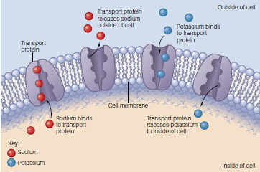
Transport proteins in the cell membrane pick up potassium and sodium and transport them across the cell membrane.

Slide 12
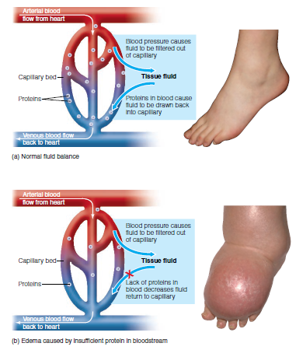
(a) This healthy (nonswollen) tissue suggests that body fluids in the bloodstream and
in the tissue spaces are in balance.
(b) When the level of proteins in the blood is insufficient to draw fluids out of the tissues, edema can result.
This foot with edema is swollen due to fluid
imbalance.

Slide 13
Proteins Help Maintain a Strong Immune System
Antibodies are special proteins that are critical components of the immune system.
When a foreign substance attacks the body, the immune system produces antibodies to defend against it.
Bacteria, viruses, toxins, and allergens (substances that cause allergic reactions) are examples of antigens that can trigger antibody production.

Slide 14
Proteins Serve as an Energy Source
The body’s primary energy sources are carbohydrate and fat
When proteins need to be used for energy, they are taken from the blood and body tissues such as the liver and skeletal muscle
In healthy people, proteins contribute very little to energy needs
Because we are efficient at recycling amino acids, protein needs are relatively low as compared with needs for carbohydrate and fat

Slide 15
Food sources of protein

Slide 16
Carbohydrates
Carbohydrates are compounds that consist of carbon, hydrogen, and oxygen, linked together by energy-containing bonds.
There are two types of carbohydrates: complex and simple.
In the digestive tract, carbohydrates are broken down into glucose, which provides energy for the body’s cells and tissues.
Glucose is the body’s primary source of fuel.
Carbohydrates come almost exclusively from plants, vegetables, and grains.
Milk is the only animal based product that contains a significant amount of carbohydrate.

Slide 17
Food sources of carbohydrates

Slide 18
Lipids
Like proteins and carbohydrates, lipids are essential components of all living organisms.
Unlike proteins and carbohydrates, however, lipids have widely varied structures.
They are often defined as water-insoluble (or only sparingly soluble) organic compounds found in biological systems.
The building blocks of lipids are fatty acids

Slide 19
Unsaturated and saturated fatty acids
Fatty acids that do not contain any carbon–carbon double bonds are classified as saturated, whereas those with at least one carbon–carbon double bond are classified as unsaturated.
Unsaturated fatty acids with only one carbon–carbon double bond are called monounsaturated, and those with two or more are called polyunsaturated.

Slide 20
Why do we need lipids ?
Dietary lipids are used :
-as an energy source,
as a structural component in the membranes of cells,
as structural components of a small fraction of the proteins in the cell,
and, in the case of cholesterol, for the synthesis of detergents that facilitate digestion and absorption of dietary lipids.

Slide 21
Food sources of fat

Slide 22
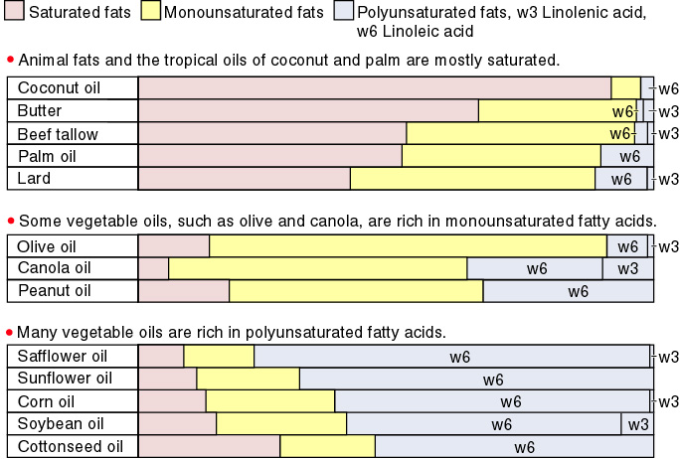
Comparison of dietary fats

