Slide 1
TREE GROWTH
A. Single tree growth
Increase in size with time
Takes place simultaneously and independently in different parts of a tree
Trees show both primary and secondary growth
Primary growth is the increase in height
Secondary growth is the increase in diameter or girth

Slide 2
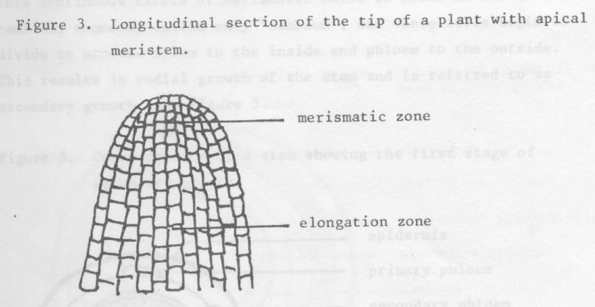
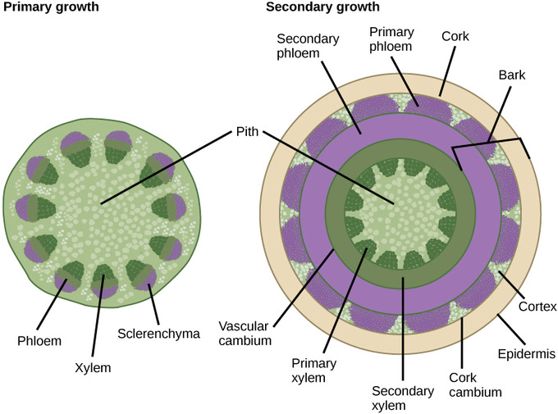
Tree growth
Growth in height
Growth in diameter (girth)

Slide 3
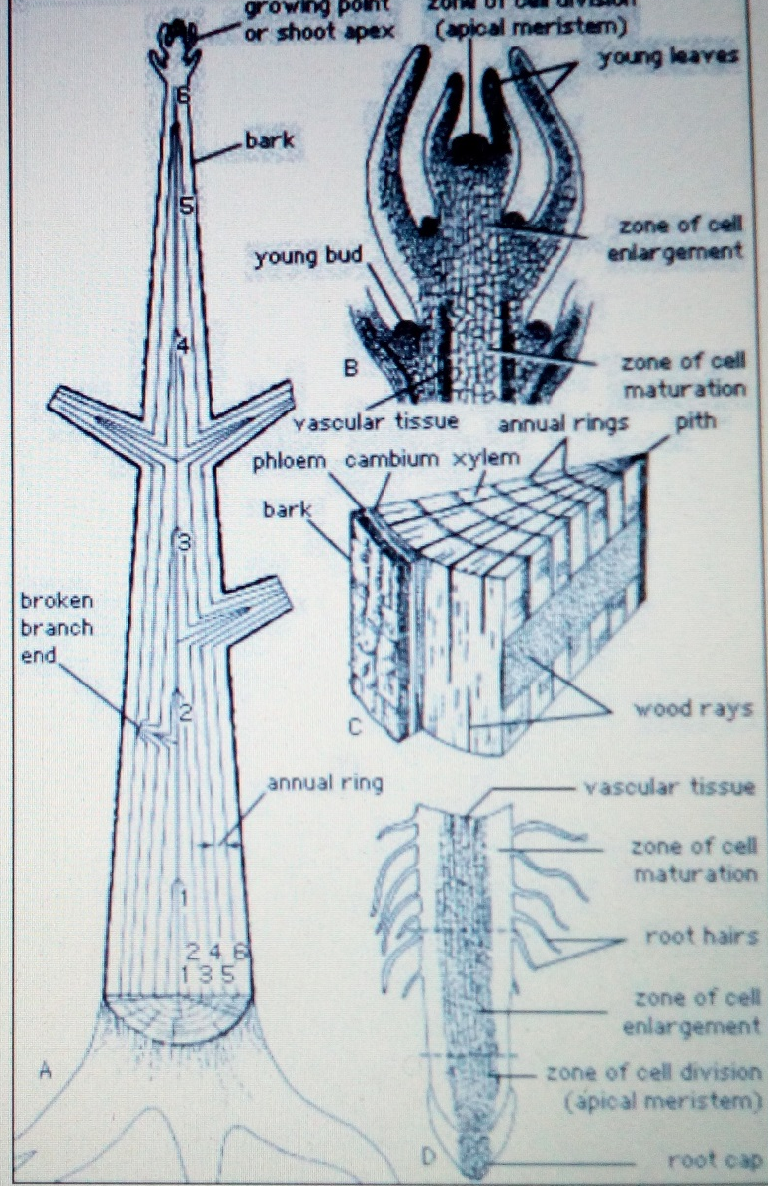
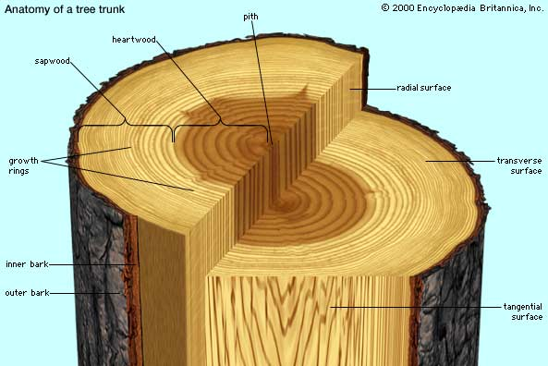
Tree growth contd’

Slide 4
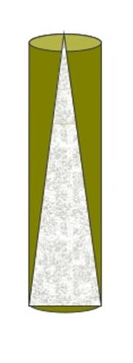
Stem form
Stem form refers to stem taper, or the relative rate of change in stem diameter with increasing tree height above the ground
Open-grown trees usually have a long and vigorous crown which exerts profound influence on the development of the stem
  Have a bigger taper than stand grown trees
Cylinder
Tree stem

Slide 5
B. Stand growth
In plantations, individual trees must compete for growing space with neighbouring trees
Stand growth will be profoundly influenced by the nature and intensity of this competition
Stand growth will be the sum of individual tree growth in that particular stand
We need to know the behaviour of a stand as a whole, as influenced by silvicultural conditions
  =>How different spp. will behave under different conditions of site, climate and stand density

Slide 6
Competition
In nature, survival of a species is ensured by providing many seedlings than needed to occupy a space
An intense battle arises between seedlings for space and necessary resources for growth
Even in man made plantations where the number of seedlings is highly controlled, the growth of individual trees leads to competition for space and resources

Slide 7
Competition starts when 2 or more individuals make demands on the same resources in excess of the capacity of the site to provide those resources
Tree growth will be affected when any one of those resources (water, nutrients, light) become limiting i.e., is in short supply
Often these trees will exist in a state where several vital resources are at, or close to, critical limits which can change from time to time throughout the year depending on weather patterns

Slide 8
From near the time of crown closure, a stand will enter a state in which between tree mutual competition will govern the development process of both individuals and of the stand as a whole
Initial spacing will determine when competition commences
The process will commence sooner at close spacing, on better sites, and for less tolerant species

Slide 9
Tolerance for trees is their ability to grow satisfactorily under the shade of, and in competition with, other trees
If shade intolerant, they are called light demanders; if tolerant, shade bearers

Slide 10
Effects of Competition on Stand and Tree Growth
High stocking densities (small spacing) leads to greater stand growth but less biomass allocation per tree
Largest trees in high stocking densities are usually smaller than those in low stocking densities
Larger stocking densities lead to less biomass allocation per tree

Slide 11
Largest trees in high stocking densities exhibited more desirable wood properties including:
  Less variability in wood anatomy
  More uniform wood density, and
  Finer branching - hence low knot content and knot size

Slide 12
Stand development
Trees in a stand grow together under similar conditions and management treatments
Stands grow in a predictable manner through a series of stages: stand initiation, stem exclusion, understorey initiation and old growth
  Seedling => Sapling => Pole =>Mature tree =>Old tree
  =>Dead tree

Slide 13
Stand Development cont’d
After a significant disturbance such as fire or clear felling, a new stand will establish either by planting or natural regeneration – this is stand initiation
Once the site is fully occupied, trees start to compete with each other, the stand passes through an exclusion phase
Stems are excluded because the site is fully utilised and resources become limiting, leading to severe, exclusive competition

Slide 14
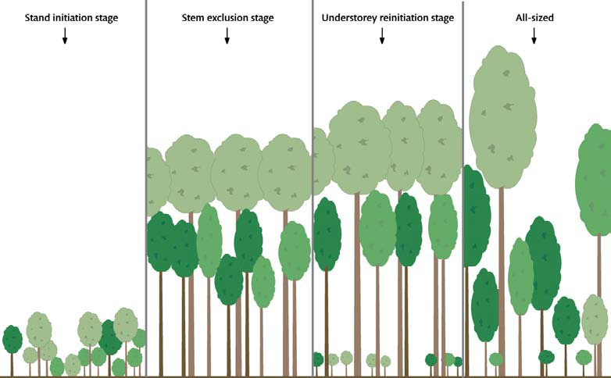
Stand development continued
A s a result of competition, some of the trees die, creating open spaces in the canopy in which new individual may develop
This phase is called understorey re-initiation stage
This stage is followed by the old growth phase characterised by a balance of older trees dying off and being replaced by new ones

Slide 15
Management Implications
Differences in tree growth characteristics such as tolerance and stand development patterns are many
These have management implications
As a rule, a forest manager will “work with nature” when planning and implementing practices
For example, thinning and improvement prescriptions should base on favouring the best performing trees of species that are most suited to the site conditions

