Slide 1
Challenges in Health Financing

Slide 2
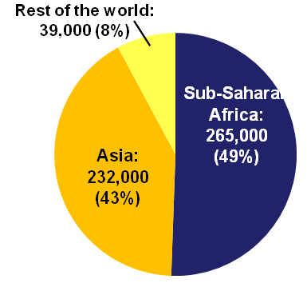
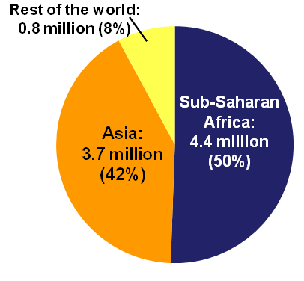
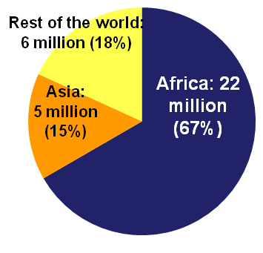
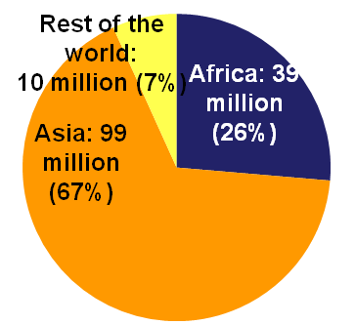
Global Health issues are increasingly about Africa
With only 12% of the world’s population, Africa accounts for 49% of the world’s maternal deaths, 50% of child deaths, 85% of Malaria cases, 67% of people with HIV, and 26% of underweight children
Maternal deaths, 2005
Death of children under five, 2008
Adults and children estimated to be living with HIV, 2007
Underweight children under five, 2007
Ref: Science in Action – Saving the lives of Africa’s mothers, newborns and children. ASADI 2009. Eds Kinney MV, Lawn JE, Kerber KJ
Data sources: UNAIDS 2007, UNICEF, www.childinfor.org, Lancet nutrition series, World Malaria Report 2009.
Notes:
2

Slide 3
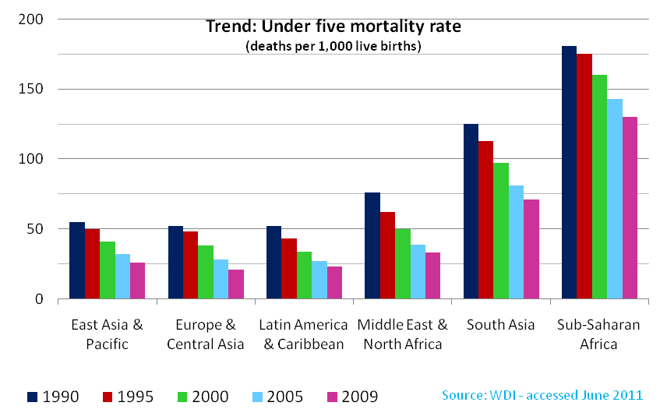
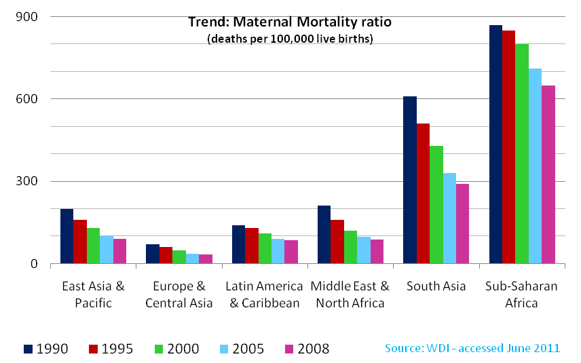
Yes Africa did progressed towards the MDG targets.. but slower than in the rest of the world ..and progress inequitably shared..
For SSA 20% less under 5 deaths in 2009 compared to 1990.
For SSA 26% % less maternal deaths in 2008 compared to 1990.

Slide 4
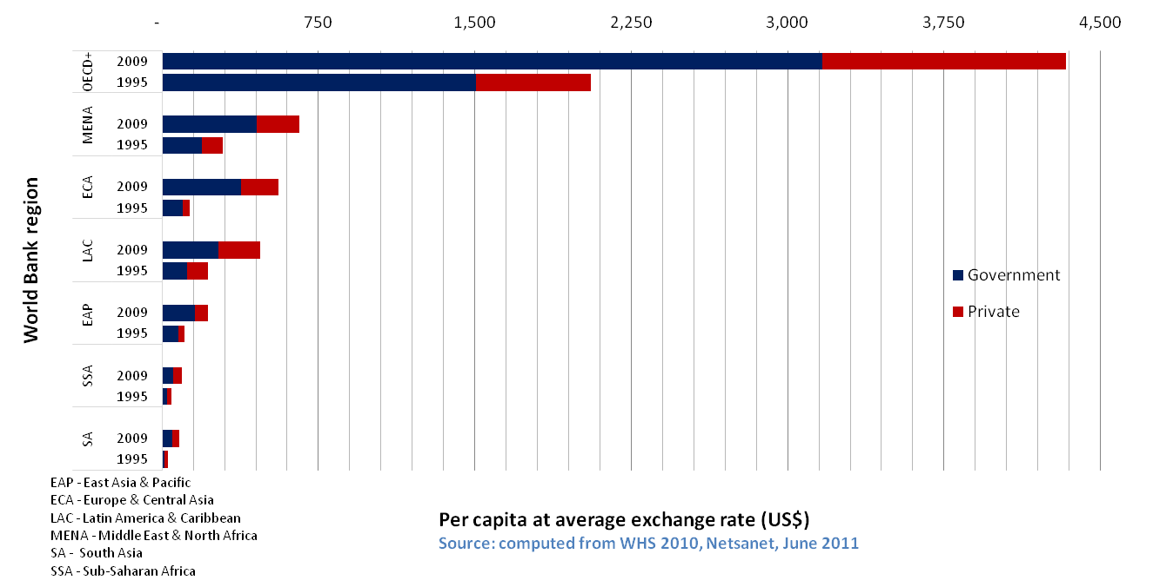
SSA still has a low per capita spending on health..
……yet not the lowest

Slide 5
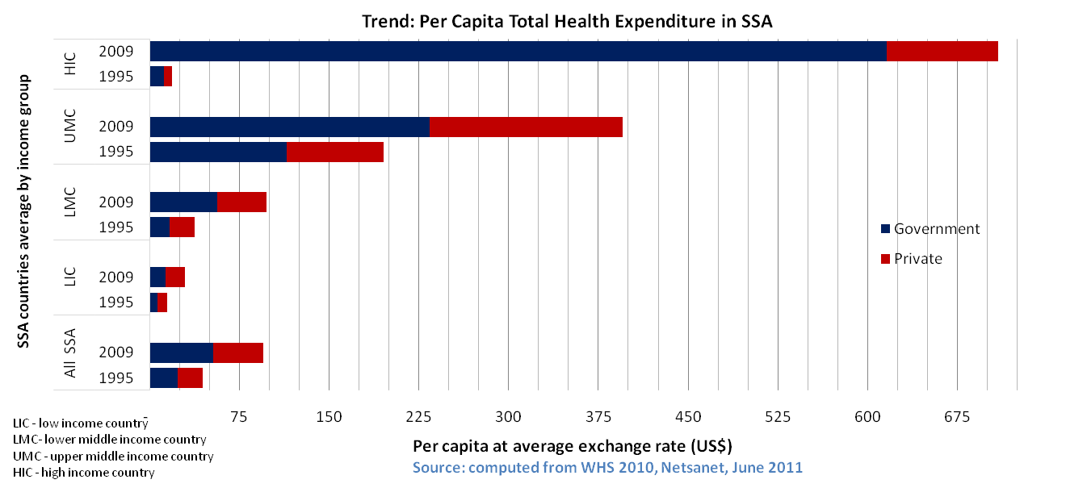
Average total health spending has more than doubled between 1995 and 2009. ..

Slide 6
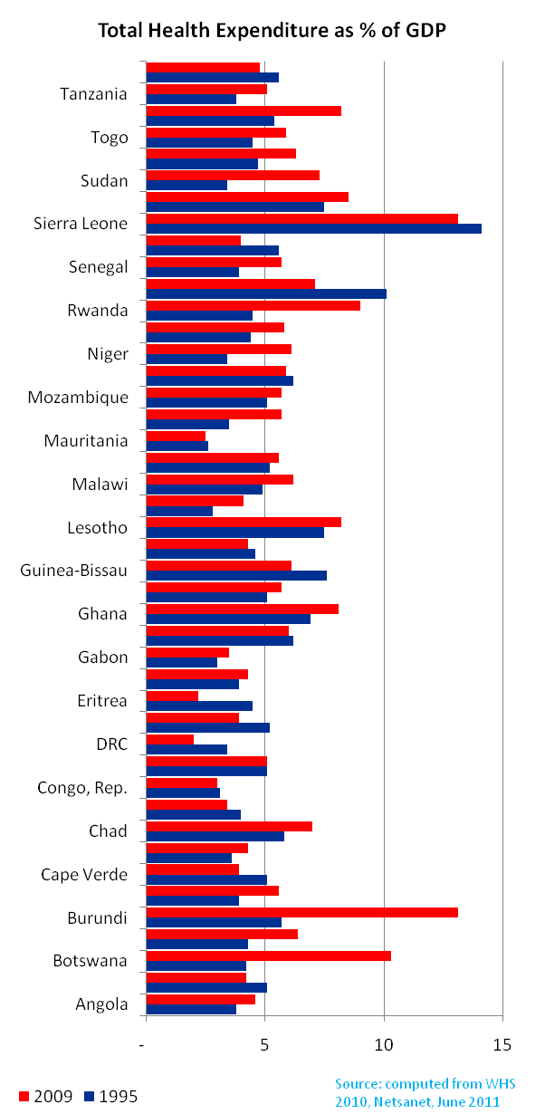
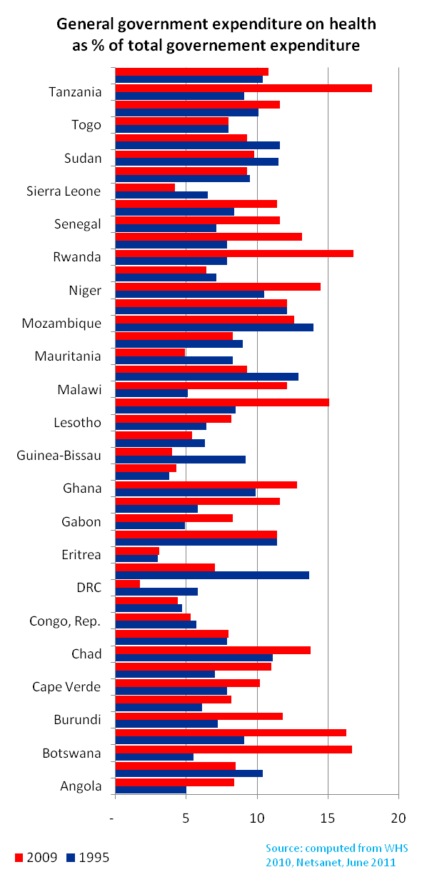
No major increase in allocations to health in SSA between 1995 and 2009
THE as % GDP increased from 5% in 1995 to 6% in 2009
GGHE as % total GE increased from 8% in 1995 to 10% in 2009. Very few countries achieved the 15% Abuja commitment

Slide 7
External aid is an important source of health spending in Sub-Saharan Africa

Slide 8
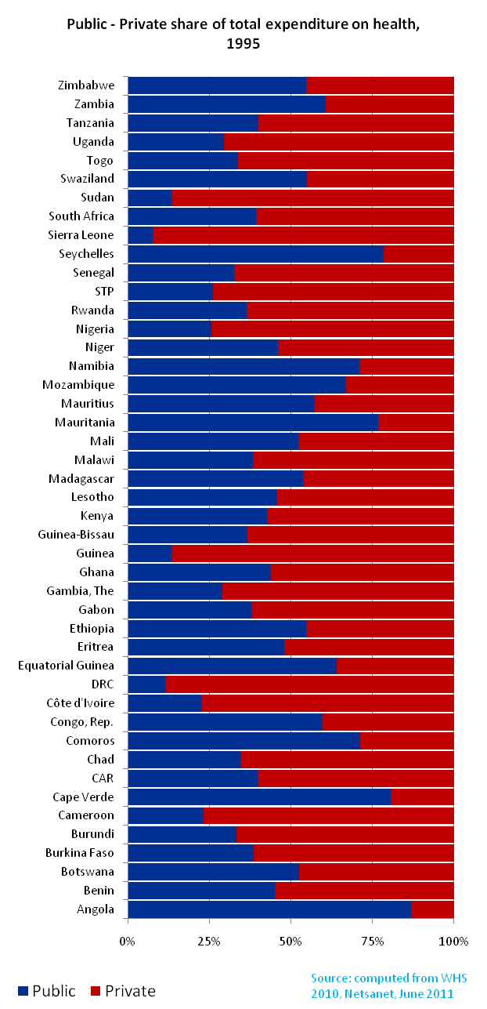
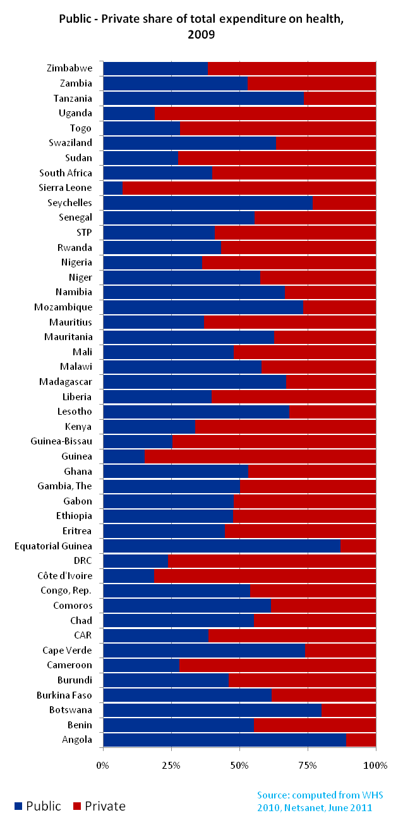
Private sources -mostly out of pocket - finance more than half of health expenditures

Slide 9
Low levels of Spending in Africa, but higher than in South Asia
Yet South Asia, in general, has better health outcomes.
Deaths per 1000
US$

Slide 10
How money is used and in which system it is injected is an essential question

Slide 11
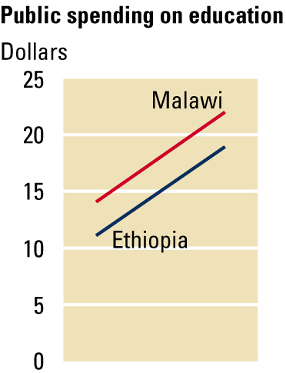
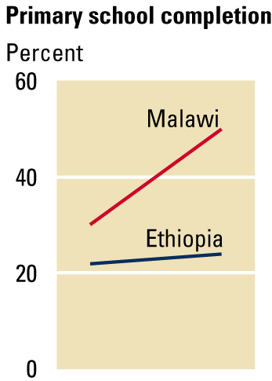
……Increasing spending is not enough! Similar changes in public spending can be associated with vastly different changes in outcomes

Slide 12
Increasing spending ? Fiscal space
Fiscal space:
  room in a government´s budget that allows it to provide resources for a desired purpose without jeopardizing the sustainability of its financial position or the stability of the economy
  refers to the envelope of resources available for spending
How can we increase fiscal space?

Slide 13
Is there any room to increase the public budget?
Raise more government revenue?
Allocate more of the government budget to health?
Ask people to contribute more?
Get more health out of the existing resources (Efficiency)!

Slide 14
Increasing fiscal space
Public sources
  Tax collection
  Budget reallocation
  Loans
  Debt relief
  Grants
Private sources
  Social Health insurance
  Community Based Health insurance
Donor funding

Slide 15
Increasing fiscal space (ctd)
Tax collection
  depend highly on the growth rate
  However room to increase revenues from taxation available
  Special taxes and fees
  Implementation: institutional changes are important, and many interests
  → Countries are unlikely to attempt tax reforms only to accommodate additional health expenditures.

Slide 16
Increasing fiscal space (ctd)
Budget reallocation:
  Prioritization: reallocate resources from lower priority expenditures to higher
  However, budgets are often rigid with little discretionary spending to shift
  Implementation: difficult requires major political will and significant time for an important impact to take place

Slide 17
Increasing fiscal space (ctd)
Debt relief
  Linked with borrowing
  LIC have a large debt burden already
  Borrowing money not for recurrent expenditures
  Debt relief allows releasing domestic resources and saving on debt service payments
Grants, loans

Slide 18
Increasing fiscal space (ctd)
Social Health Insurance
  Easy and effective way to increase resources
  Earmarked for health
  Requires strong institutional capacity—a requirement that often tends to be under-estimated
Feasibility in LIC
    Level of income: growth rate slow
    Size of informal sector: narrow pool
    Increase of labor cost

Slide 19
Increasing fiscal space (ctd)
Donor funding: development assistance represents a high proportion
  Lack of predictability, short term and volatile (commitment not predictor of disbursement)
  Focus on specific diseases: earmarked
  Non alignment with government priorities and harmonization
  Poor harmonization : large number of new actors, high transaction costs
Greater dependence on aid creates other vulnerabilities:
  Greater fiscal uncertainty
  Fungibility implies that not all DAH is “additional”
  Donors are often fragmented; there may be lack of ownership and skewing of priorities towards donor preferences

Slide 20
So Africa not only needs more money for health, it also needs more health for the money… efficient use of money…
What is efficiency?
  In health , a system is efficient when the right services are produced - given one’s goals - and are produced in the right way.
Two specific notions:
  Technical efficiency: refers to situation in which a good or service is produced at minimum cost:”maximum output for our money” (right mix of inputs)
  Allocative efficiency: refers to whether a nation is producing the right set of outputs to achieve its goals (set of services maximizing health status gain).
Notes:
How and what services are produced!

Slide 21
Improving efficiency without affecting equity…
Despite increase in government health spending, budget constraints remain and LIC will continue to face allocation decisions that have important implications for equity and efficiency.
Existing factors generate incentives to use increased health resources to fund sophisticated equipment, tertiary level hospitals, specialized lab that don’t have a significant impact on health outcomes.
The use of resources should be directed to interventions with a great marginal impact on health outcomes.

Slide 22
Efficiency gains
Empirical evidence on efficiency and quality in public health systems is often lacking
Align government health expenditures to identified health needs and costed strategic plans
Reduce fragmentation in financing and service provision
Allocate a greater share of spending to primary care
Improve geographic targeting
Focus on cost-effective interventions
Many other common sources of inefficiency:
Rigid public finance systems
Imbalances in input use, particularly excessive expenditures on wages
Corruption
Low capacity to utilize existing funds--weak management capacity; leakages
Fragmentation in donor funding

Slide 23
Four important questions..
What services should the government purchase?
How should it purchase those services?
From whom should it purchase services?
For whom should it purchase services?
Notes:
To overcome the allocative and technical efficiency problems and increase probability that the additional resources will have the desired effect on health outcomes, countries must carefully answer some fundamental questions through the plans embedded in their poverty reduction paper.

Slide 24
What services should the government purchase?
Determined by economic, social and political factors
Important but not limited to:
  Burden of disease : important with the current epidemiological transition in LIC
  Effective interventions targeting these diseases
  Public goods: generate externalities
Public financing of private goods can also be justified from an equity perspective for a targeted population.
This a difficult decision often made on social and political grounds rather than economic.
Notes:
Public goods are goods which the "free market" will not provide because they are:
non-excludable: benefits of good available to all
non-rival in consumption: consumption by one person does not prevent consumption by others (e.g. a lighthouse, street lighting, clean air...)

Slide 25
How and From whom should the government purchase services ?
Which provider payment mechanism? Or mix?
Public or private providers?
Which level of the health structure?
  Eg: health center, district hospital or referral hospitals?

Slide 26
For whom should the government purchase services?
A major problem with allocations of resources is that the increase expenditures may often benefit the better-off more than the poor.
  Eg: subsidies to a hospital will benefit the better-off as they have more access that the poor.
To favor the poor, there is a need of cross-subsidization. In LIC given the limits of the formal economy the options are not very clear. Special targeting mechanisms are needed.

Slide 27
Domestic Resources Mobilization
CREATE FISCAL SPACE
Government tax base effort
Prioritization for expenditures for Health
Sector specific foreign aid (on-budget)
MAXIMIZE EFFICIENCY
Allocation of public resources
Service delivery: change in model of care
Public Financial Management
GENERATE ADDITIONAL REVENUES
Sector specific foreign aid (off-budget)
Regulated benefits and private health insurance
Out-of-pocket payment linked to exemptions
Innovative financing, sin taxes and earmarking

Slide 28
More money is important but government must also address…..
Accountability
Regulation
Coverage and equity
Quality and outcomes

