Slide 1
Purchasing

Slide 2
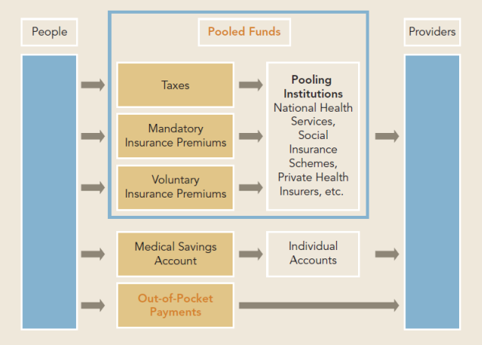
What is purchasing?
Purchasing refers to the transfer, allocation of pooled resources to healthcare providers to obtain services on behalf of identified groups or the entire population and for which the funds were pooled. (Kutzin 2001)
Notes:
Key issues in purchasing:
Who are the purchasers?
What is bought/ purchased and for whom (benefit entitlements)?
From whom are services purchased (who are the providers)?
How are services purchased and at what price (provider payment mechanisms)?

Slide 3
Who are the purchasers?
Ministry of Finance and Economic Planning
Ministry of Health
Social health Insurance fund(s): RSSB (ex-RAMA), MMI
Private heath Insurance fund(s)
Community based health Insurance fund(s)

Slide 4
What to purchase?
Services to which beneficiaries of the pooled resources are entitled = Benefit package/ entitlement
Therefore there is a need of identifying the interventions or services to purchase

Slide 5
Planning a benefit package
Should the benefit package be comprehensive or limited? Focus on cost-effective package or on services most likely to be financially catastrophic to households?
What should be the balance be between the breadth of coverage (include as many of the population as possible) and the depth of coverage (size of the benefit package)?
Is one single benefit package feasible, or is it better to aim for a basic package with additional elements available for better-off groups?
It is important to first identify health needs of the population and understand their preferences and values
Notes:
In planning a benefit package, the first consideration is the type of service to be covered under a particular financing mechanism (e.g. tax revenue and/or health insurance).
In particular, should the package only include low-frequency, high-cost services, such as hospital care and long-term, terminal illnesses, which are often regarded as “catastrophic events”? Or should it only cover high-frequency, low-cost services, such as acute and chronic care that can be provided at the primary care level? Or should cover both types of service? Given the central goal of providing financial protection, many believe that the emphasis should be on protecting individuals and households from “catastrophic” expenditure, which has traditionally been associated with inpatient care and other high-cost, low-frequency services.
However, it is becoming increasingly clear that even small payments for primary care services can have catastrophic consequences for vulnerable households (Whitehead et al., 2001)and that essential primary health care services should, therefore, be covered in countries with high poverty levels. The design of a benefit package clearly depends on what people in a given country can afford, but a reasonably comprehensive benefit package is best able to protect households from catastrophic health care costs (see Box 9 below).
Allocative efficiency is an important consideration in deciding which services should be included in the benefit package. The purchaser, whether a ministry of health, district health office or insurance scheme, must be aware of the major causes of ill-health and hence the health care requirements of the beneficiary population.

Slide 6
Who are the providers (from whom?)?
Health posts, health centers, district hospitals, provincial hospitals, referral hospitals
Pharmacies, laboratories
Private facilities
  Clinics, hospitals, individual practitioners, single or multi-specialty group practices

Slide 7
How to purchase? (How are services purchased?)
There are two ways of purchasing:
Passive purchasing implies following predetermined budget or simply paying bills when presented.
Strategic purchasing involves a continuous search for best ways to maximize health system performance by deciding which interventions should be purchased, how and from whom.
Notes:
A passive purchaser typically transfers funds to providers without using information on either performance or need. A common form of this is a budget based on the quantity of inputs, for example the number of beds in a hospital.
A strategic purchaser, however, allocates funds in a way which actively promotes improvements in service quality and efficiency, through the use of incentives and administrative mechanisms. An example of this is paying hospitals based on the number of patients successfully treated, following a review to ensure that the services provided were appropriate.

Slide 8
Rationale for strategic purchasing
Information asymmetries give providers influence over consumer demand for health care
Incentives and regulations oriented towards the supply side of the market are one policy tool to address the issue.
A critical factor for health care system performance is the extent to which purchasers link resource allocation decisions to provider performance and encouraging providers to pursue efficiency and quality in services delivery.
Notes:
Information asymmetries give providers influence over consumer demand for health care which can lead to provider-led cost escalation and/ or unnecessary service delivery.

Slide 9
From passive to strategic purchasing
Strategic
Passive
Limited information used to allocate funds and pay providers, e.g.
Resource allocation using norms
Little/no selectivity of providers
Little/no quality monitoring
Price and quality taker
Deliberate decisions about what to buy, from whom to buy, and how to buy services:
  Clear service packages and service delivery standards
  Selective contracting
  Output-based payment systems that create deliberate incentives
  Provider autonomy
  Price and quality maker
  Manage overall costs in the system

Slide 10
Relationship 3
Relationship 1
Decide interventions to be purchased considering health priorities and cost-effectiveness
Purchase health care services for population; decide which services reflect population needs and references
Government
Citizens
Ensure the needs and preferences of citizens are reflected in purchasing
Ensure national health priorities are met by executing a stewardship role
Purchasers
Decide contractual mechanisms and payment systems used in purchasing health care services; decide suppliers of services in light of quality and efficiency
Deliver an appropriate mix of health care services, of acceptable quality and price
Providers
Conceptual Framework from McIntyre D.
Relationship 2
Notes:
Relationship 1: The relationship concerns the existence of effective mechanisms to determine and reflect people’s needs, preferences and values in purchasing decision-making.
– The purchaser acts as the citizens’ agent in purchasing health care services
– A key question in this relationship concerns the extent to which the purchaser represents the needs, preferences and priorities of citizens.
Relationship 2: The relationship involves the use of levers by purchasers to improve provider responsiveness and efficiency
– The purchaser uses financial, contractual, regulatory and monitoring mechanisms to ensure that health care providers deliver an appropriate mix of quality health care services, at an agreed price.
– Purchasers should consider the criteria for selecting providers, the forms of contract employed, the mechanisms by which providers are paid, how affordable and realistic prices are set and the mechanisms for monitoring performance.
– The organizational environment in which providers function (e.g. number of purchasers and health care providers, etc.) and their internal management mechanisms, is also critical.
Relationship 3:The relationship concerns how the Government provides stewardship to ensure that (public health) priorities are linked to resource allocation and purchasing decision-making.
– The purchaser acts as an agent for the government
– The government must play a stewardship role to ensure that national health priories are met.

Slide 11
Strategic purchasing
Which interventions?
  Limited >< comprehensive range of services, cost-effective package or costly services.
  Identify health needs of the population, understand their preferences and values.
From whom?
  Public providers and/or Private providers: Often involve an accreditation process
  Encourage access to care at the lowest effective level (rationing mechanism)
  Not always possible in geographic area where there is only one type of providers
Notes:
jk

Slide 12
Theoretically ideal strategic purchasing actions and scenario
Providers
Select providers, considering range, quality, location
Establish service arrangements: make purchaser’s expectations clear
Develop formularies and standard treatment guidelines
Establish payment rates
Secure information on services provided
Audit provider claims
Monitor performance, act on poor performance
Protect against fraud and corruption
Pay providers promptly
Allocate resources equitably across geographic areas
Establish and monitor user payment policies
Develop, manage and use information systems
Government:
Establish clear frameworks for purchaser and providers
Fill service delivery and infrastructure gaps
Ensure adequate resources mobilised to meet service entitlements
Ensure accountability of purchaser
Strategic purchasing
Citizens:
Assess population needs, values, preferences
Inform citizens of their entitlements and obligations
Ensure access to services
Establish mechanisms to receive and respond to complaints and feedback
Publicly report on use of resources and performance

Slide 13
Strategic purchasing
How?
  Establish some form of agreement with accredited providers (ex formal contract )
  Make purchaser’s expectations clear (range of services ; quality; method, timing and level of payment; information providers should provide; outline action for poor performance)
  Promote efficiency and quality in service provision: Producing an essential drug lists or formulary and associated standard treatment guidelines and ensure they are used

Slide 14
Strategic purchasing
How?
  Include also diagnostic, surgical and other supplies and equipment
  Establish gate keeping system to access higher levels of care
  Ensure affordability and sustainability of entitled benefits
  Design, implement and modify (if necessary) provider payment methods that will encourage providers to enhance and maintain service quality and efficiency

Slide 15
Strategic purchasing
How?
  Audit providers claims and protect against fraud and corruption
  Ability to pay providers regularly and timely
  Promote equity in access and financial protection of members or population

Slide 16
Strategic purchasing
Purchasers can have considerable power, the government’s responsibility is to ensure this power is not abused
Establish clear policy and regulatory frameworks within which purchasers and providers will operate (including regular reporting on the use of funds, services purchased etc. especially where public funds are used)

Slide 17
Strategic purchasing
Would you support a system that purchases
  A very vaguely defined benefit package or a wide package that is effectively not deliverable
Would you support a system that purchases
  Ineffective services, ineffective drugs
  Inappropriate services
  High volume of expensive diagnostic and curative services at the expense of cost-effective public health measures and low cost curative services
Would you support a system that pays for services without information on need and effectiveness
Most of our systems do the above to some extent!

Slide 18
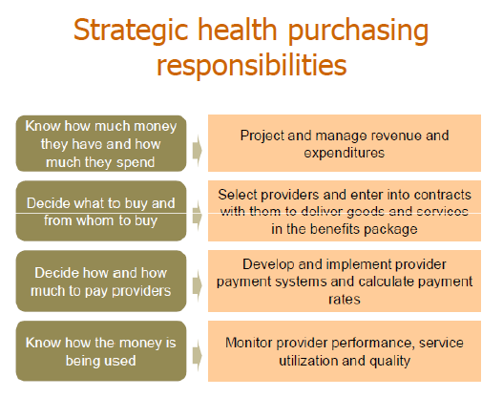
Strategic purchasing responsibilities
Notes:
Very important!!!!!Strategic health purchasing responsibilities requires information!
Strategic purchasers need to develop, manage and use data and information systems

Slide 19
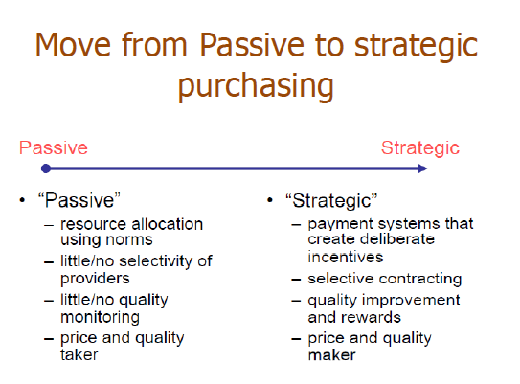

Slide 20
Organizational structures & process in Strategic Purchasing
Institutional
Arrangements
Institutional
Arrangements
Who does what?
Institutional roles & responsibilities
How are purchasing functions carried out?
Contracting and provider payment systems
Information systems and data flows
Monitoring systems
Operational
Systems
Operational
Systems
Capacity-
building
Capacity-
building
What capacities are needed?
Implement & manage improved systems

Slide 21
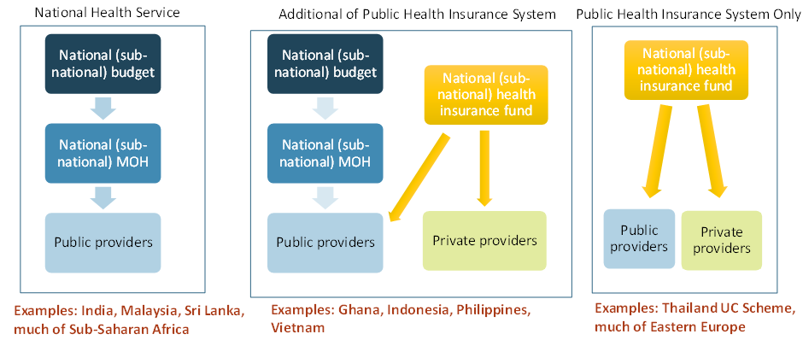
Overview of institutional arrangements for health purchasing
PURCHASERS
Purchaser-Provider Split
How are the purchasing arrangements in Rwanda organized? Are there areas for improvement?
Notes:
The purchaser–provider split (PPS) is a service delivery model in which third-party payers are kept organizationally separate from service providers. The operations of the providers are managed by contracts. One of the main aims of PPS is to create competition between providers. Competition and other incentive structures built into the contractual relationship are believed to lead to improvements in service delivery, such as improved cost containment, greater efficiency, organizational flexibility, better quality and improved responsiveness of services to patient needs.

Slide 22




Operational systems for strategic health purchasing
Information Systems
Contracting
Provider payment (design and rate-setting)
Medicines pricing and procurement
Claims/payment processing
Provider Monitoring
Quality and cost-effectiveness

Slide 23
Examples of sample operational systems
Kenya
Thailand
Estonia
S. Africa
Information systems
Fully automated
Fully automated/some fragmentation
Fully automated/integrated
Automated
Selective with some private and all public
Selective contracting private/public
Selective contracting with public and private
Contracting
Some selective contracting
Claims processing
Automated
Automated
Automated
Automated
Mixed (Capitation, budgets, FFS)
Mixed (capitation, DRG, FFS)
Mixed methods(Capitation, DRG, FFS
Provider payment
Mixed methods (Capitation, DRG, FFS, P4P
Provider monitoring
Routine monitoring tools + IT
Routine monitoring tools
Routine monitoring tools
Routine monitoring tools
How are the processes like in Rwanda?
Are there areas that can be improved on?

Slide 24
Purchasing: what role does provider payment play?
Refers to methods/ mechanisms used to allocate resources to providers
Generate incentives that can affect the behavior of service providers
How we choose the unit of activity for payment affects the supply and quality of services, promote efficient use of resources and attention to continuity of care.
Most countries use a mixture of payment methods.
«Picking a payment system is like picking someone to marry. All options are imperfect. The question is what problems are you prepared to live with in the long run» Prof W. Hsiao
Notes:
This ultimately makes it possible to expand coverage within limited funds.

Slide 25
Incentives
All provider payment systems create incentives

Slide 26
Purchasing: provider payment methods
Strategic purchasing decisions create powerful incentives that influence the actions of all the organizations and individuals in the healthcare system
Draw your attention to what incentives payment schemes create for both buyers and sellers and how you can adjust them to further the goals of health sector reform
Notes:
Empirical evidence shows financial incentives are among the most important influences over organizational and individual behavior in the health sector
Unlike regulation, financial incentives rely on the “carrot” of monetary reward to induce changes in behavior

Slide 27
Purchasing or payment methods
Empirical evidence shows financial incentives are among the most important influences over organizational and individual behavior in the health sector
Unlike regulation, financial incentives rely on the “carrot” of monetary reward to induce changes in behavior

Slide 28
Purchasing or payment methods
You can link payment to influence the quantity of services (asymmetry of information)
You can link payment to influence quality of services is more difficult:
  Clinical quality (skill and judgment of providers)
  Service quality (amenity, convenience etc.) is highly multidimensional and vary from individual to individual

Slide 29
Purchasing or payment methods
For example:
  Pay more for new technology, and hospitals will rush to acquire MRI machines
  Pay hospital more for each day a patient stays, and lengths of stay go up
  Pay more for caesarian sections, and their rate goes up and rate of normal deliveries will go down
  Pay doctors on salary, they will see fewer patients. Pay them for each visit, they will see more patients
  Pay hospital a fixed fee per admission, they will discharge patients quicker and sicker

Slide 30
Provider Payment Incentives—Best Practices
Choose the right mix of provider payment methods
Appropriate for the country context and create the right incentives to achieve objectives
Strategically design the payment system
Payment system is based on a formula with strategic decision about each component
Create the right implementation arrangements and supporting systems
Clear contracts, information systems, complementary measures
Calculate appropriate payment rates
Payment rates based on a combination of policy priorities, cost information and negotiation
Notes:
The mix of payment methods used
How the payment system is designed
Implementation arrangements
Payment rates (absolute and relative)

Slide 31
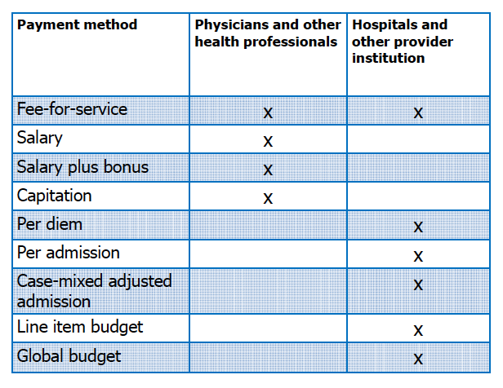
Purchasing: provider payment methods

Slide 32
Purchasing: provider payment methods
Fee-for service: the unit of payment consists of individual visits or clinical activities such as injections, laboratory tests, and x-rays
Salary: the unit of payment is based on a time period that employed health providers are at work, regardless of the number of patients seen, volume of services, or costs of services provided
Salary plus bonus: the unit of payment=salary supplemented by bonus of various kind based on performance (individual productivity, patient satisfaction, test ordering behavior)

Slide 33
Purchasing: provider payment methods
Capitation: the unit of payment is defined on a per person basis. Providers are paid a fixed amount in advance to provide a defined set of services for each individual enrolled for a fixed period of time. The most common capitation payment is when a fixed rate is paid to a general practitioner for each patient registered with him for that month, regardless of the services required by or rendered to the patient.

Slide 34
Purchasing: provider payment methods
Per-diem: the unit of payment is a fixed rate paid per day of hospitalization regardless of the actual services given or their costs. Commonly used for hospitals.
Per admission: the unit of payment is a fixed amount based on admission. The payment is made to cover all the services during a particular hospital stay regardless of the actual services provided.

Slide 35
Purchasing: provider payment methods
Case mixed adjusted per admission: the unit of payment is the disease and treatment categories. Hospitals are paid a fixed amount per admission depending on patient clinical characteristics.
Ex: the Diagnosis related group (DRG). Each DRG has a payment weight assign to it based on the average resources used to treat patients in that DRG.

Slide 36
Purchasing: provider payment methods
Line budget: the unit of payment is an expense category (e.g. salary, supplies, transportation, drugs) for an organization. Providers receive a fixed amount to cover specific input expenses (e.g., personnel, drugs, utilities,).
Once the agency (e.g., the ministry of finance) has approved the budget, the provider has little discretion to switch funds across budget categories.
Notes:
The amount budgeted is typically based on some mix of the facility’s case load, the number of staff, and past budgets.

Slide 37
Purchasing: provider payment methods
Global budget: This payment method sets an all inclusive operating budget in advance. Providers receive a fixed amount of funds for a certain period to cover aggregate expenditures. Budget is flexible and not tied to line items.

Slide 38
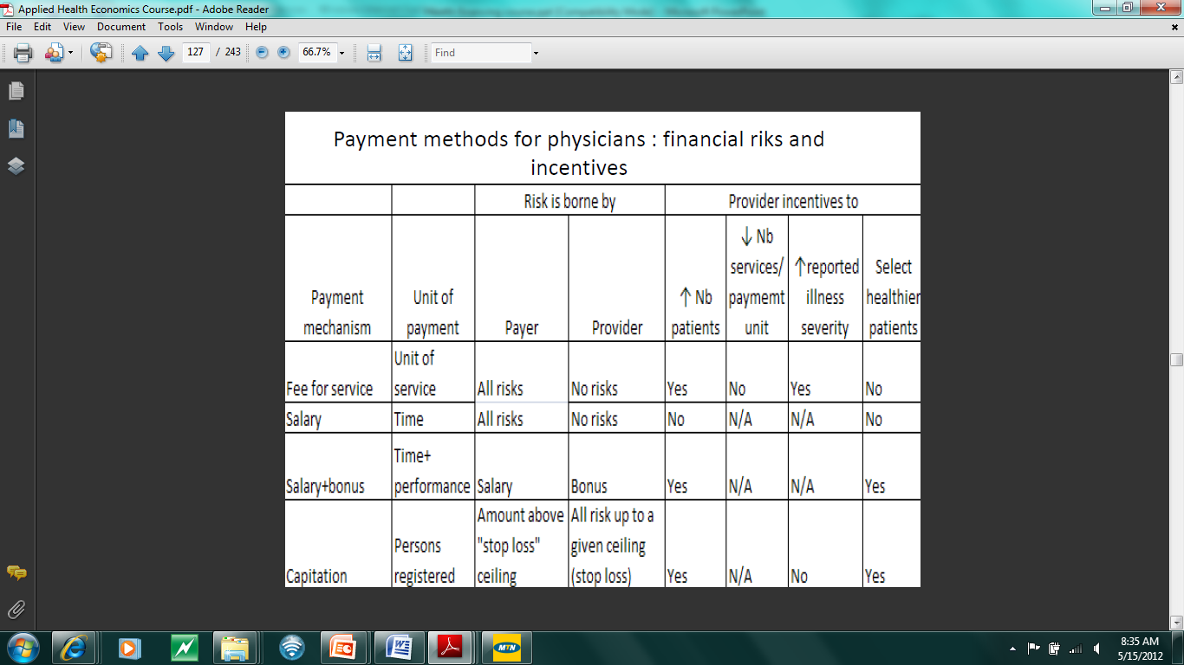
Purchasing: provider payment methods: physicians or other health professionals
Notes:
As with all payment mechanisms, close monitoring and regulation is critical to counteract and limit the negative incentives
Common primary health care providers payment methods: salary, fee-for service and capitation.
Stop loss ceiling; the point where the providers is exposed to incurring catastrophic spending. If insured for this then the risk is shifted to the insurance who will have to cover for it.

Slide 39
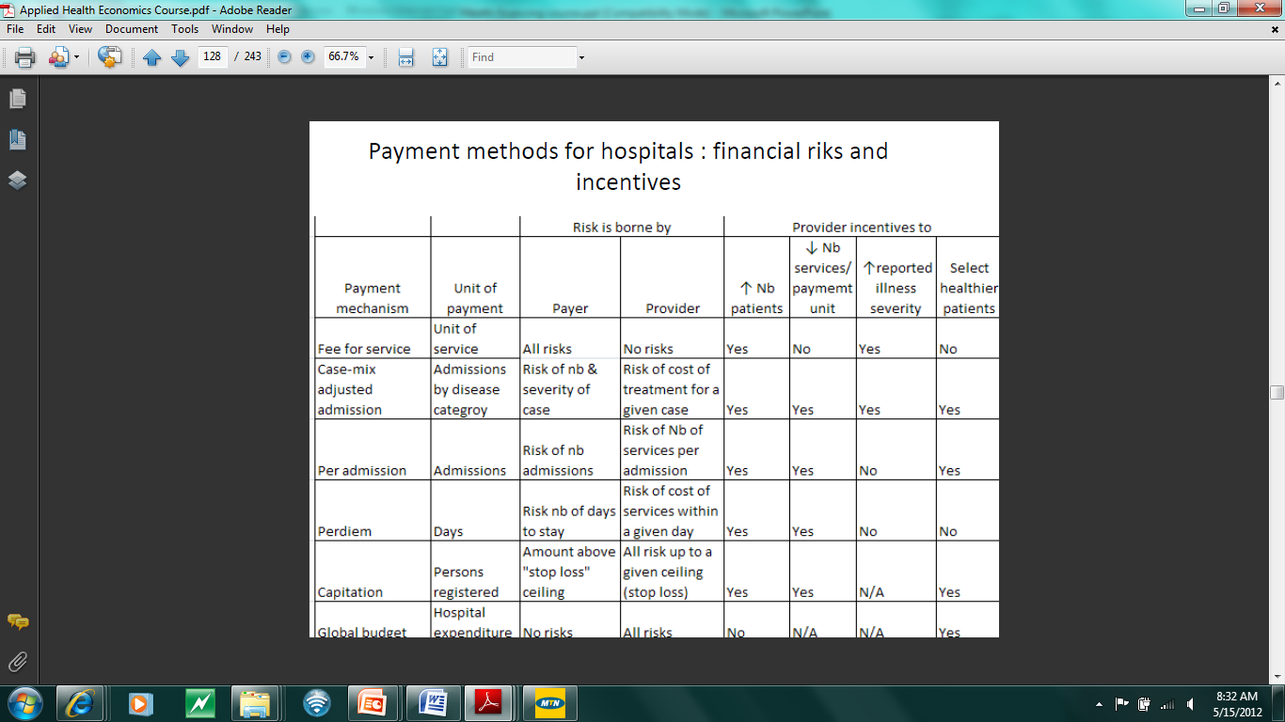
Purchasing: provider payment methods: hospitals
Notes:
As with all payment mechanisms, close monitoring and regulation is critical to counteract and limit the negative incentives

Slide 40
Purchasing: provider payment methods: patients
Deductibles: payment made by the patient before the insurance policy begins to cover the incurred expenses.
Copayment: fixed payment made by the patient for each physician visit or each hospital day
Coinsurance: Patients pay a certain percentage of theirs costs

Slide 41
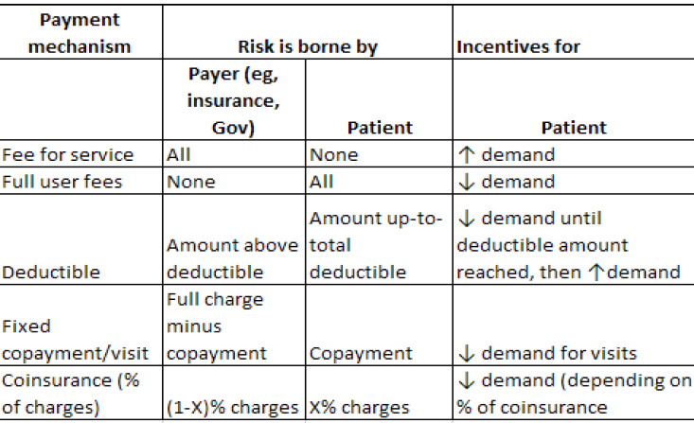
Purchasing: provider payment methods and patients

Slide 42
Strategic purchasing in practice
Emphasizes primary health care (PH) services:
  Ex:
  Pays relatively high amounts for PH services in order to reflect their priority
  Protects funding for PH services
Purchasing Primary health care services more strategically
  Mixed payment approach: by combining capitation payment with an additional Performance based payment linking payment based on the delivery of specific services, or targets met, that are expected to improve health.
  Paying relatively high rates for services that address the needs
  Gatekeeping
Notes:
Based on a recent study, an effective strategic purchaser...

Slide 43
Strategic purchasing in practice
Uses incentives to limit the provision of services which are expensive to provide:
Examples:
  Introduces co-payments for patients who by-pass primary care, by self-referring to hospitals or specialists
  Pays relatively low prices for high-cost but low-priority services
  Links some part of payment to performance
Negotiates over the price of medicines

Slide 44
Institutional arrangements
The main policy issues include:
  whether or not to introduce a purchaser which is independent of providers, a situation often known as a 'purchaser-provider split'
  whether there is only one purchaser of services or multiple purchasers
  the extent to which purchasers and providers are autonomous; for example, the flexibility they have to manage their own budgets and make decisions on staffing.
Notes:
Institutional arrangements are also important for strategic purchasing.
Strategic tools at their disposal:
Agreement contract made with the provider which defines the conditions which need to be met for payment
The indicators and measures used to measure performance
Specific payment mechanism used to actually pay providers, and what conditions

Slide 45
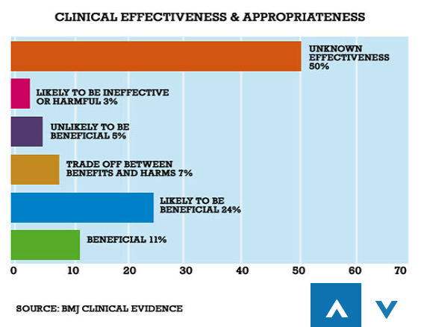
Challenges facing purchasers
Notes:
Health systems in different parts of the world and the problems they face in terms of determining the cost-effectiveness.
Most health systems around the world pay for some services and medicines which are clinically ineffective. As this chart shows, a review by the British Medical Journal of 3,000 treatments subjected to randomised-control trials, found that half of the different interventions were of unknown clinical effectiveness.

Slide 46
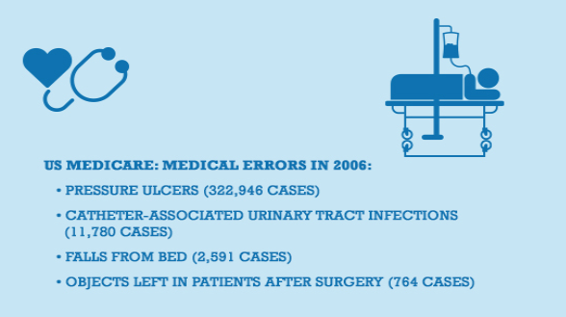
Challenges facing purchasers
Notes:
Many health systems also pay for interventions which actually do harm. The evidence for this lies in the growing information on medical errors, and in response the increasing focus on patient safety.
In the USA since 2009, for instance, Medicare has stopped paying for medical complications which were clearly due to poor clinical practice, such as pressure ulcers and infections associated with catheter usage. This is an example of using purchasing in a strategic way to try and improve both the quality and efficiency of health services.

Slide 47
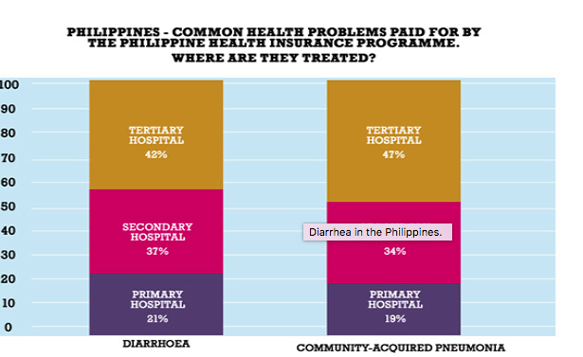
Challenges facing purchasers
Notes:
Many health systems pay too much for certain services; for example, patients being treated in expensive hospital facilities for health problems which should be treated at a primary health care facility.
The claims database of the Philippine Health Insurance Corporation shows that almost half of patients with diarrhoea were being treated as inpatients in tertiary hospitals. Such health problems can and should be managed at lower levels of the health system. A strategic purchaser may respond by paying very low amounts to hospitals for treating such conditions, or not paying at all. However, such decisions need to be taken carefully and should look closely at the health situation of each individual patient, and also at the current capacity at the primary level to deal adequately with such problems.

Slide 48
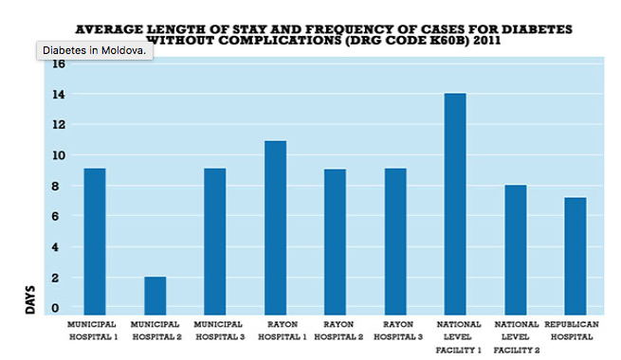
Challenges facing purchasers
Notes:
In Moldova, data shows large variations in the length of time that patients with uncomplicated diabetes, which in principle can be managed on an outpatient basis, were kept in hospital.
Again, this suggests that there are considerable inefficiencies in the health system, although considerable information is required for purchasers to judge whether such variations were justifiable or not, and then to use this information to inform strategic purchasing decisions.

Slide 49
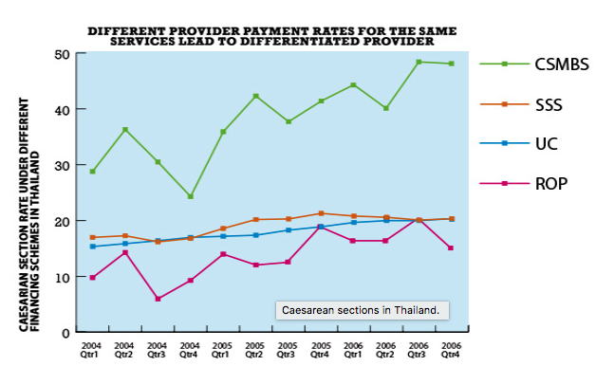
Challenges facing purchasers
Notes:
In Thailand, widely varying rates of caesarean sections across the three health insurance/coverage schemes cannot be explained through differences in need.
On investigation, it was found that the different coverage schemes use different payment mechanisms with different incentives for providers. For example, the Civil Servants Medical Benefits Scheme pays hospitals on a 'fee-for-service' basis which largely explains the higher rates compared with other schemes, given the clear incentive to increase volume.

Slide 50
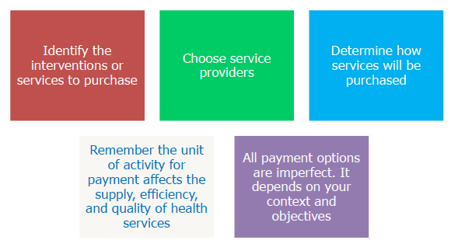
In summary-strategic purchasing

