Slide 1
Pooling resources

Slide 2
Fund pooling as a health finance function
Described as the accumulation of prepaid health care revenues on behalf of a population” (Kutzin, 2001).
By pooling funds we enable the pooling of risk, meaning that everyone on whose behalf the funds are pooled (i.e. the "covered population") has a degree of protection against the costs of using health services should they need them, irrespective of their individual health risk.
Core policy objectives of pooling:
  equity in service use relative to the need for care,
  equity in the distribution of health resources
  financial protection

Slide 3
Fund pooling as a health finance function
Core policy objectives of pooling:
  equity in service use relative to the need for care,
  equity in the distribution of health resources
  financial protection
For raised revenue to achieve the intended purpose :
  Collect the money in advance-prepayment contribution
  Contribution should be based on ability to pay
  Access should be based on the need
  A mix of contributors is needed

Slide 4
Fund pooling as a health finance function
Pooling agencies are responsible for “insuring” some or all of the population
So…each of those pooling agencies manages an “insurance function”, even if not all use the label “insurance”…

Slide 5
Examples of pooling agencies
National Ministry of Health
Decentralized MOH or local government health agency (e.g. district, provincial)
Autonomous public agency
Social Health Insurance fund(s)
Private health insurance funds
- For profit and not-for-profit
Member-owned “mutual” insurance, including community schemes, NGOs, etc.

Slide 6
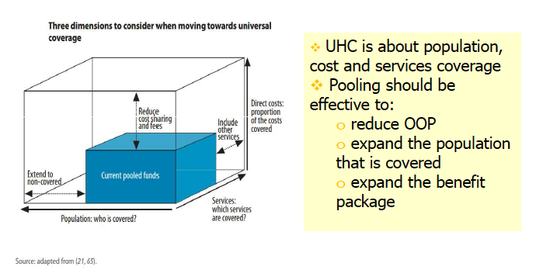
Pooling and UHC objectives

Slide 7
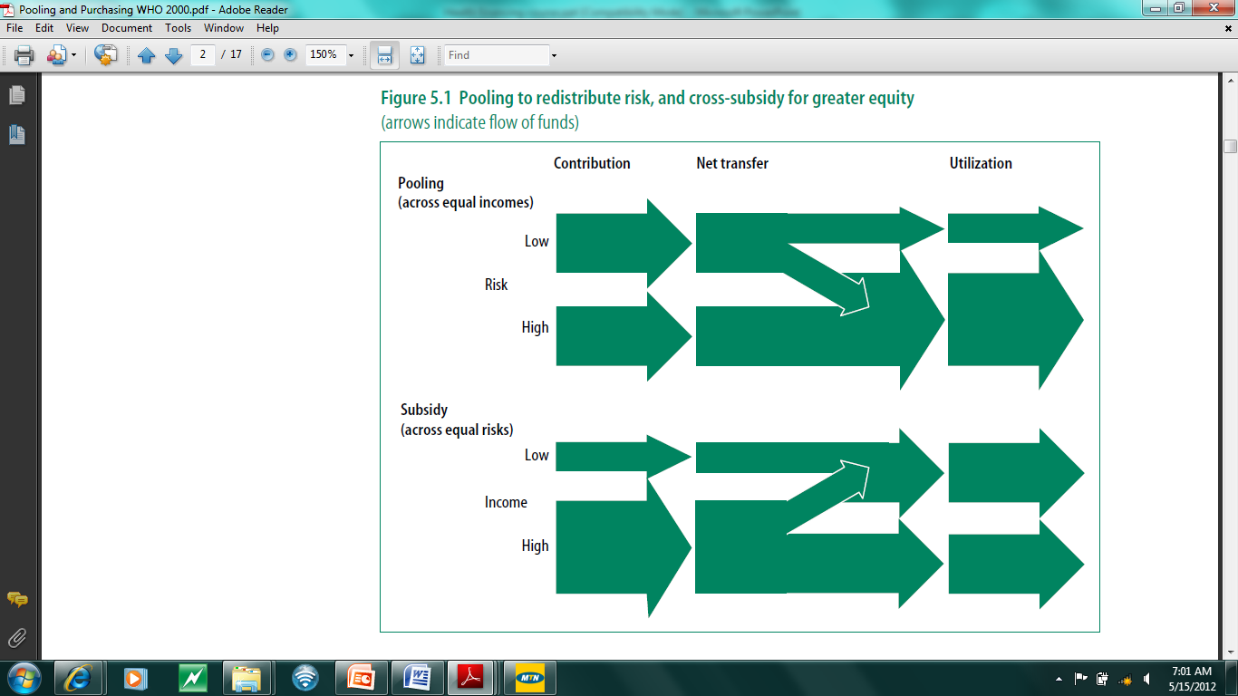
Cross-subsidies in pools

Slide 8
Visualizing risk pools
No pooling
Integrated risk pools
Unitary pool
Pool 1
Pool 2
Fragmented pools
Pool 3
Pool 4
Key
low risk
medium risk
high risk

Slide 9
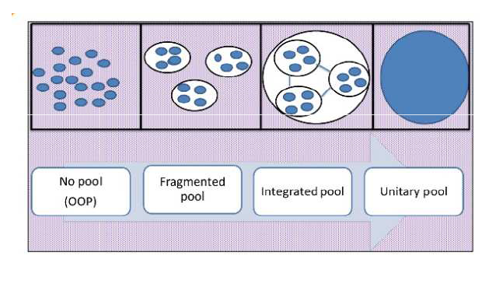
Visualizing risk pools
A system is fragmented when there are barriers to the redistribution of prepaid funds
Fragmentation limits the ability to cross-subsidize
The greatest concern with having a range of financing mechanisms is fragmentation of risk among a large number of small risk pools. The smaller the risk pool, the less sustainable the financing mechanism.
Is there a central redistributive mechanism?
Notes:
Fragmentation of the pool damages performance of revenue collection, pooling and purchasing. It is not the number of existing pools and purchasers that matters, but many of them are too small.
The administrative capacity and financial reserves required to ensure financial viability of small pools + low wages of their beneficiaries, guarantee limited benefit packages
OOP represent the highest degree of fragmentation.
Multiple pool can exist without fragmentation if their size and financing mechanism allow for adequate spreading of risk and subsidization of the poor.

Slide 10
Types of risk pools
Type | Features | Impact and efficiency
No risk pool | Individual bears all expenses out of pocket | Highly catastrophic especially for the poor
Fragmented risk pools | Series of independent risk pools exist | Inefficient in redistributing prepaid funds
Integrated risk pools | Fragmented risk pools are compensated for variations in risks to which they are exposed. | Limits ability to cross-subsidize
Unitary risk pool | Under which all expenditure liability is transferred to a single national pool | Better cross-subsidization; promotes efficiency but difficult to make them operational

Slide 11
Features of an effective risk pool
small
large
😁
☺️
size of pool
☺️
similar
diverse
😁
diversity of pool
☺️
voluntary
compulsory
😁
cross-subsidies
participation
☺️
subsidies + cross subsidies
😁
subsidization
☺️
weak
strong
😁
institutional frameworks
Notes:
Increase number and share of the people covered under pooling arrangements
Decrease incidence of catastrophic payments for the poor
Increase access to good quality preventive and simple curative care

Slide 12
Features of an effective pool
Size: Bigger is better
  The larger the pool, the greater the capacity for redistribution
    increase resource availability for health services,
    take advantage of economies of scale in administration
    reduce the level of contributions required to protect against uncertain needs
Diversity: Diverse is better
    Aim is to redistribute for the healthy to the sick
    So try to avoid having separate pools for separate population groups
Notes:
Fragmentation of the pool damages performance of revenue collection, pooling and purchasing. It is not the number of existing pools and purchasers that matters, but many of them are too small.
The administrative capacity and financial reserves required to ensure financial viability of small pools + low wages of their beneficiaries, guarantee limited benefit packages
OOP represent the highest degree of fragmentation.
Multiple pool can exist without fragmentation if their size and financing mechanism allow for adequate spreading of risk and subsidization of the poor.
Economies of scale is an economics term that describes a competitive advantage that large entities have over smaller entities. It means that the larger the business, non-profit or government, the lower its costs. For example, the cost of producing one unit is less when many units are produced at once.

Slide 13
How does fragmentation look alike?
Decentralized local government health agencies with overlapping population coverage
Territorially distinct but small insurance funds
Multiple insurance funds (competing or noncompeting) in overlapping geographic areas
Overlapping but uncoordinated population or service mandates between different funding agencies, e.g. MOH, local governments and national SHI fund
Vertical program flows

Slide 14
Pooling agency
Very often, the organization responsible for the collection of contributions is also responsible for the pooling of these resources.
Examples of pooling agencies:
  National Ministry of Health
  Decentralized MOH or local government health agency (e.g. district, provincial)
  Autonomous public agency
  Social Health Insurance fund(s)
  Private health insurance funds
  For profit and not-for-profit
  Member-owned “mutual” insurance, including community schemes, NGOs, etc.

Slide 15
Different approaches to diversity
In most rich countries with universal mandatory contributory insurance, the poor are fully subsidized and integrated into the same pool as anyone else in the population
Many LMICs have different pools for different population groups, e.g.
  SHI scheme(s) for the formal sector
  MOH facilities for the rest
  Sometimes a separate scheme for the poor

Slide 16
Unequal entitlements across schemes
Common feature of many countries that have introduced social health insurance for the formal workforce, with public spending on such persons being much greater, per capita, than for the rest of the population
  Examples Mexico, Thailand, and other countries that introduced SHI in context of small formal sector
  Kenya, Gabon

Slide 17
Fragmentation in South Africa: inequity in distribution of total health spending
Source: "Who benefits from health care in South Africa?" Health Economics Unit, University of Cape Town. 2010.

Slide 18
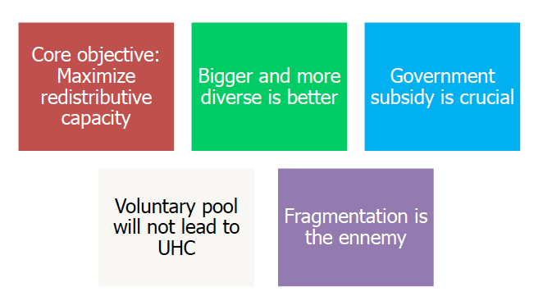
In summary-Pooling

Slide 19
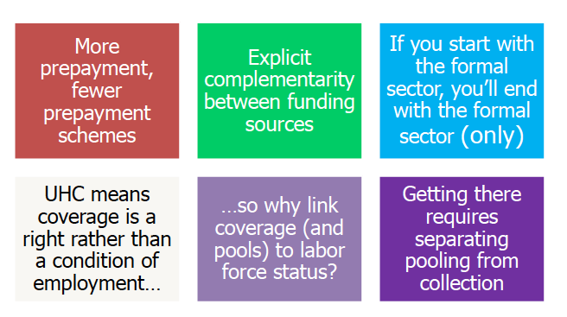
In summary-Pooling

