Slide 1
Revenue collection

Slide 2
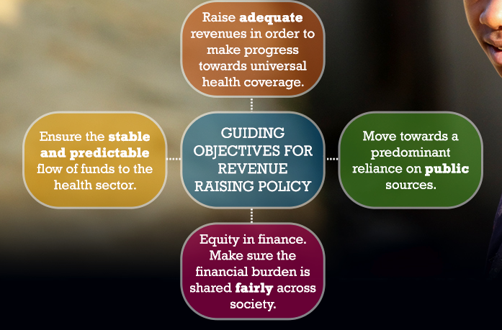
Objectives of revenue raising policy?
Notes:
There are four specific objectives to consider when raising revenues in support of UHC

Slide 3
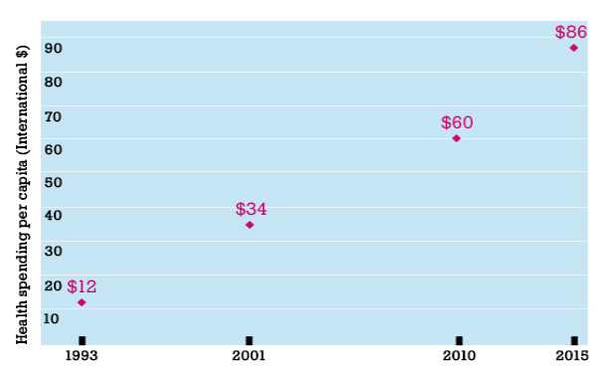
How much spending is “adequate”?
Notes:
There have been a number of attempts to estimate how much countries should spend on health to ensure access to essential services for the entire population.
In 1993, the World Development Report came up with a figure of $12 per capita in low-income countries and $22 per capita in middle-income countries. These figures are based on the estimated cost of delivering a package of essential clinical and public health services.
In 2001 the WHO Commission on Macroeconomics and Health estimated that delivering essential health interventions in low income countries would cost, on average, $34 per capita. The focus was on addressing communicable diseases, with both recipient and donor governments requested to significantly scale-up funding.
In 2010, the World Health Report estimated that low-income countries would need to spend, on average, around $60 per capita by 2015 to deliver priority interventions. Priority interventions included those communicable diseases targeted as part of the Millennium Development Goals, and also the growing burden of non-communicable diseases. Significant emphasis was also given to health system strengthening
Further analysis in 2015 updated these estimates to $86 per capita, stressing more clearly than previous estimates that this is the amount which governments need to spend. The analysis also noted that countries would find it difficult to get close to universal health coverage, if public spending on health is less than 4-5% of GDP.

Slide 4
Why public sources?
When countries rely predominantly on public sources of revenue, they make greater progress towards universal health coverage.
  This is because public revenues enable risk-sharing between the better-off and the worse-off, and between the healthy and the sick in society.
  This in turn enables health systems to improve access to health services, with financial protection, for all citizens.
Notes:
Risk-sharing, in particular through public revenue sources and related institutional mechanisms, is critical in the health sector given that services can be extremely expensive, especially for life-saving care and for those patients in need of long-term medication

Slide 5
Why public sources?
When health systems rely heavily on private revenue sources, and patients have to pay for health care themselves, many will not be able to access the services they need.
A person's ability to afford health care services becomes the main driver of whether or not they can access those services, making it unaffordable for many, and not only the poor.
For this reason public revenues are central to the UHC agenda.

Slide 6
Fairness in revenue raising (collection)
Countries need to consider whether the way in which revenues for health services are raised is fair or progressive.
This is often referred to as equity in finance, or equity in financial contributions, and is one of the main goals of universal health coverage.

Slide 7
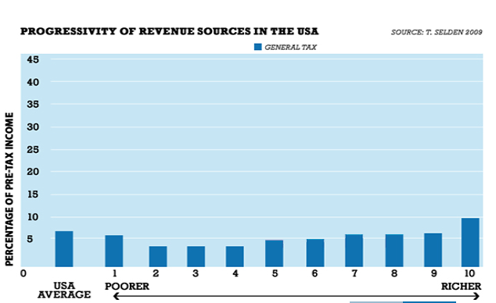
Fairness in revenue raising (collection)
Notes:
To know whether the way a country raises money for health is fair, or progressive, we need to look at each of the different sources of revenue for the health sector in turn. The graph divides the population of the USA into 10 income groups, from the poorest 10% (decile 1) to the wealthiest 10% (decile 10). For each group, the bar shows the financial burden of making income tax contributions.
We can see that revenues for health raised through general taxation in the USA are progressive or fair, with the wealthier groups in society generally contributing a higher proportion of their income, although the higher percentage paid by the poorest decile shows an element of regressivity. This is a public, or compulsory, revenue source for the health sector.

Slide 8
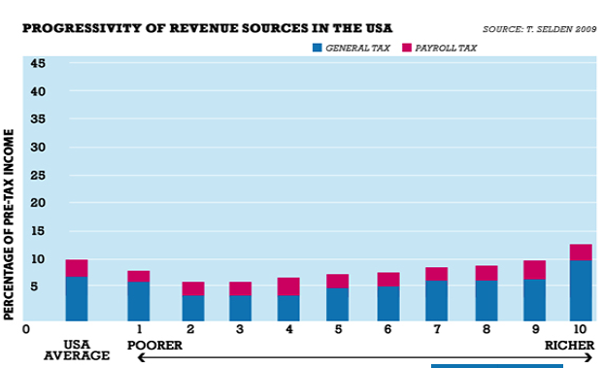
Fairness in revenue raising (collection)
Notes:
Payroll taxes are also a public or compulsory source of revenues. In the USA their effect is proportional, with all income groups contributing the same percentage of their pre-tax income. When combined with general tax revenues, the overall effect of contributions remains progressive, fair, or equitable, apart from for the poorest 1-% of the population.

Slide 9
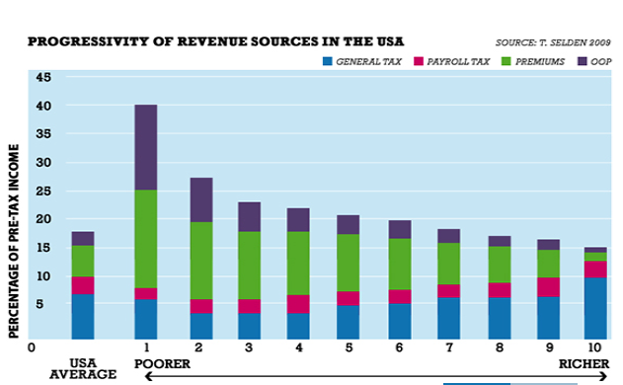
Fairness in revenue raising (collection)
Notes:
Finally, revenues raised through out-of-pocket payments, another private revenue source, are also regressive or unfair in the USA. This places a significantly larger financial burden on the poorest members of the population compared with richer households.
Overall the picture in the USA is clear, that despite having some revenue sources which are mostly fair or progressive, the effect is out-weighed by the high volume of regressive payments, making the overall picture highly unfair. It will be interesting to repeat this analysis in light of the Affordable Care Act signed into law in 2010, which aims amongst other things to make health insurance premiums more progressive.

Slide 10
Why is stable and predictable funding important?
If the move towards UHC is to happen, adequate public funds need to be made available, together with a stable and predictable flow of those funds to health facilities.
Both are required to ensure the effective delivery of health services to those who need them.
Notes:
Reliable cash flow is important for good service delivery performance. When cash flow is not stable staff may not be paid on time, there may be shortages of essential medicines and other critical supplies, and as a result those without the funds to seek care privately will not be able to access the services they need.

Slide 11
How does a country raise funds for health?
General Revenue
Social Health Insurance
Voluntary Health insurance
Community based Health Insurance
Out-of-pocket payments
External assistance: grants, donations, external loans

Slide 12
Unpacking revenue sources
Initial funding sources
Contribution mechanisms
Collecting agencies
Individuals/ families/ employees
Central Government
1. General tax
(direct & indirect taxes)
2. Payroll taxes
3. Other compulsory contributions (MSA)
4. Voluntary prepaid contributions
(premium)
5. Direct payment to providers at time of use (out-of-pocket)
6. Grants
7. Loans
Local Government
Employers/ corporate entities
Social Security Agency
Foreign and multinational companies
Commercial insurance fund
Other insurance fund
Foreign governments and multilateral agencies
Employers
Earmarked savings fund
Foreign and domestic NGOs and charities
Health care provider
Notes:
Typically we combine a number of things when we say “sources”.
Gov’t isn’t really a source. People pay taxes.
We mean some combination of source, contribution mechanism, and collection agency. Need to think about these three dimensions as part of revenue raising policy
Initial sources relevant for “diversity” of funding base
Contribution mechanisms relevant for a host of policy objectives e.g. equity / fairness in funding, access to services
Direct taxes are based on the earnings of households and companies, and are paid directly to the government or another public agency.
Indirect taxes are based on what a household or company spends, not on what they earn, and are paid to government indirectly via a third-party such as a retailer or supplier.

Slide 13
Revenue collection options: General revenue
Collected through many kinds of taxes and therefore the health system has to compete with other sectors. Each type of taxes places burdens on different groups of citizens and the mix of taxes depends on the country’s socio-economic situation.
Direct taxes
  Income taxes
  Corporate profit taxes
  Property taxes
  Wealth taxes
Indirect taxes
  Sales taxes
  Value added taxes
  Excise taxes (Tobacco and alcohol)
Revenues from state-owned industries such as oil, gas… Referred as
non-tax revenues
Notes:
In general revenue financing, many kinds of taxes are used to support the full range of government activities. The health system, therefore, has to compete for funds with other government-funded programs and obtains its resources via the regular government budget process.
A wide variety of taxes is available to governments, including income taxes, corporate profit taxes, value-added taxes, excise taxes, import duties, and severance taxes on minerals. Each places burdens on different groups of citizens
The mix of taxes used by a particular country generally depends on its level of economic development!!!!

Slide 14
Revenue collection options: Social Health insurance
Law compels employers to deduct a % of each employees monthly wage for health to be paid to a “social insurance fund”
Law compels employee to pay a % of his/her monthly wage, (deducted by the employer) to “social insurance fund”
Social insurance funds can be managed publicly or privately; they can be monopolies or competitive
The employer/employee deductions are earmarked for health, and cannot be used for any other purpose
Applicable largely to formal sector employers and employees
Notes:
Compulsory, employment group-targeted

Slide 15
Revenue collection options: Community financing
Developed on the absence of alternative financial protection mechanisms (ILO, 2002).
Community-based funds where members prepay a set amount each year for specified services. Government subsidizes the poor.
Organize and operate primary care clinic at village level to gain efficiency and quality
Contract and pay secondary services
Affiliation is based on community membership, and the community is strongly involved in managing the system, not the government, accountable back to members
Governmental role--initiate, train, support monitor and regulate CF schemes.
Notes:
Compulsory, employment group-targeted

Slide 16
Revenue collection options: Others
Private or voluntary health insurance: from independent, competitive sellers, either for-profit or not, who charge premiums that reflect the buyer’s risks than ability to pay.
Out-of-pocket payments: payments made by individual patients directly at the point of service.
External assistance: grants, donations, loans

Slide 17
Assessing financing mechanisms
Feasibility: social acceptability, adequate administrative capacity (e.g. actuarial expertise, information systems, etc.)
Sustainability: relates to the ability of a financing mechanism both to maintain its level of funding in the long term and to expand its level of funding over time as the need for health care grows (McPake and Kutzin, 1997).
Notes:
Health care financing mechanisms are frequently judged on the basis of the extent to which they are feasible, equitable, efficient and sustainable.
Feasibility, often overlooked in assessing financing mechanisms, raises critical questions: Are stakeholders likely to support or to oppose a given financing mechanism? Is there adequate administrative capacity (e.g. actuarial expertise, information systems, etc.) to ensure its successful implementation?
An efficient financing mechanism is one that generates a relatively large amount of funding and thus obviates the need for multiple funding mechanisms, with each
generating only a limited amount of funds. In addition, the costs of fund collection
and administration will be low with an efficient financing mechanism, leaving as much revenue as possible for actual health service provision.

Slide 18
Assessing financing mechanisms
Equity: individuals should contribute to health care according to their ability-to-pay.
Efficiency: an efficient financing mechanism is one that generates a relatively large amount of funding (no need of multiple funding mechanisms) with low fund collection and administration costs.
Notes:
Although a proportional, or even mildly regressive, health care financing system would help to reduce inequalities in such countries, this review favours progressive funding mechanisms as a means of achieving an equitable financing system, i.e. a system whereby individuals contribute according to their ability to pay.
Individuals should contribute to health care funding according to their ability to pay and should benefit from health services according to their need for care.
Allocative efficiency refers to the allocation of resources among different levels of
care, e.g. tertiary (hospital) care vs. primary health care, and among services dealing with different areas of care, e.g. tuberculosis, immunization, hypertension, and so on. “Doing the right thing” through allocative efficiency means allocating resources to those services dealing with the heaviest burden of ill-health in the community for which effective interventions exist and, within those services, giving priority to the most cost-effective interventions, i.e. interventions offering the lowest cost per unit of health outcome (quality-adjusted life year, for example).
“Doing it the right way” through technical efficiency means providing resources to the maximum number of fundable services and minimizing the cost of each service without compromising quality of care (Donaldson and Gerard, 1993).
The sustainability of a financing mechanism refers mainly to its long-term stability and potential for generating revenue.

